Slide 1
Energy Research Conference 2014
Fuel panics insights from spatial agent-based simulation
Eben Upton and William J Nuttall
3 April 2014 william.nuttall ‘at’ open.ac.uk
© All rights reserved

Slide 2
Reference:
IEEE Transactions - Intelligent Transport Systems
In press 2014 – available online 20 February 2014 10.1109/TITS.2014.2302358

Slide 3
Structure of My Remarks:
Context for the research
Research Methodology
Model Behaviour
Policy Relevant Lessons
Closing Remarks

Slide 4
2000 Fuel Protest
N. Robinson (Political Quart. 2002)provides a chronology of the 2000 protests, which may be summarized as follows:
7 September: 150 protesters blockade Stanlow refinery in Cheshire for several hours, before being moved on by police.
Only one of 60 scheduled Shell tankers departs.

Slide 5
2000 Fuel Protest
N. Robinson (Political Quart. 2002)provides a chronology of the 2000 protests, which may be summarized as follows:
8-9 September: Protests spread to other depots. Some filling stations closed due to lack of fuel in Northern England. Isolated reports of panic-buying of fuel.

Slide 6
2000 Fuel Protest
N. Robinson (Political Quart. 2002)provides a chronology of the 2000 protests, which may be summarized as follows:
11 September: Most refineries and depots effectively closed. Government secures emergency powers to protect fuel supplies for essential services.

Slide 7
2000 Fuel Protest
N. Robinson (Political Quart. 2002)provides a chronology of the 2000 protests, which may be summarized as follows:
12 September: 25% of filling stations closed. Widespread panic-buying of fuel. Government announces deliveries will return to normal within 24 hours.

Slide 8
2000 Fuel Protest
N. Robinson (Political Quart. 2002)provides a chronology of the 2000 protests, which may be summarized as follows:
13 September: 90% of filling stations closed. Deliveries at less than 4% of normal levels. The National Health Service begins to cancel non-essential operations. Royal Mail deliveries cease and schools close in many areas. Panic-buying spreads to groceries; Tesco and Sainsbury's introduce rationing.

Slide 9
2000 Fuel Protest
N. Robinson (Political Quart. 2002)provides a chronology of the 2000 protests, which may be summarized as follows:
14 September: Government begins to deploy military tankers, and provides police escorts for commercial tankers. Protest leaders call off blockades in face of changing public opinion.

Slide 10
2000 Fuel Protest
N. Robinson (Political Quart. 2002)provides a chronology of the 2000 protests, which may be summarized as follows:
16 September:
Fuel deliveries at 135% of normal levels.
Filling stations begin to reopen.
All in all a very stressful week for government

Slide 11
Change in UK Average Motorway Traffic
September 2000
Source: DfT

Slide 12
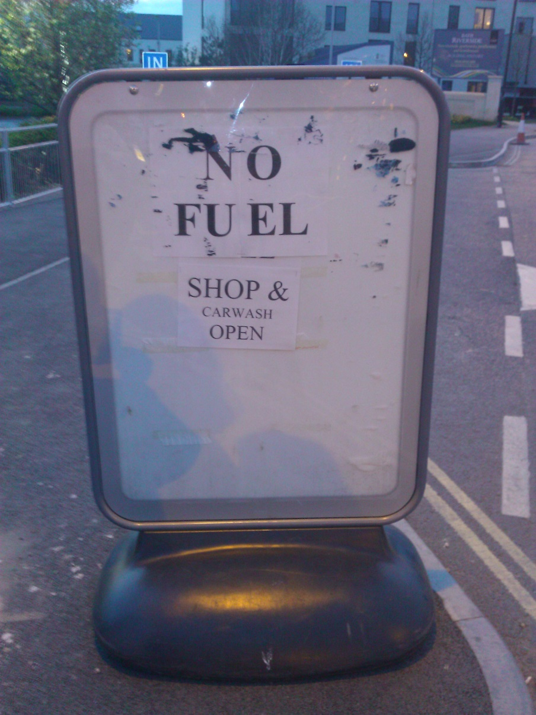
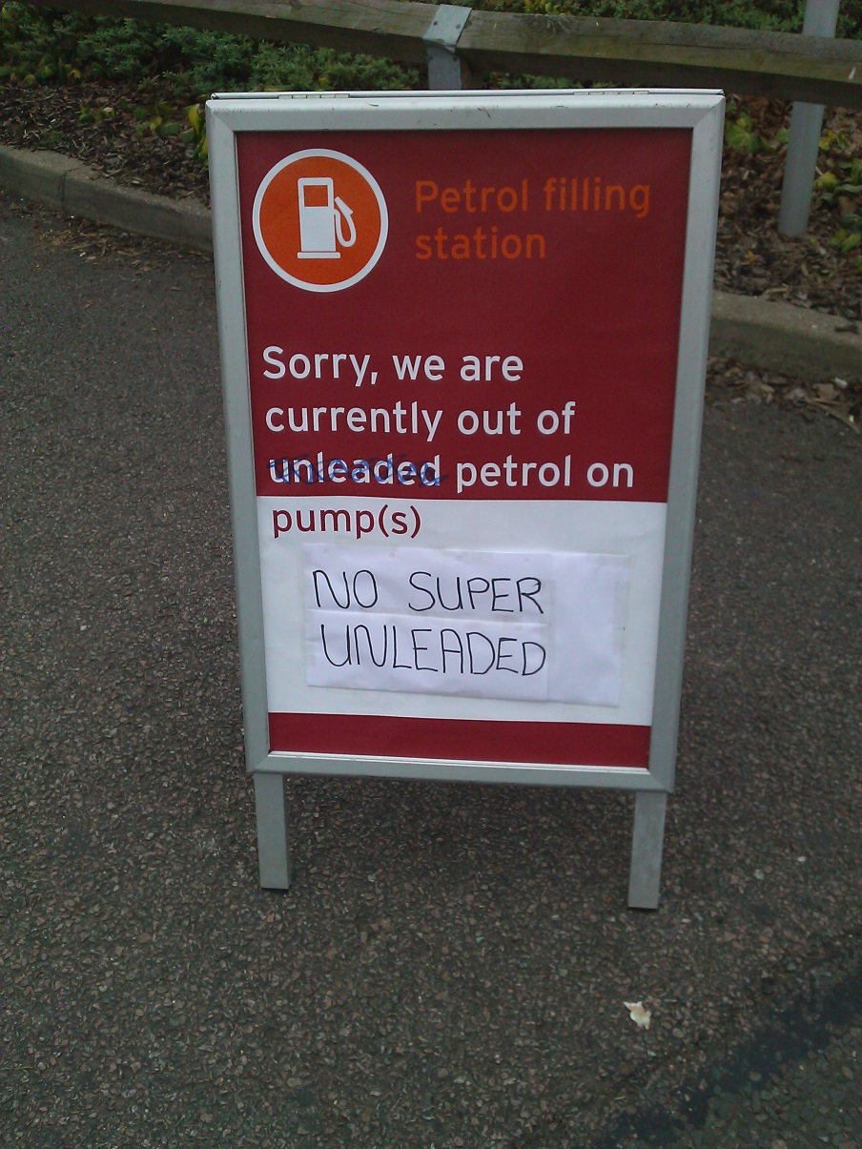
History repeats March 2012
But this time no actual initiating shortage
Photos: WJN
March 2012

Slide 13
We estimate that in 2010:
Filling station fuel capacity 620M litres
34.3M vehicles - average capacity 55 litres
Vehicle fuel tanks total capacity 1.9B litres
Vehicle capacity 3x that of filling stations
Filling station throughput 83M litres
Mean time between full refuelling 23 days
[See paper for data sources]

Slide 14
The Model – a circular world
coded in Python by Eben Upton
There is an odd number of cells so each cell has a unique closest filling station
Every agent has a home cell defining its neighbours
We assign each agent two randomly positioned destinations d₀ and d₁ within a distance of home

Slide 15
An agent drives in the model
(no panic – no rationing)
The model has no opportunistic or ad-hoc refuelling.
Start at d₀ and move towards d₁ once there turn around and return to d₀
If not enough fuel to go from destination to next fuelling station then it will now refuel at nearest station, see figure.
If no fuel at filling station (not shown in figure) then agent will proceed to an adjacent station unless it does not have enough fuel to get there in which case it will stay where it is and wait for a fuel delivery

Slide 16
And communicates with other agents
An agent may communicate his or her state of panic in a social network
A panicked agent will “top-off” his/her tank at the first opportunity switching away from a pattern of large infrequent purchases.
The graphic shows a rewiring of the social network to allow 7 of 36 connections to be not with neighbours but randomly in the model world.

Slide 17
Agent Based Simulation
The origins of panic
Drawing on Icek Ajzen’s 1991 Theory of Planned Behaviour but omitting “perceived behavioural control” we construct each agent’s “intention” from a range of inputs including his/her own observations, communication with a social network and his/her own psychological predisposition.

Slide 18
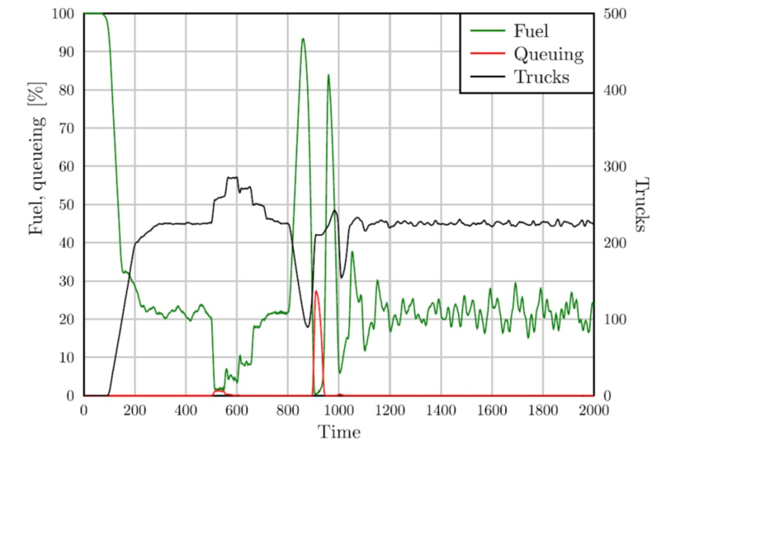
Results: Baseline Scenario
Supply response
Oscillation
Onset of panic

Slide 19
One of two examples
Effect of imposing a maximum fill ration.
Heat Maps:
Top: Without Rationing
Below: With Rationing
Position in circular world
Heat denotes panic
Time

Slide 20
Second of two examples
Unbiased Communication Can Inhibit Panic
Lower heat map has communication between agents where there is an equal chance of propagating good news as bad news.
The upper heat map interestingly shows spatial waves of panic (as distinct from the temporal oscillations mentioned earlier).

Slide 21
We observe
Panic buying can lead to “oscillations”
Adding delivery capacity can promote oscillation
Unbiased Communication Can Inhibit Panic
Evenly slightly biased communication can promote panic
Information censorship works, but …
Rationing can inhibit panic

Slide 22
In conclusion
We suggest that even a relatively simple spatial agent based model can yield policy relevant insights relating to real world problems.
There is a caveat however in that clearly our model is a simplified abstraction and hence any policy-maker looking at our analysis should be alert to divergences between model and real-world behaviours.

Slide 23
Thank you
william.nuttall ‘at’ open.ac.uk
We would like to thank EPRG Cambridge University and IEEE ITS for their anonymous referee inputs.

