Slide 1
The Potential Value of Energy Storage as a Provider of Multiple Balancing Services
Ellen Webborn
4th April 2014
The University of Warwick in partnership with National Grid

Slide 2
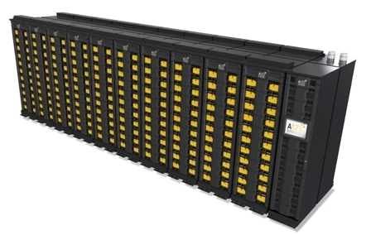
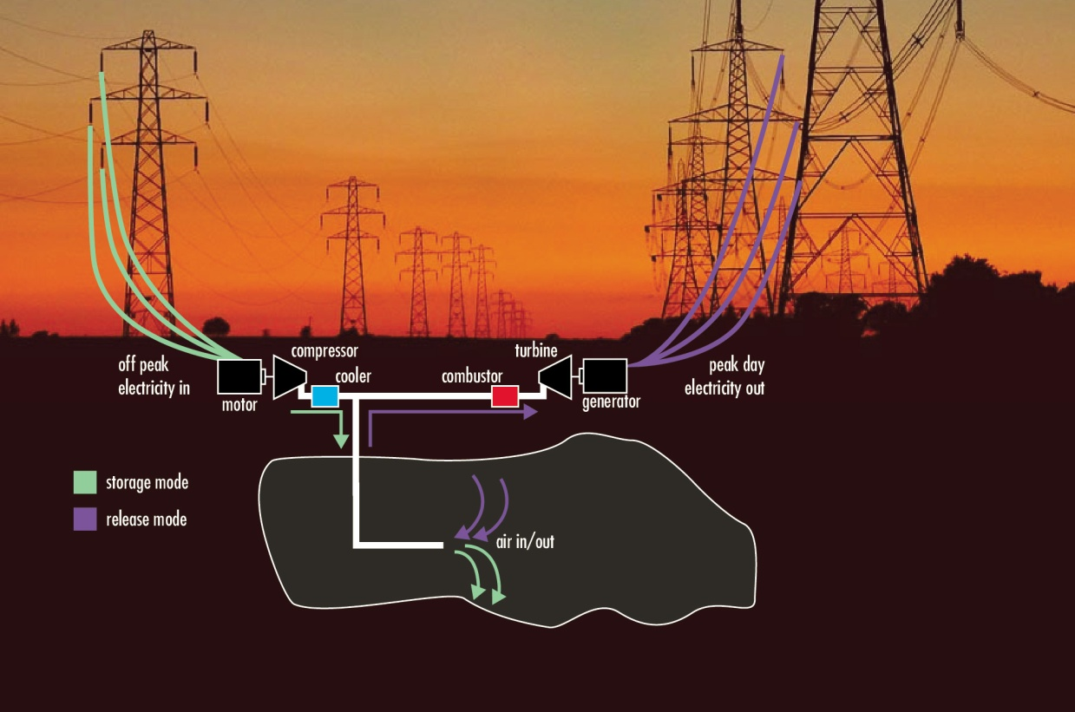

Slide 3
Questions to Address
What services could energy storage provide to the system operator?
Could provision of multiple services be possible? If so, which?
What would be the expected revenue from providing such services/combinations of services?
What issues need to be considered, for instance reliability?

Slide 4
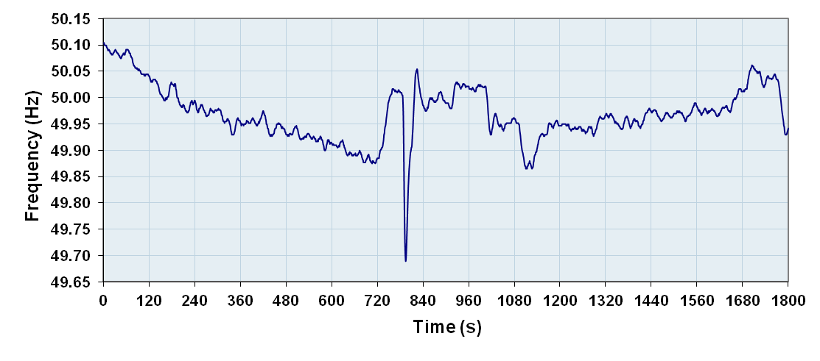
Frequency Response
National Grid is obliged to maintain system frequency at close to 50Hz
Employs generators to increase or decrease power output to control system frequency
Cost to National Grid is approximately £170m per year

Slide 5
Reactive Power Services
Important for voltage management
Generators paid to absorb/generate reactive power to control local voltage levels
Cost to National Grid is approximately £68m per year (expected to increase)

Slide 6
Network Development and Constraint Management
Creation of new power generation or areas of demand can increase congestion on power lines
National Grid invests to reinforce the network to prevent congestion issues
An optimally-located energy store could delay or even eliminate some of these investment costs

Slide 7
System Challenges
Cause
Effect
Impacted Services
Embedded
Generation (Renewable Power)
Lower System Inertia
Frequency Response
Less predictable power supply
Supply further from
consumption
Reactive Power Services
Interconnectors
to continental Europe
Lines less loaded
(particularly at night)
Electrification of
Transport
Greater electricity demand
Infrastructure Reinforcement

Slide 8
Project Outline
Data
Gather data at National Grid relating to balancing service usage in 2013
Feasibility
Assess feasibility of contracting multiple services simultaneously
Value
Estimate the potential value of multiple service provision by energy storage
Simulate
Study how different types of storage act under different scenarios

Slide 9
Simulation (Evolutionary Algorithm)
Data
Frequency Incidents
Reactive Power
Constraint Mgt.
Spot Prices
Store
Model
Capacity
Efficiency
Ramping rates
Running costs
Optimal Operation Strategy (when to charge and discharge)
Expected Revenue/Savings to National Grid
Optimal Combination of Services Contracts

Slide 10
Summary
The potential value of future energy storage technologies is hard to estimate
Multiple services could be provided, but the feasibility and profitability of combining service provision is still unclear
A study based on real data about the current provision of balancing services should help with estimating the potential role energy storage could play in a future energy market
If energy storage could be shown to offer a financially viable alternative to current methods, this could have an impact on policy making and investment in energy storage technology research

Slide 11
Thank You
e.webborn@warwick.ac.uk
www.warwick.ac.uk/ewebborn

