Slide 1
PLEASE READ BEFORE ACCCESSING PRESENTATION
Please note that this presentation gives a snapshot of the current, ongoing research on the Zero Carbon Britain project. Details may change before the publication of the report, therefore please contact me (tobi.kellner@cat.org.uk) before you use or cite the material in this presentation.

Slide 2


Future Energy Networks
Modelling Supply And Demand in a Renewable Energy Future
Tobi Kellner
CAT
Notes:
2

Slide 3

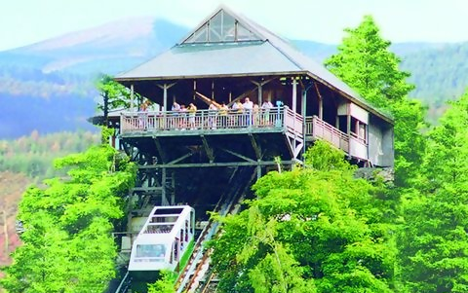
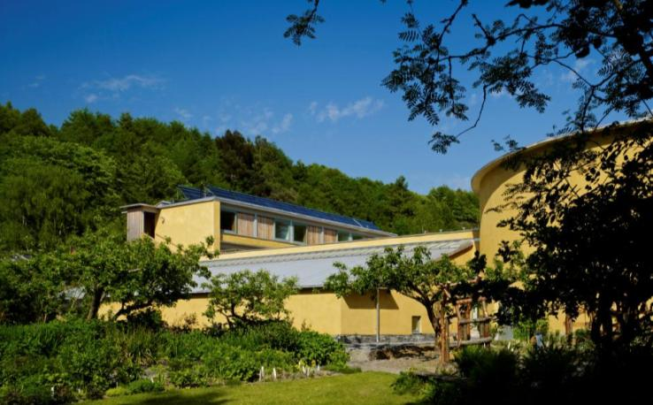
Quick Introduction
I am a renewable energy consultant & researcher at the Centre for Alternative Technology (CAT)
in Machynlleth, Wales
CAT is an education & research centre established 1973
Notes:
3
Next few slides show who was involved in creating the report, not just CAT

Slide 4


About ZCB 2030
Aims:
Show that a future with 100% renewable energy & zero (net) GHG emissions is physically possible
Stimulate debate,
shift goal posts
Notes:
4
Next few slides show who was involved in creating the report, not just CAT

Slide 5
Modelling: Why?
Modelling Future Energy Systems –
Why?

Slide 6
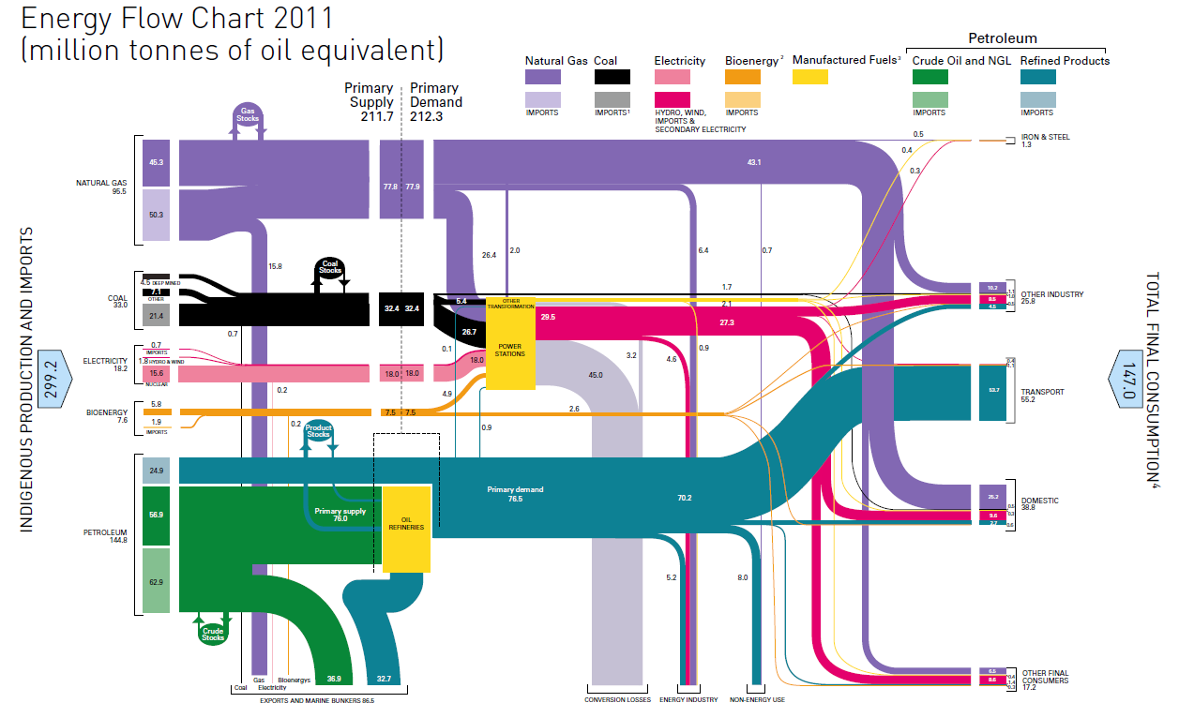

Modelling: Why?
Today’s Energy System
DECC UK Energy Flow Chart 2011

Slide 7
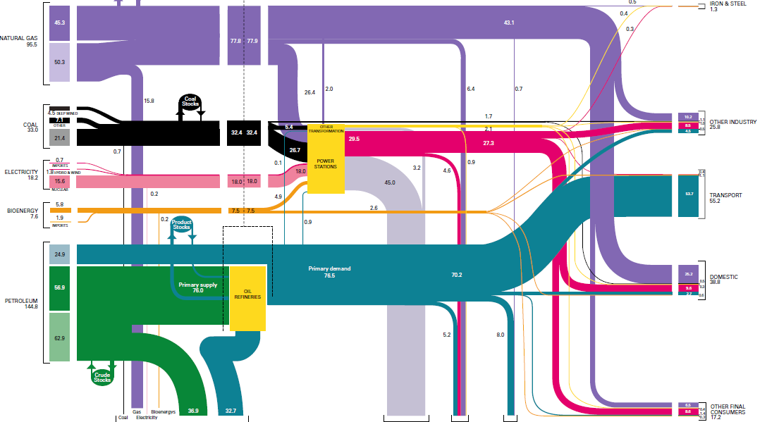
Modelling: Why?
Today’s Energy System
Gas
Industry
Coal
Transport
Domestic
Oil
DECC UK Energy Flow Chart 2011

Slide 8
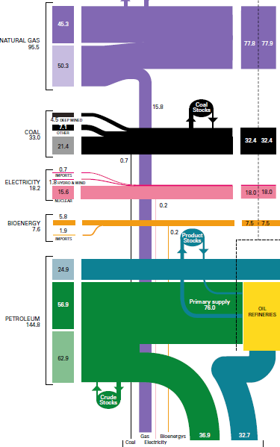
Modelling: Why?
Today’s Energy System
Gas
Today‘s energy system
Is heavily dependent on finite fossil fuels with high GHG emissions
Has grown & evolved over many decades
Coal
Oil

Slide 9
Modelling: Why?
Today’s Energy System
Gas
Tomorrow‘s energy system
Radical changes in supply:
Uncontrollable renewables
(and/or inflexible nuclear)
Radical changes in demand:
Electrification of heating & transport
No time for trial & error evolution!
Coal
Oil

Slide 10
Modelling: How?
Modelling Future Energy Systems –
What?

Slide 11
Modelling: What?
Parameter | Options | ZCB choice
Spatial system boundaries | Single region? UK? Europe? | UK (not “Britain”...)
Interaction with outside | Interconnectors? Imports/exports? | None (island system)
Spatial resolution | Model individual regions & flows between them? | Treat UK grid as a single point, “copper plate UK”
Temporal resolution | Year? Day? Hour? Millisecond? | 1 hour

Slide 12
Modelling: How?
Modelling Future Energy Systems –
How?

Slide 13
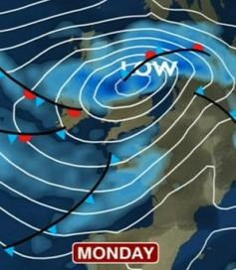
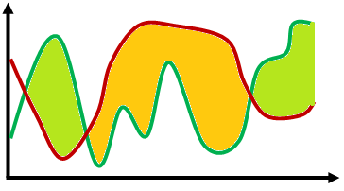
Modelling: How?
ZCB energy model
Hourly supply
wind speeds
Supply
Model
solar radiation
Weather
wave height
...
Storage
Backup
Heat demand
Demand Model
Appliances
hourly demand
Hourly demand
Transport
demand model

Slide 14
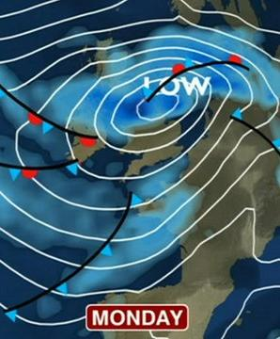
Modelling: How?
ZCB energy model
For the ten years 2002-2011
(87,648 hours), we have
Hourly data on offshore & onshore wind speeds, solar radiation, wave heights
Hourly electricity consumption
from National Grid
Daily weighted temperatures from National Grid

Slide 15
Modelling: How?
ZCB energy model
wind speeds
Use real historic data or synthesise from statistical model?
Potentially complex interactions ➔ synthetic model would be very complex
Is historic data plausible basis for future model?
solar radiation
Weather
wave height
...
Heat demand
Appliances
hourly demand
Transport
demand model

Slide 16
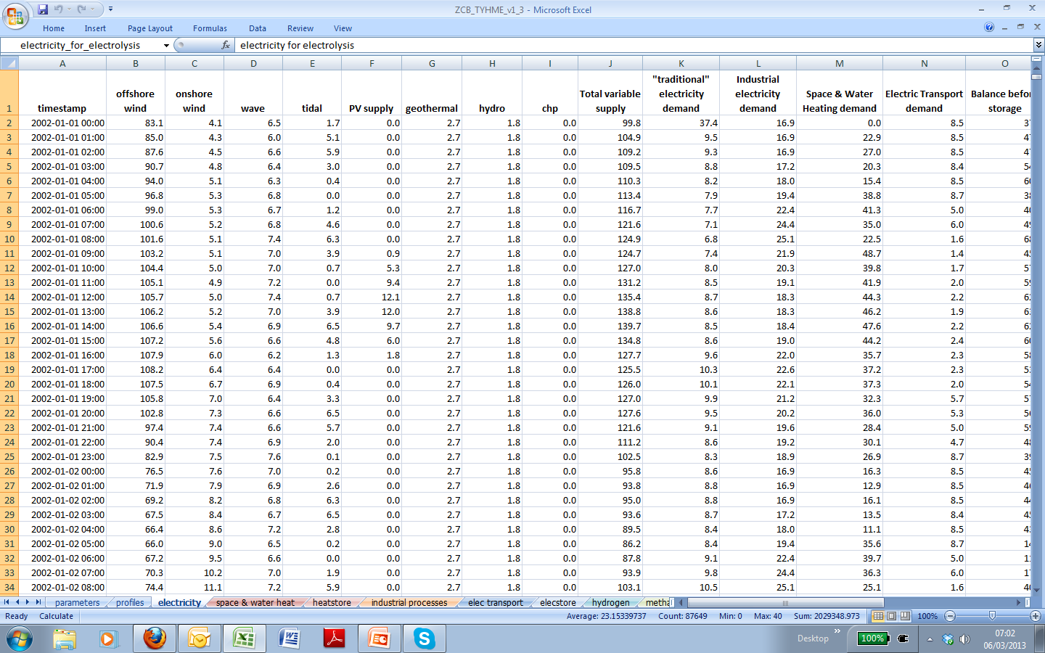

Slide 17
Offshore Wind
Example:
Hourly model for
offshore wind power

Slide 18
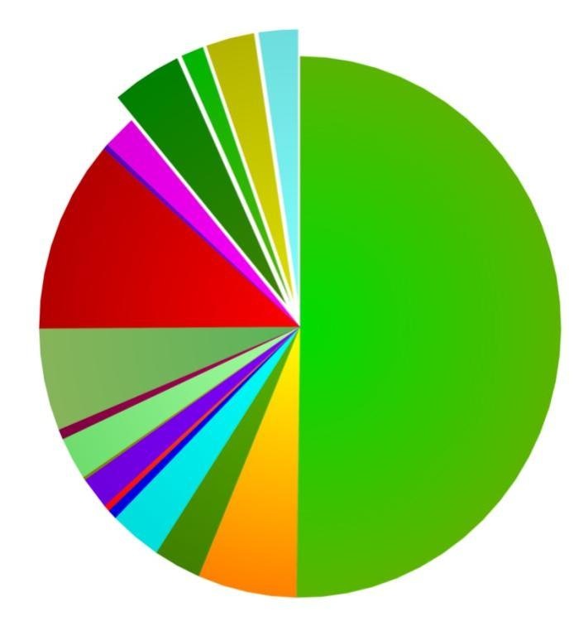
Offshore Wind
Offshore wind: Strongest UK renewable energy source
Need to model output of widely distributed future wind farm fleet
Problem: Almost no historic measured offshore wind speed data
Heat pumps
Offshore wind

Slide 19
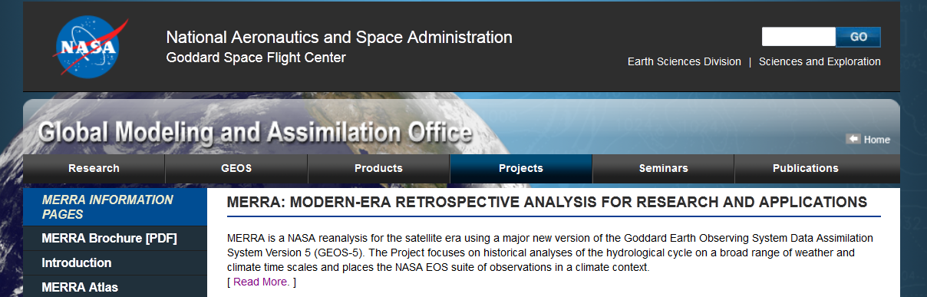
MERRA
Offshore Wind
Solution: NASA‘s MERRA (Modern-Era Retrospective Analysis for Research and Applications), a kind of „weather back-cast“
Hourly data for past decades, 0.5° spatial resolution

Slide 20
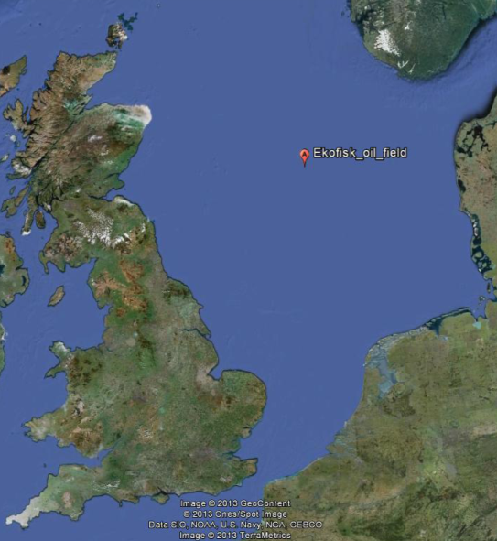
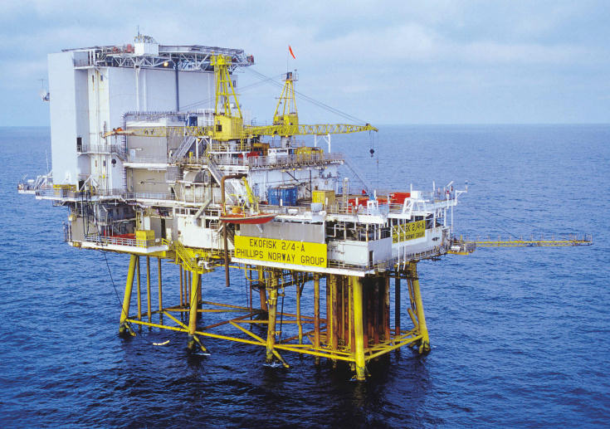
Validation
Offshore Wind
Validation: compare MERRA to real offshore wind data, e.g. half-hourly readings from helipad at Ekofisk oil field

Slide 21
Validation
Offshore Wind

Slide 22
Validation
Offshore Wind

Slide 23
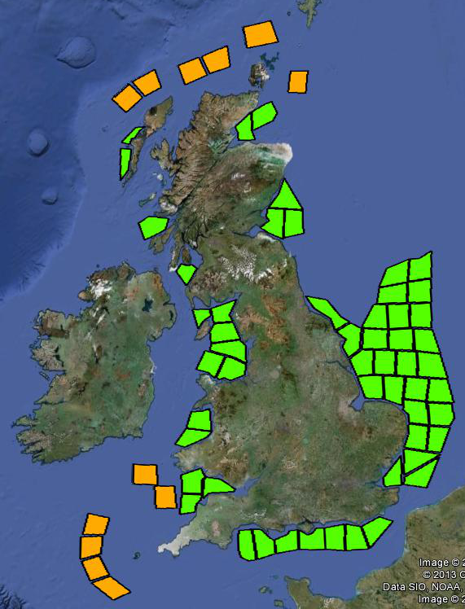
Methodology
Offshore Wind
Approach: Define regions for fixed & floating offshore wind farms
Assign capacity (in GW) for each region
Get hourly wind speeds & calculate hourly power output for each region

Slide 24
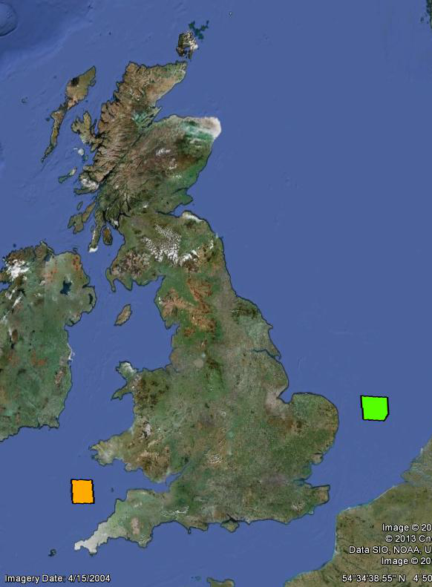
Methodology
Offshore Wind

Slide 25
Complete model
Bringing it all together:
The Hourly Energy Model

Slide 26

Hourly energy model

Slide 27
Hourly energy model
>90GW excess supply available
>60GW dispatchable backup required

Slide 28
Hourly energy model
% of time level is exceeded

Slide 29
Short term variation
Large hour-to-hour fluctuations, dominated by heat demand
Demand Side Management (DSM) can help, e.g. „smart charging“ of electric cars
Pumped hydro storage and
heat storage can provide short term storage
(a few 100GWh)

Slide 30
Hourly energy model

Slide 31
Long term variation

Slide 32
Long term variation
Significant longer-term variation between months & years
Ideally many TWh of storage

Slide 33

Backup & storage
Flexible dispatchable storage & backup is still required
Gas allows storage of large quantities of energy
(100s of TWh)
Gas turbines allow flexible dispatch, proven technology

Slide 34
Backup & storage
Hydrogen can easily be created from renewable electricity (electrolysis)
But natural gas (methane) is easier to store and we have vast existing infrastructure
The Sabatier reaction allows „methanation“ of hydrogen

Slide 35
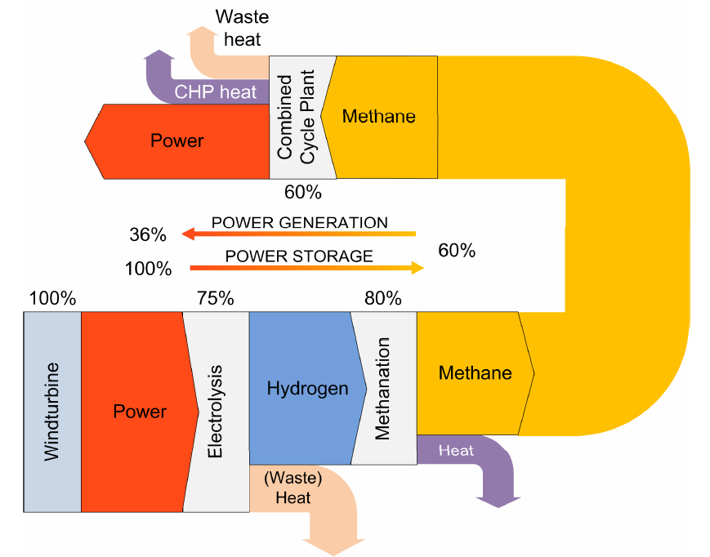
Sabatier reaction
source: Sterner (2010)
Sabatier: CO₂ + 4H₂ → CH₄ + 2H₂O

Slide 36
Long term gas storage

Slide 37



The Future: Integrated Energy Networks
Variable
generation
Synthetic
H₂ / CH₄
Production
Electricity
Grid
Central Heat Pumps
Gas Storage
Heat Storage
Heat Networks
Gas
Grid
Dispatchable generation
CHP (maybe?)

Slide 38
The easy part:
Hourly model of energy supply
The tricky part:
Model of interaction between price, demand, storage and backup

Slide 39
Thank You
Very Much
tobi.kellner@cat.org.uk

