Slide 1
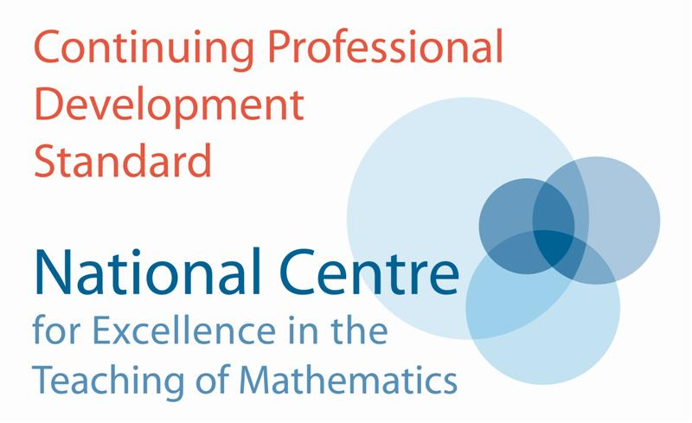
Functioning with Coordinates & Coordinating Functions
Promoting Mathematical Thinking
Anne Watson & John Mason
Prince’s Teaching Institute
2014
The Open University
Maths Dept
University of Oxford
Dept of Education

Slide 2
Aims, Intentions & Possibilities
To offer mathematical challenge
To open up some possible ways of working on mathematics
To draw attention to core aspects (awarenesses) of coordinate geometry and functions
To raise questions about how to provoke students to move flexibly between discrete and continuous

Slide 3
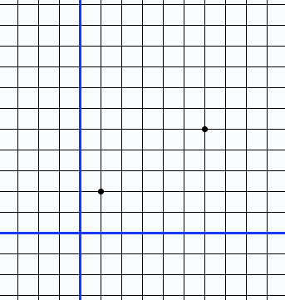
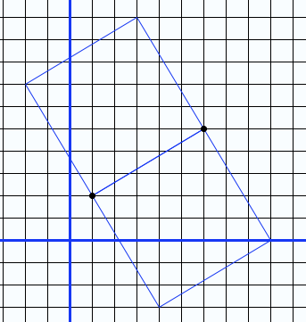
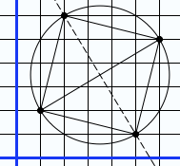
Corners of a Square

Slide 4
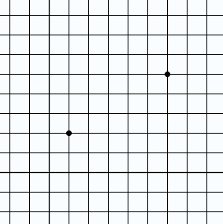
Corners of a Kite

Slide 5
Function: images through School
x
+ 5
x 7
Mappings
Machines
Formulae for getting y-values from given x-values
Input/output ‘black boxes’ such as trigonometric or exponential functions
Relations between a domain of x-values and a range of function values;
Relations between variables in ‘realistic’ situations
Graphs which have particular characteristics;
Graphs which can be transformed by scaling, translating;
Particular kinds of relations with parameters e.g.

Slide 6
Getting a Lift
You are staying in a hotel on its 14th floor. You are going to use the lift to go down to the parking level. The hotel has a ground level numbered zero, and there are several parking levels underneath the zero floor.
The table below shows what floor you reach after a number of seconds.
Number of seconds | Floor Number
0 | 14
2 | 10
4 | 6
6 | 2
7 | ?

Slide 7
Functions From Sequences
What is the function?
x | 1 | 2 | 3 | 4
y | 2 | 4 | 6 | 8
x | 1 | 2 | 3 | 4
y | 1 | 4 | 9 | 16

Slide 8
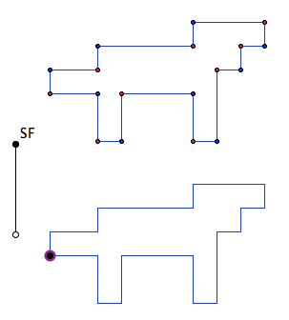
Alge-Dog
Alge-dog is going to be scaled.
What will happen to its perimeter?

Slide 9
Introduction to Polynomials
Imagine a quadratic graph through these three points
How might the graph change if one of the points is dragged up and down?

Slide 10
Cobwebs

Slide 11
Understanding Functions
shift
from seeing functions as instructions to calculate,
to seeing them as correspondences between sets,
to seeing them as describing variations,
to becoming familiar with functions,
to using functions to describe situations,
and also to appreciating functions as objects in their own right.
functions are not lines, straight or curved, that join plotted points
plotting points focuses the mind on values of variables rather than parameters and properties

Slide 12
Understanding Functions (2)
students have to understand
the relation between coordinates for individual points,
the fact that the same relation applies to sets of points,
and that the equation and line represent this relationship and all the points that have it
in linear graphs, the roles of y, x, m and c in are very different from each other
having 'time' on the x-axis helps students move towards understanding continuous independent variables but can also limit understanding
students often think graphs 'start' at zero and need a broad repertoire of functions to counteract this

Slide 13
Understanding Functions (3)
Different forms of quadratic give access to different understanding
the y-intercept is visible clearly as c, but the roles of a and b are obscure;
the turning point (probably the most obvious visual feature of quadratics) is most visible in the completed square form. The displacement of +a in the x-direction appears in (x – a) which students find counter-intuitive
the x-intercepts are visible as roots a and b in the factorised form but the y-intercept is not obvious; changing k is interesting, particularly with software;
students can get the idea that all functions are continuous, smooth and calculable unless they meet a broad repertoire of functions

Slide 14
Aims, Intentions & Possibilities
To offer mathematical challenge
To open up some possible ways of working on mathematics
To draw attention to core aspects (awarenesses) of coordinate geometry and functions
To raise questions about how to provoke students to move flexibly between discrete and continuous

Slide 15
Further Development
Institute for Mathematical Pedagogy (IMP14) (4 days July 28-31) see mcs.open.ac.uk/jhm3
Picturing Functions (labspace.open.ac.uk/mod/oucontent/view.php?id=426866&section=1.2.2)
mcs.open.ac.uk/jhm3 (go to presentations)
Key Ideas in Teaching Mathematics (Watson, Jones & Pratt (O.U.P)
j.h.mason@open.ac.uk

