Slide 1




Generalisation as the Core and Key to Learning Mathematics
Promoting Mathematical Thinking
John Mason
PGCE
Oxford Feb 12
2014
The Open University
Maths Dept
University of Oxford
Dept of Education

Slide 2
Conjectures
Everything said here today is a conjecture … to be tested in your experience
The best way to sensitise yourself to learners …
  is to experience parallel phenomena yourself
So, what you get from this session is what you notice happening inside you!

Slide 3

Differing Sums of Products
Write down four numbers in a 2 by 2 grid
4
7
5
3
Add together the products along the rows
28 + 15 = 43
Add together the products down the columns
20 + 21 = 41
43 – 41 = 2
Calculate the difference
That is the ‘doing’
What is an ‘undoing’?
Now choose positive numbers
so that the difference is 11
Notes:
Mathematical context
What probaby matters most is not eh context, but whether students ‘think’ they can solve the problem!

Slide 4
Differing Sums & Products
4
7
Tracking Arithmetic
5
3
4x7 + 5x3
4x5 + 7x3
4x(7–5) + (5–7)x3
= (4-3)x (7–5)
So in how many essentially different ways can 11 be the difference?
So in how many essentially different ways can n be the difference?
Notes:
Revealing Structure by attending to relationships not calculations

Slide 5

Think Of A Number (ThOANs)
Think of a number
Add 2
Multiply by 3
Subtract 4
Multiply by 2
Add 2
Divide by 6
Subtract the number you first thought of
Your answer is 1
7
7
+ 2
3x + 6
7
7
3x + 2
6x + 4
7
6x + 6
7
+ 1
7
1

Slide 6


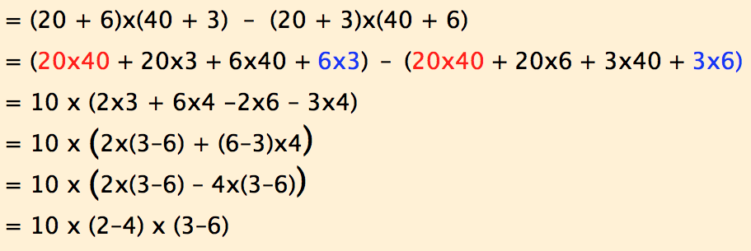
Varied Multipication Differences

Slide 7
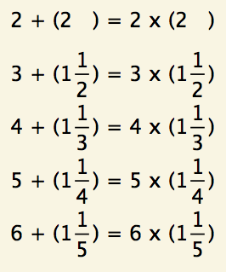
Patterns from 2

Slide 8
Tunja Sequences

Slide 9
Structured Variation Grids

Slide 10
Sundaram’s Grid
16 | 27 | 38 | 49 | 60 | 71 | 82
13 | 22 | 31 | 40 | 49 | 58 | 67
10 | 17 | 24 | 31 | 38 | 45 | 52
7 | 12 | 17 | 22 | 27 | 32 | 37
4 | 7 | 10 | 13 | 16 | 19 | 22
Claim: N will appear in the table iff 2N + 1 is composite
What number will appear in the R^{th} row and the Cth column?

Slide 11
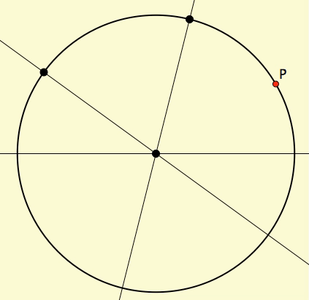
Rolling Triangle
Imagine a circle with three lines through the centre
Imagine a point P on the circumference of the circle
Drop perpendiculars from P to the three lines
Form a triangle from the feet of those three perpendiculars
As P moves around the circle, what happens to the triangle?

Slide 12
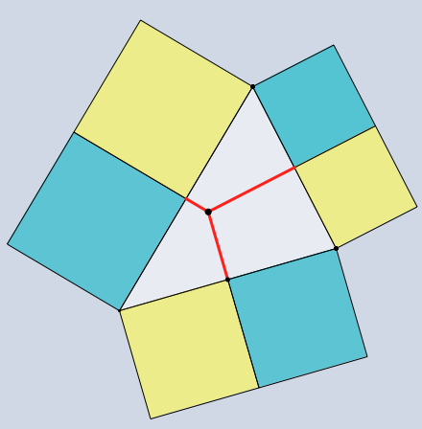
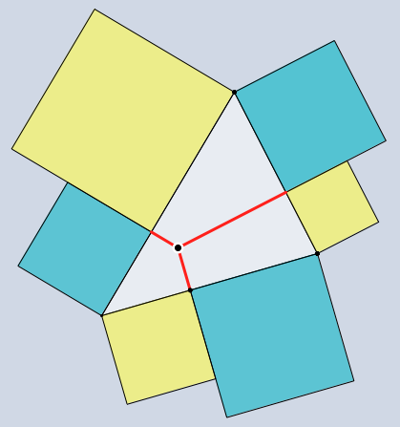
Squares on a Triangle
Imagine a triangle;
Imagine the midpoint of each edge;
Construct squares outwards on each of the six segments;
colour them alternately cyan and yellow;
Then the total area of the yellow squares is the total area of the cyan squares.

Slide 13
Expressing Generality
Notes:
H(n)=3(n-1)+1+3(n-1)(n-1) H(n)=2n(n-1)/2+n*n+(n-1)(n-1) H(n)=2n(n+1)/2-1+(n-1)(n-1) XXX
H(n)=1+6n(n-1)/2 H(n)= (n+n-1+n)/2(n)+(n+n-2+n)/2(n-1) H(n)=

Slide 14
Variation ‘Theory’
What is available to be learned
  From an exercise?
  From a page of text?
What generality is intended?

Slide 15
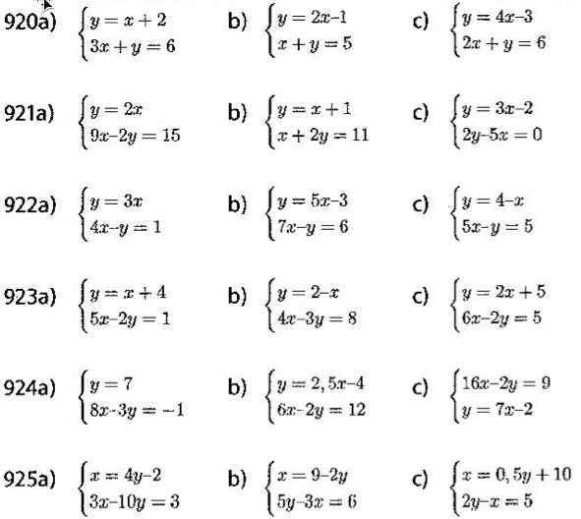
Same & Different
Do you ever give
students a set of
exercises to do?
What is your immediate response?
What might students be attending to?
What is the same & what is different?
What is being varied?
Adapted from Häggström (2008 p90)
Notes:
Bury the Bone!

Slide 16
Raise your hand when you can see …
Something that is 3/5 of something else
Something that is 2/5 of something else
Something that is 2/3 of something else
Something that is 5/3 of something else
What other fraction-actions can you see?
How did your attention shift?
Flexibility in choice of unit
Notes:
Generalise!

Slide 17
Raise your hand when you can see …
Something that is 1/4 – 1/5
of something else
Did you look for
something that is 1/4 of something else
and for
something that is 1/5 of the same thing?
Common Measure
What did you have to do with your attention?
What do you do with your attention in order to generalise?
Notes:
Generalise!

Slide 18
Stepping Stones
R
…
What needs to change so as to ‘see’ that
…
R+1

Slide 19
SWYS
Find something that is
, , , , , of something else
Find something that is of of something else
What is the same, and what is different?
Find something that is of of something else

Slide 20
Describe to Someone How to See something that is …
1/3 of something else
1/5 of something else
1/7 of something else
1/15 of something else
1/21 of something else
1/35 of something else

Slide 21
Counting Out
In a selection ‘game’ you start at the left and count forwards and backwards until you get to a specified number (say 37). Which object will you end on?
A
B
C
D
E
1
2
3
4
5
9
8
7
6
10
…
If that object is elimated, you start again from the ‘next’. Which object is the last one left?
Notes:
How do you know?
Generalise!

Slide 22
Money Changing
People who convert currencies offer a ‘buy’ rate and a ‘sell’ rate, and sometimes charge a commission in addition!
Suppose they take p% from every transaction, and that they sell $s for 1£ but buy back at the rate of £b for $1. How can you calculate the profit that make on each transaction?

Slide 23
Mathematical Thinking
Describe the mathematical thinking you have done so far today.
How could you incorporate that into students’ learning?

Slide 24
Possibilities for Action
Trying small things and making small progress; telling colleagues
Pedagogic strategies used today
Provoking mathematical thinks as happened today
Question & Prompts for mathematical Thinking (ATM)
Group work and Individual work

Slide 25
Tasks
Tasks promote Activity;
Activity involves Actions;
Actions generate Experience;
  but one thing we don’t learn from experience is that we don’t often learn from experience alone
It is not the task that is rich …
  but whether it is used richly

Slide 26
Powers & Themes
Powers
Themes
Imagining & Expressing
Specialising & Generalising
Conjecturing & Convincing
Stressing & Ignoring
Organising & Characterising
Doing & Undoing
Invariance in the midst of change
Freedom & Constraint
Extending & Restricting
Are students being encouraged
to use their own powers?
or
are their powers being usurped by textbook, worksheets and … ?

Slide 27
Follow Up
j.h.mason @ open.ac.uk
mcs.open.ac.uk/jhm3 → Presentations
Questions & Prompts (ATM)
Key ideas in Mathematics (OUP)
Learning & Doing Mathematics (Tarquin)
Thinking Mathematically (Pearson)
Developing Thinking in Algebra (Sage)
Fundamental Cosntructs in Maths Edn (RoutledgeFalmer)

