Slide 1
Drawing on Learners’ Perspectives
Promoting Mathematical Thinking
Anne Watson & John Mason
STEM Education NW
July 5 2014
The Open University
Maths Dept
University of Oxford
Dept of Education

Slide 2
Conjectures
Everything said here today is a conjecture … to be tested in your experience.
uttered in order to externalise it, consider it, and modify it on the basis of people’s responses
What is real is what can be imagined, conjured up.
The best way to sensitise yourself to learners
is to experience parallel phenomena yourself
So, what you get from this session is what you notice happening inside you!

Slide 3
Main Points
Material Objects are not in themselves mathematical.
What IS mathematical is how they are used.
The other major resource is Learners’ Powers
Models of … –> Models for…
Three worlds:
Enactive (material objects)
Iconic (imaginative)
Symbolic (words, symbols)
A lesson without the opportunity for learners to use their own powers, especially generalising … is not a mathematics lesson!

Slide 4
Powers & Themes
Powers
Themes
Imagining & Expressing
Specialising & Generalising
Conjecturing & Convincing
Stressing & Ignoring
Organising & Characterising
Doing & Undoing
Invariance in the midst of change
Freedom & Constraint
Extending & Restricting
Are students being encouraged to use their own powers?
or are their powers being usurped by textbook, worksheets and … ?

Slide 5
Cuboids
On your tables you will find a collection of Cuboids.
One is missing.
What would it look like?
How are you going about the task?
What powers are you using?
What worlds are you in?
Notes:
Possible methods: combinatorics; 'it looks like'; 'it looks as if'; judging by eye; finding similarity by eye; finding similarity by rays from a point
materials being used to promote mathematical ideas - enactive
learners' powers: comparison -same and different; observation- what do I see?

Slide 6
Palouse Relationships

Slide 7
What is the Same & What Different?
What sort of numbers can n be?
What is being said?
In what contexts might these occur?
With the grain
Fractional increase followed by fractional decrease
Generalise!
Duckweed & Weed-killer
Across the grain
Undoing a scaling
Interest & Discount
Dividing by a fraction

Slide 8
What is the Same & Different?
Generalise!

Slide 9
Reflection
What powers were you using?
What worlds were you in?
connections with cuboids?
Notes:
Not materials -symbolic
learners' powers: same/different; pattern/relationship/structure;
desire to express;
with and across the grain (sequential numbers are avoided, but 'with the grain' shows similarities, 'across the grain' to express structure)

Slide 10
Elastic Scaling

Slide 11
Reflection
What powers were you using?
What worlds were you in?
Connections with Cuboids & Palouse?
Notes:
we demonstrate the use for fractional increase and decrease;
same as Palouse relationship, different experience.
Materials - enactive: model for understanding ratio as change in the unit
learners' powers: do/undo; desire to express

Slide 12
Raise your hand up when you can see …
Something that is 3/5 of something else
Something that is 2/5 of something else
Something that is 2/3 of something else
Something that is 5/3 of something else
What other fractional actions can you see?

Slide 13
Stepping Stones
Raise your hand when you can see
something that is 1/4 – 1/5 of something else
R
…
What needs to change so as to ‘see’ that
…
R+1

Slide 14
SWYS (Say What You See)

Slide 15
Describe to Someone How to See something that is …
1/3 of something else
1/5 of something else
1/7 of something else
1/15 of something else
1/21 of something else
1/35 of something else

Slide 16
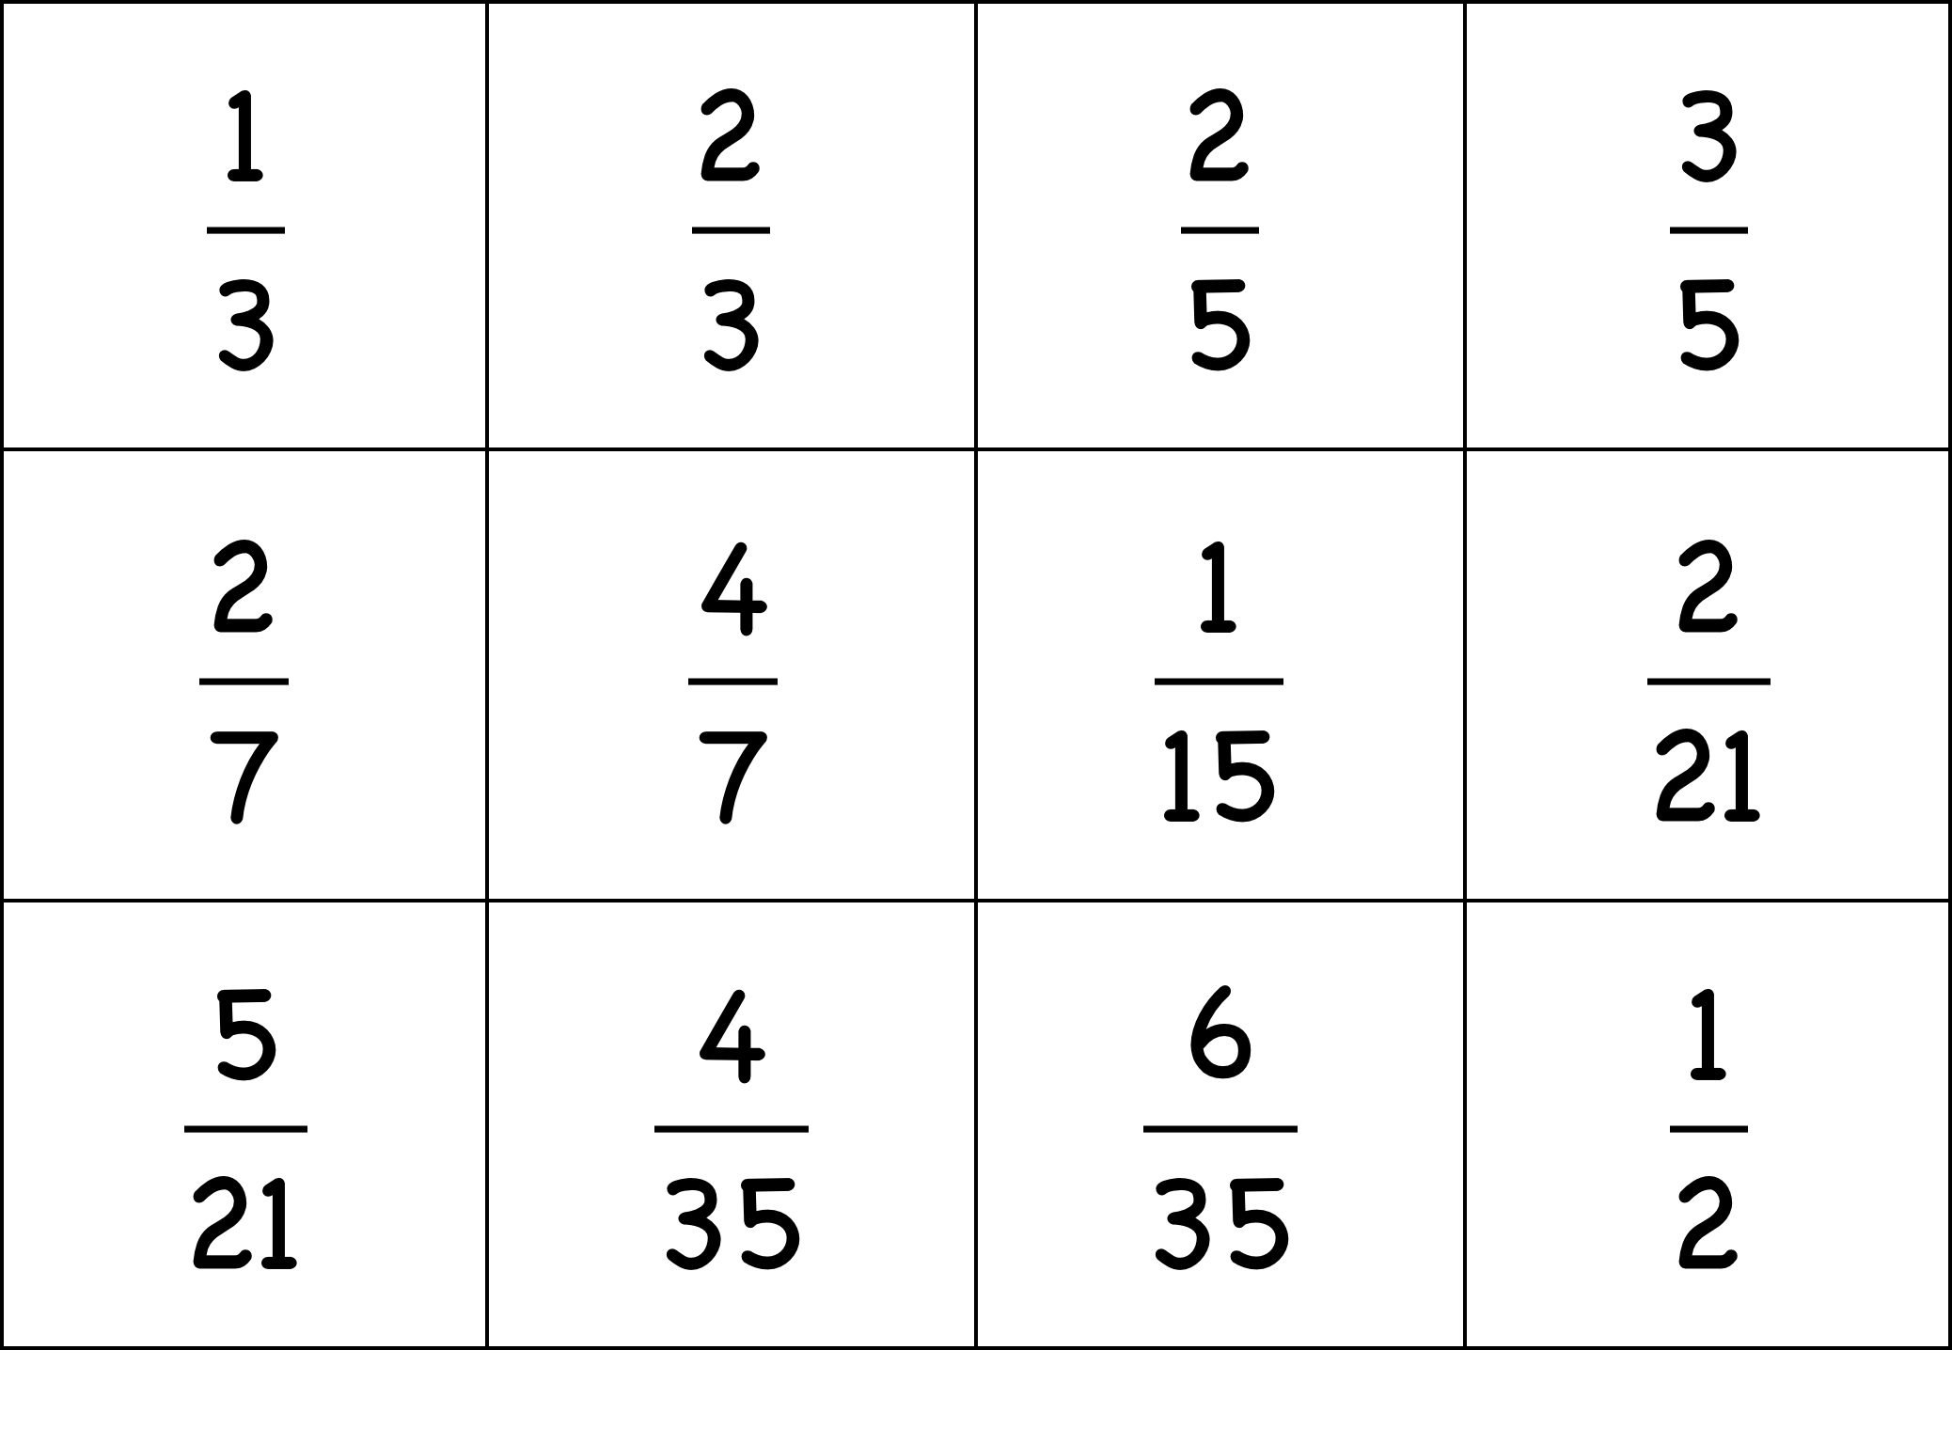
Sorts of Sorts
Sort them into two classes
Make up another one for each of your classes
Notes:
Sorting and Matching tasks reveal a good deal about what learners are attending to.
Construction tasks are even more revealing

Slide 17
Sorts of Sorts
Make up a set of 6 fractions which you think other people will not put correctly in number-line order
Put your fraction cards in numberline order
Notes:
Sorting and Matching tasks reveal a good deal about what learners are attending to.
Construction tasks are even more revealing

Slide 18
Sorts of Relationships
How many different multiplicative relations can you find?
How many different additive relations can you find?
What other mathematical content could you use in this type of task?
How many different subtractive relations can you find?
How many different divisive relations can you find?
Notes:
Sorting and Matching tasks reveal a good deal about what learners are attending to.
Construction tasks are even more revealing

Slide 19
Reflection
What powers were you using?
What worlds were you in?
Connections with Cuboids & Palouse?
Notes:
materials - iconic; what can be gained through observation and discussion?
What needs didactic structure?
pedagogic issues: exploring materials, mathematical meaning developing from exploration + input(cuboids);
'scientific' knowledge through structure (Palouse);
exploration of materials in a structured environment (elastics & 3D cards);
didactic guidance (3D cards).

Slide 20
Outer & Inner Tasks
Outer Task
What author imagines
What teacher intends
What students construe
What students actually do
Inner Task
What powers might be used?
What themes might be encountered?
What connections might be made?
What reasoning might be called upon?
Meta Task
What social or personal dispositions might be challenged?
What personal propensities might be being worked on?

Slide 21
Powers & Strategies
Powers
Strategies
Imagining & Expressing
Specialising & Generalising
Conjecturing & Convincing
Stressing & Ignoring
Organising & Characterising
Say What You See
Doing & Undoing
Same & Different
Changing Representations
Are students being encouraged to use their own powers?
or are their powers being usurped by textbook, worksheets and … ?

Slide 22
Teaching pupils to think mathematically …
involves developing a disposition to
think mathematically, to use powers mathematically, to be mathematical
to attend to situations mathematically
How often do you think mathematically
with and in front of students?
What powers is the task calling upon?
What mathematical themes are involved?
What are pupils attending to? (and how?)
What are you attending to when interacting with them? (and how?)

Slide 23
Drawing on Learners’ Perspectives
Enactive – Iconic – Symbolic
What was available to be encountered?
What was available to be learned?
Notes:
Palouse: symbolic presentation; participants ‘making real’; dependent on SWYS and use of powers; Structured so Same & Different applies to encounter underlying structure; also rehearsal of fraction calculations
Cuboids: underlying structural relations; constraint (only one missing); no measuring instrruments
Elastics: underlying awareness being appealed to; used to fractionate; supports mental and kinesthetic appreciation

Slide 24
To Follow Up
Promoting Mathematical Thinking
anne.watson@education.ox.ac.uk
j.h.mason@open.ac.uk
mcs.open.ac.uk
Key Ideas in Teaching Mathematics (9-19) (2013)
Thinking Mathematically (new edition 2010)
Developing Thinking in Algebra (Sage)
Designing & Using Mathematical Tasks (Tarquin)
Questions and Prompts (ATM)

