Slide 1
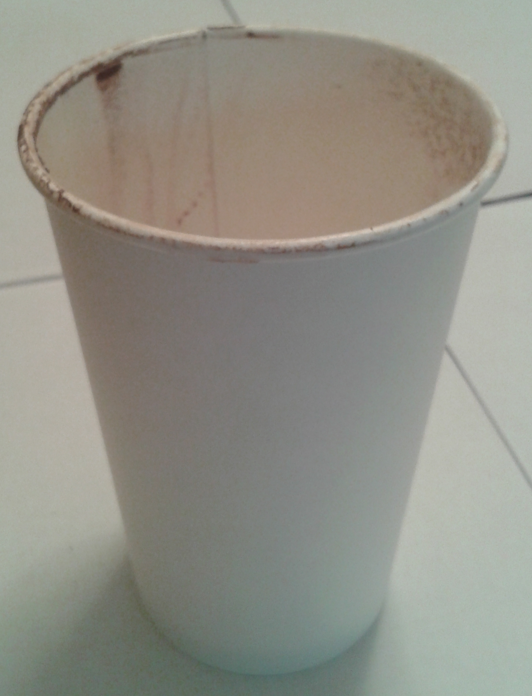
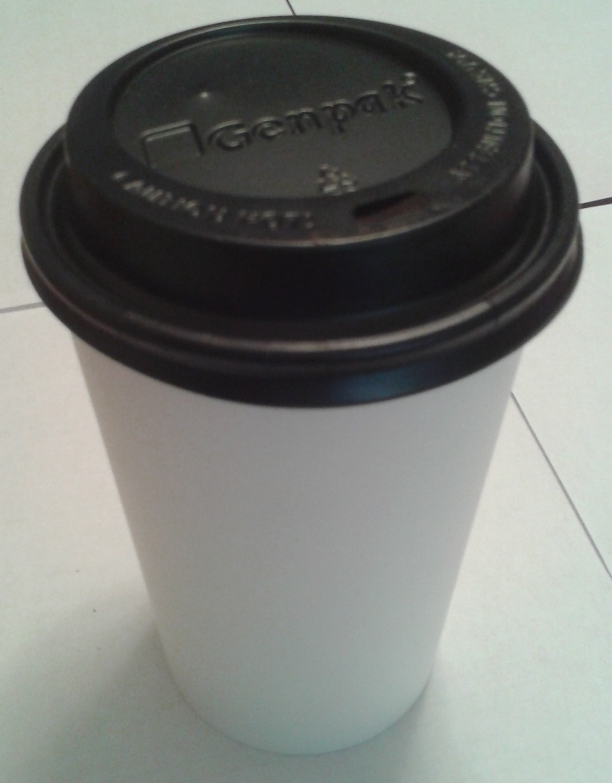
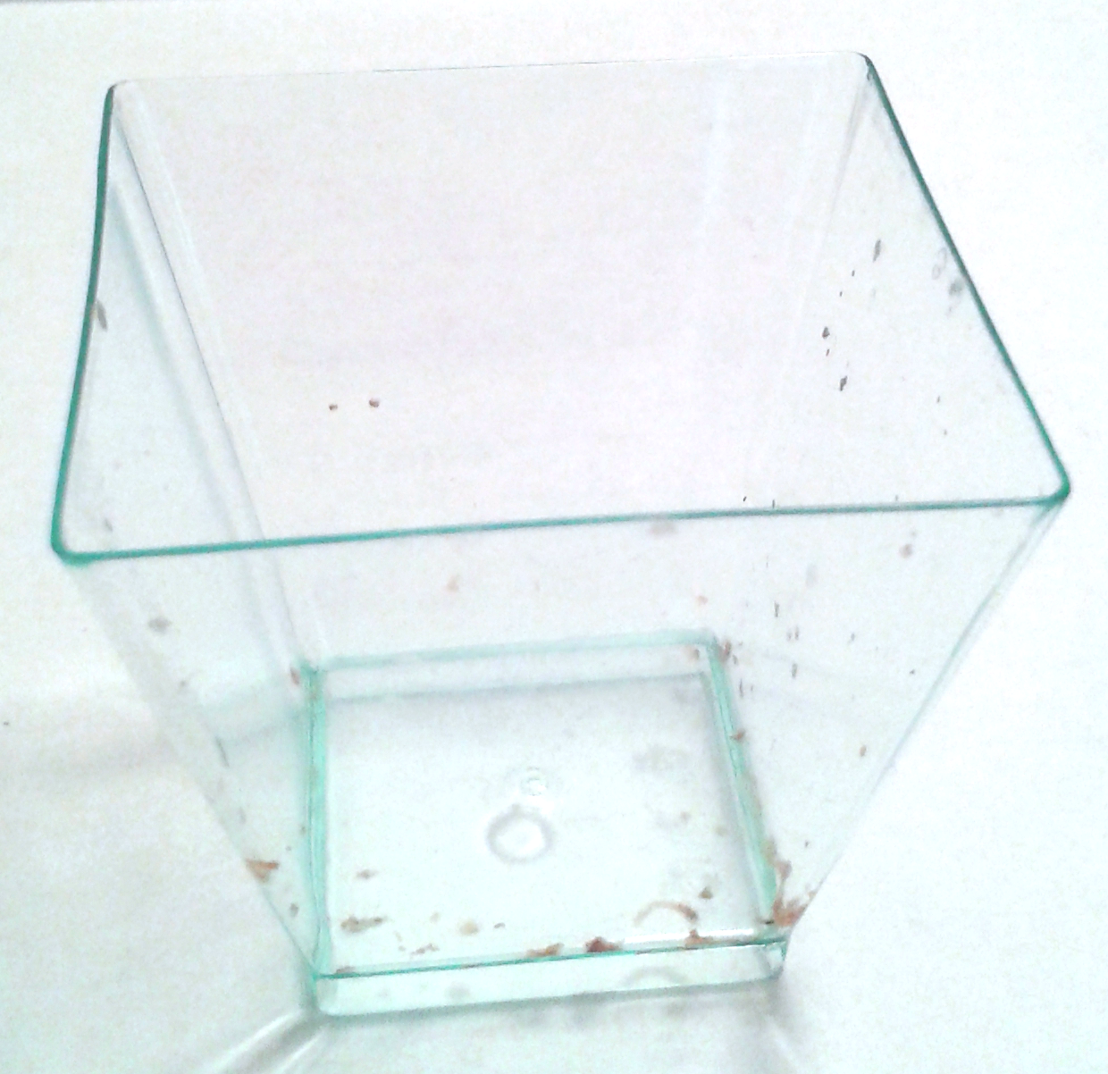
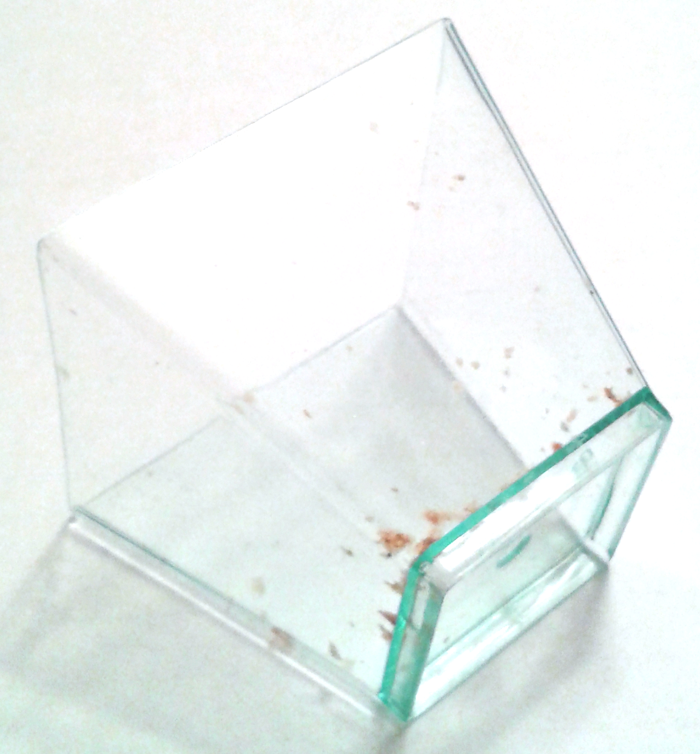
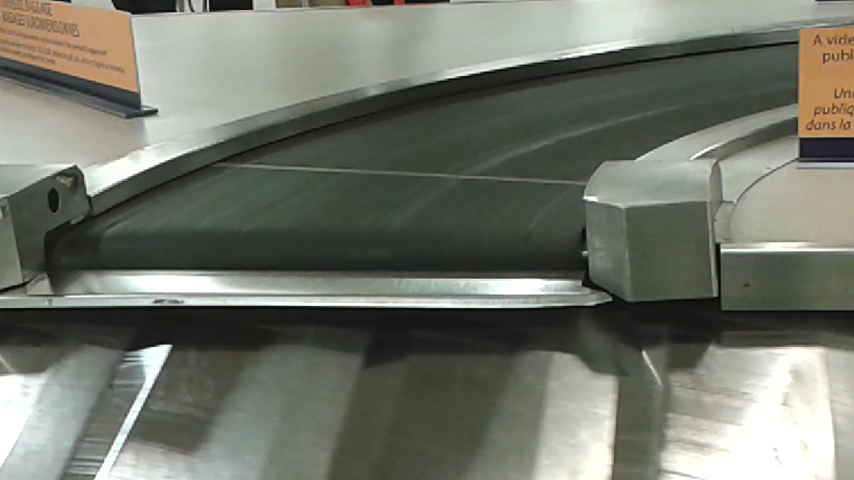
While You Wait: Rolling Cups & Luggage Belts
Allow the cup on your table to roll about. What do you notice?
What difference does a lid make?
What happens when the plastic canapé cup is ‘rolled’?
What variations come to mind?
What shape is the upper belt?
Are these two phenomena related in any way?

Slide 2






Being Mathematical with and in front of
Students
Promoting Mathematical Thinking
John Mason
Killam Lecture
Calgary
Nov. 2014
The Open University
Maths Dept
University of Oxford
Dept of Education

Slide 3
Outline
Throat clearing
Tasks to evoke powers & themes
Interlude on tasks, powers & themes
Being & Attention
More Tasks
Reflection

Slide 4
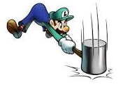
Throat Clearing
Everything said here is a conjecture …
  … to be tested in your experience
My approach is fundamentally phenomenological …
I am interested in lived experience.
Radical version: my task is to evoke awareness (noticing)
So, what you get from this session will be mostly …
  … what you notice happening inside you!
Avoid the teaching of
speculators,
whose judgements are
not confirmed
by experience.
(Leonardo Da Vinci)
Central role of attention:
… What is being attended to?
… How it is being attended to?
Awareness
as consciousness
as that which enables action

Slide 5
Rich Tasks
It’s not the task that is rich
but whether the task is used richly: rich pedagogy
  Calling upon & developing learners’ natural powers
  Encountering mathematical themes
  Bringing personal dispositions and propensities to the surface
Outer, Inner & Meta aspects of tasks
Avoid sterile debates around simple names for pedagogies
(discovery, child-centred, problem solving, reform, constructivist, …)
Focus on (Rich) Pedagogic Actions

Slide 6

Differing Sums of Products
Write down four numbers in a 2 by 2 grid
4
7
5
3
Add together the products along the rows
28 + 15 = 43
Add together the products down the columns
20 + 21 = 41
Subtract second result from first
43 – 41 = 2
Now add a number to both of the main diagonal numbers
and
subtract a number from both of the off-diagonal numbers:
6
4
Repeat the calculation
2
5
Notes:
Mathematical context
What probaby matters most is not the context, but whether students ‘think’ they can solve the problem (follow instructions)
Notice movements of attention: discerning details; recognsiing relationships
Invariance in the midst of change; Conjecturing

Slide 7
Differing products
4
7
45
x
37
Take your two grids
Form the four two-digit numbers as indicated
5
3
47
35
–
x
= 20
Perfom the calculations
indicated
6
4
62
x
54
Compare your answers
2
5
64
x
52
–
= 20
Notes:
Relationship to previous calculations
Invariance in the midst of change

Slide 8
Differing Sums of Products
Write down four numbers in a 2 by 2 grid
4
7
5
3
Add together the products along the rows
28 + 15 = 43
Add together the products down the columns
20 + 21 = 41
43 – 41 = 2
Calculate the difference
That is the ‘doing’
What is an undoing?
Now choose positive numbers
so that the difference is 7
Notes:
Note the proceptual move: a sequence of actions becomes a compound action and is on the edge of becoming a noun
Undoing is often creative

Slide 9
Tracking Arithmetic
4
7
45 x 37
4x7 + 5x3
5
3
47 x 35
4x5 + 7x3
(40+5)x(30+7) – (40+7)x(30+5)
= 40x30 + 5x7 + 40x7 + 5x30
–(40x30 + 5x7 + 40x5 + 7x30)
4x(7–5) + (5–7)x3
= 40x(7-5) + (5-7)x30
= 4x(7–5) – (7–5)x3
= 40x(7-5) – (7–5)x30
= (4-3) x (7–5)
= (40–30)x(7–5) = 10(4–3)(7–5)
So in how many essentially different ways can 6 be the difference?
So in how many essentially different ways can n be the difference?
Notes:
Revealing Structure by attending to relationships not calculations
Dimensions of possible variation; range of permissible change

Slide 10
Powers
Themes
Imagining & Expressing
Specialising & Generalising
Conjecturing & Convincing
Organsing & Characterising
Invariance in the midst of change
Doing & Undoing
Freedom & Constraint
Extending & Restricting
Attention
Holding Wholes (gazing)
Discerning Details
Recognising Relationships
Perceiving Properties as being instantiated
Reasoning on the basis of agreed properties

Slide 11
Roots
It is his present powers which are to assert themselves; his present capacities which are to be exercised; his present attitudes which are to be realized. John Dewey 1922
Who, indeed, can watch the ceaseless observation and inquiry and inference going on in a child’s mind, or listen to its acute remarks on matters within the range of its faculties, without perceiving that these powers it manifests, if brought to bear systematically upon studies within the same range, would readily master them without help? This need for perpetual telling results from our stupidity, not the child’s. We drag it away from the facts in which it is interested, and which it is actively assimilating of itself. … Herbert Spencer 1878
Russell; Whitehead; Wertheimer, Mary Boole, Krutetskii; … Gattegno
Notes:
From, The Child and The Curriculum, reprinted in 1971, The Child and The Curriculum and The School and Society, University of Chicago Press, Chicago, p19-31

Slide 12
Outer, Inner & Meta Aspects of Tasks
Outer Task
  What author imagines
  What teacher intends
  What students construe
  What students actually do
Inner Task
  What powers might be used or developed?
  What themes might be encountered and enriched?
  What connections might be made?
  What reasoning might be called upon?
  What sense students make of their activity
  What students are now prepared to be able to hear & see
  What students recosntruct later
Meta Task
  Personal propensities and dispositions to challenge or work on
  Working collaboratively and individually

Slide 13
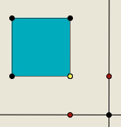
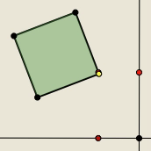
Perimeter Projections
Imagine a square
Imaging a point traversing the perimeter of the square
Let your right hand track the vertical movement of the point
Let your left hand track the horizontal movement of the point
Now imagine your square tilts a bit, say about 30°. What happens?

Slide 14
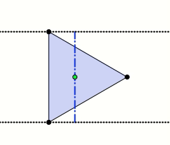
Polygon Projections
Imagine an equilateral triangle
A light (very far away) lies in the plane of the triangle so that the triangle casts a one-dimensional shadow.
How does the length of the shadow change as the light circulates around the triangle?

Slide 15
The world is a mirror for the people
(Hyemeyhosts Storm)
The universe is a mirror in which we can contemplate
only what we have learned to know about ourselves
(Italo Calvino)
It is only after you come to know
the surface of things
that you venture to see what is underneath;
But the surface of things is inexhaustible
(Italo Calvino)

Slide 16
Observation
  A name or label immediately shapes what is seen and what is recalled (Frederick Bartlett 1932)
  Observation is theory laden (George Hanson 1958)
  We want our theories to be as fact laden as our facts are theory laden (Nelson Goodman 1978)
  He who loves practice without theory is like the sailor who boards ship without a rudder and compass and never knows where he may cast.
  Practice always rests on good theory.
  (Leonardo Da Vinci)

Slide 17
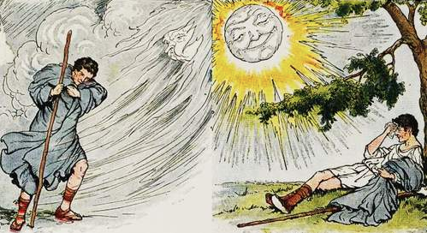
Aesop’s story of the Sun & the Wind
Direct instruction can be like the action of the wind;
Providing students with what is sufficient-necessary so they can use
their natural powers to work things out can be like the action of the sun

Slide 18
Multi-Level Initiating of Tasks
In how many ways can a unit fraction be expressed as the difference of two unit fractions?
Notice that
Notice that
Notes:
Ways of initiating activity through presentation of a task

Slide 19
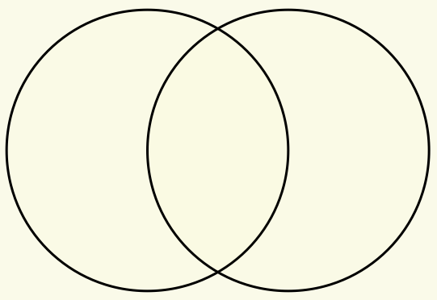
Set Ratios
In how many different ways can you put 17 objects into the two sets (the circles) so that both sets have the same number of objects?
Notes:
Now apply what we have been doing, paying attention to powers and themes.
How else could the task be presented?

Slide 20
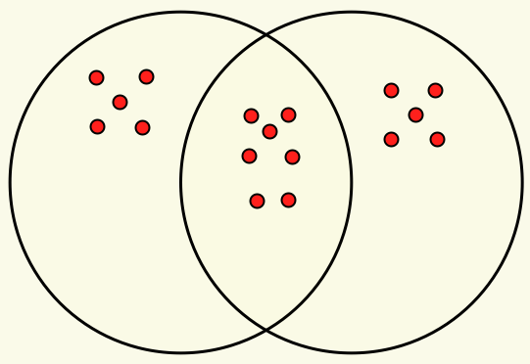
Example

Slide 21
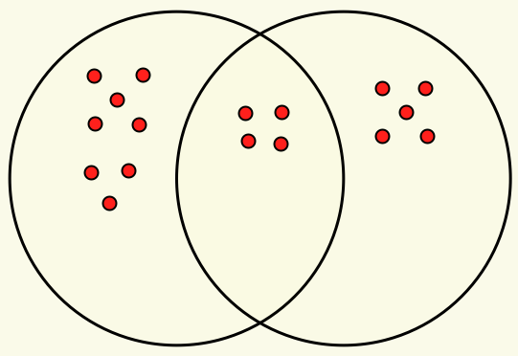
Extension
Here the sets are in the ratio of 4 : 3.
In how many ways can the 17 objects be placed so the sets are in the ratio 3 : 2?
4 : 3
What about 3 sets?

Slide 22
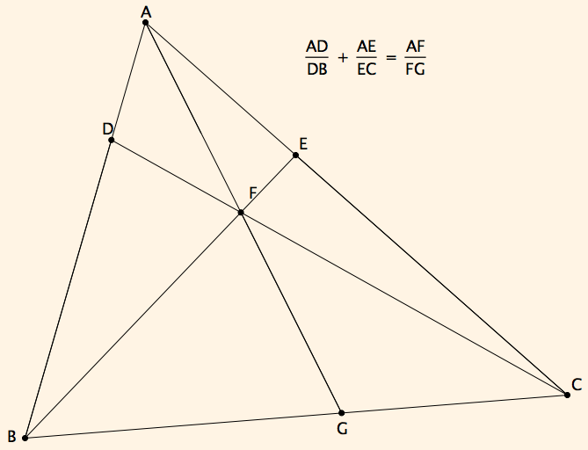
Ratio Addition

Slide 23
Reasoning
A
Movements of attention:
E
D
F
C
B
G

Slide 24
On Being Mathematical & Mathematical Being
What do you actually value?
  Developing complex ways of thinking?
  Developing flexibility?
  Getting answers to routine questions?
  Having a go at problems?
Teaching Responsively
  Listening to students not for what you desire or expect but for variation so as to extend possibilities
  Distinguishing between babbling and gargling
Teaching Responsibly
  Becoming articulate about both what and why choices are made
  Being willing to justify criteria for choices
    Tasks (initiating, sustaining, intervening, concluding)
  Probing beneath the surface of like and dislike, of ‘went well’
  Negotiating technical vocabulary with colleagues

Slide 25
Being
Where confidence is situated:
  Not in knowing answers … but in having access to powers and themes
‘measure of being’ is what you can bear
  Frustrations
  Not-knowing
  Uncertainty
In self
Upholding
In students
Manifested as
  Access to mathematically oriented questions to ask:
What do I know?
What do I want?
What is the status of your statement?
How do you know?
  Attending to how students are attending
  Being aware of what you are attending to, and how

Slide 26
Aspects of Mathematical Being
Powers
  Imagining & Expressing
  Specialising & Generalising
  Conjecturing & Convincing
  Stressing & Ignoring
  Organising & Chacterising
Themes
  Doing & Undoing
  Freedom & Constraint
  Invariance in the midst of change
  Extending & Restricting
Habits of Mind (Cuoco et al)
Notes:
Spencer; Dewey;Whitehead; Piaget; Gattegno;

Slide 27
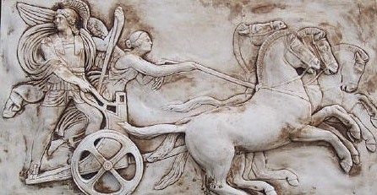
Human Psyche
Intellect (cognition)
Imagery
Attention/Will
Emotions
(affect)
Body (enaction)
Habits
Practices

Slide 28
MGA

Slide 29
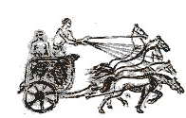
Structure of a Topic
Language Patterns
& prior Skills
Imagery/Sense-of/Awareness; Connections
Root Questions
predispositions
Different Contexts in which likely to arise;
dispositions
Standard Confusions
& Obstacles
Techniques & Incantations
Emotion
Awareness
Behaviour
Only Emotion is Harnessable
Only Awareness is Educable
Only Behaviour is Trainable
Only Attention can be Directed

Slide 30
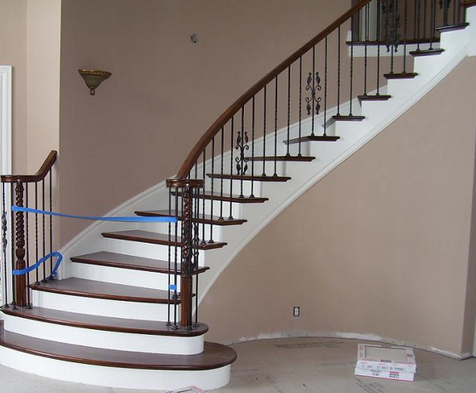
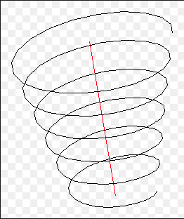
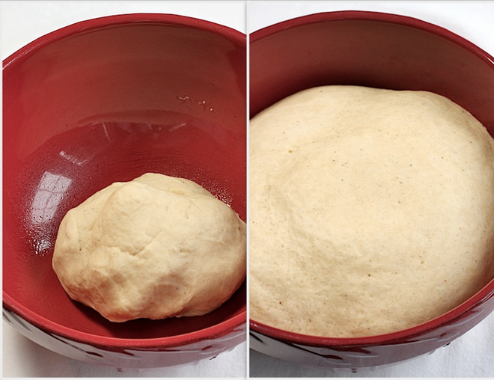
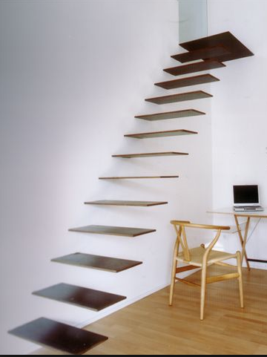

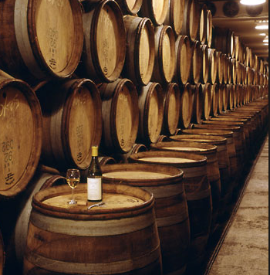
Conceptions of Learning
Staircase
Spiral
Maturation

Slide 31
Learning & Assessment
What is available to be learned?
What is discernible?
What relationships are recognisable?
What properties are perceiveable as being instantiated?
What reasoning is called upon?
What behaviour is accessible to assessment?
What is done?
What discernments, relationships and properties need to be present in order to perform?
What justifications are sought and given?
What learning is accessible to assessment?
What is discerned?
What relationships are recognised?
What properties are perceived as being instantiated?
What reasoning is displayed?

Slide 32
Reflection as Self-Explanation
What struck you during this session?
What for you were the main points (cognition)?
What were the dominant emotions evoked? (affect)?
What actions might you want to pursue further? (Awareness)
Notes:
Chi et al

Slide 33
Follow Up
John.Mason@open.ac.uk
Mcs.open.ac.uk/jhm3 go to Presentations
Questions & Prompts for Mathematical Thinking (ATM UK)
Thinking Mathematically (Pearson)
Designing & Using Mathematical Tasks (TarquinUK)
Researching Your Own Practice using the Discipline of Noticing (Routledge)

