Slide 1
Reasoning Reasonably in Mathematics
Promoting Mathematical Thinking
John Mason
Matematikbiennalen
Umeä Sweden
2014
The Open University
Maths Dept
University of Oxford
Dept of Education

Slide 2
Intentions
Participants will be invited to engage in reasoning tasks that can help students make a transition from informal reasoning to reasoning solely on the basis of agreed properties.
Background
Successful Reasoning Depends on making use of properties
This in turn depends on Types of Attention
Holding Wholes (gazing)
Discerning Details
Recognising Relationships
Perceiving Properties (as being instantiated)
Reasoning solely on the basis of agreed properties

Slide 3
Conjectures
Everything said here today is a conjecture … to be tested in your experience
The best way to sensitise yourself to learners …
is to experience parallel phenomena yourself
So, what you get from this session is what you notice happening inside you!
Principle Conjecture
Every child in school can reason mathematically
What often holds them back is lack of facility with numbers
So I look out for opportunities to reason that do not involve arithmetic

Slide 4
Actions
Inviting imagining before displaying
Pausing
Inviting re-construction/narration
Promoting and provoking generalisation
Working with specif properties explicitly

Slide 5
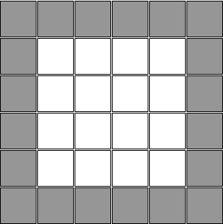
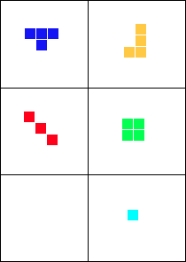
Revealing Shapes
How do you know?
Eg 2
Notes:
Imagine some shapes that could be used to tessellate the white region

Slide 6
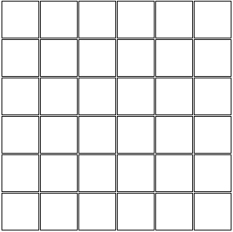
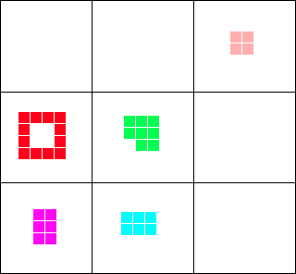
Revealing Shapes 2
How do you know?
Eg 14

Slide 7
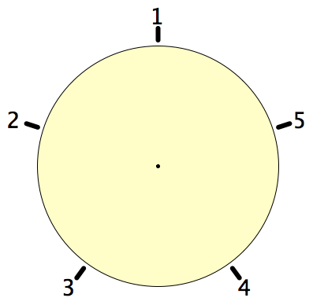
Secret Places
One of these five places has been chosen secretly.
You can get information by clicking on the numbers.
If the place where you click is the secret place, or next to the secret place, it will go red (hot), otherwise it will go blue (cold).
How few clicks can you make and be certain of finding the secret place?
Can you always find it in 2 clicks?
Notes:
Imagine a round table …

Slide 8
Magic Square Reasoning
What other configurations like this give one sum equal to another?
6
7
2
2
1
5
9
Try to describe them in words
2
8
3
4
Any colour-symmetric arrangement?
Sum(
)
–
Sum( )
= 0
Notes:
Think of all the patterns obtained like this one but with different choices of the red line and the blue line.
Sketch a few
Here is another reasoning
What about this pattern: is it true?
did you have difficulty recognising the components? This may be why learners find it hard to remember what they were taught recently!

Slide 9
More Magic Square Reasoning
Sum(
)
–
Sum( )
= 0

Slide 10
Set Ratios
In how many different ways can you place 17 objects so that there are equal numbers of objects in each of two possibly overlapping sets?
What about requiring that there be twice as many in the left set as in the right set?
What about requiring that the ratio of the numbers in the left set to the right set is 3 : 2?
What is the largest number of objects that CANNOT be placed in the two sets in any way so that the ratio is 5 : 2?
S₁
S₂
What can be varied?

Slide 11
Square Deductions
Each of the inner quadrilaterals is a square.
Can the outer quadrilateral be square?
15a = 6b
4(4a–b) = a+2b
4a–b
Acknowledge ignorance:
denote size of edge of smallest square by a;
4a
b
a+b
Adjacent square edge by b
a
To be a square:
7a+b = 5a+2b
3a+b
So 2a = b
2a+b

Slide 12
31: a game for two players
At each move you choose a whole number from 1 to 5.
Each chosen number is added to the running total. The first person to get the total to be 31 wins.
What is your (best) strategy?
How might you alter the game?

Slide 13
Perimeter Projections
Say What You See
Notes:
Imagine a rectangle

Slide 14
More Perimeter Projections

Slide 15
Bag Reasoning
Axiom: Every bean is in some bag.
Axiom: There are finitely many bags.
Definition: a bean b is loose in a bag B means that although b is in B, b is not in any bag that is in B.
Must every bean be loose in some bag? How do you know?
Definition: the number of beans in bag B is the total number of beans that would be loose in bag B if all the bags within B disintegrated.
How few beans are needed in order that for k = 1, 2, …, 5, there is exactly one bag with k beans?
What is the most beans there could be?
Can it be done with any number of beans between the least and the most?

Slide 16
What Do I know?
√2
(√2)² = 2
x² = 2 & x > 0 => x = √2
√3
(√3)² = 3
x² = 3 & x > 0 => x = √3
√3 – √2
X⁴ – 10x² + 1 = 0 & 1 > x > 0 ==> x = √3 – √2
√3 + √2
X⁴ – 10x² + 1 = 0 & x > 1 ==> x = √3 + √2

Slide 17
Covered Up Sums
Cover up one entry from each row and each column. Add up the remaining numbers.
The answer is (always) the same!
Why?
0
-2
2
-4
6
4
8
2
3
1
5
-1
Stuck?
Specialise!
1
-1
3
-3
Example of seeking invariant relationships
Example of focusing on actions preserving an invariance
Opportunity to generalise
Notes:
Use fractions to urge practice with fractions
Get students to make up their own with their age or some other number as the answer

Slide 18
Covered Up Sums
How much freedom of choice do you have when making up your own?
a
b
c
d
a
e
b
e
a
b
f
c
f
?
g
d
e
e-(a-b)
g
Opportunity to generalise
Opportunity to quantify freedom of choice
Notes:
Use fractions to urge practice with fractions
Get students to make up their own with their age or some other number as the answer

Slide 19
Reasoning Conjectures
What blocks children from displaying reasoning is often lack of facility with number.
Reasoning mathematically involves seeking and recognsing relationships, then justifying why those relationships are actually properties that always hold.
Put another way, you look for invariants (relationships that don’t change) and then express why they must be invariant.
A task like Cover up can be used to get children to practice adding (you could use fractions or decimals!) while trying to work out what is happening, or even while trying to construct their own!

Slide 20
Closer
8 < √72.3 < 9
Is √72.3 closer to 8 or to 9?

Slide 21
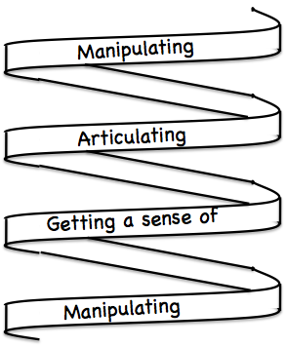
Frameworks
Doing – Talking – Recording (DTR)
(MGA)
See – Experience – Master (SEM)
Enactive – Iconic – Symbolic (EIS)
Specialise … in order to locate structural relationships …
then re-Generalise for yourself
Stuck?
What do I know?
What do I want?

Slide 22
Mathematical Thinking
How describe the mathematical thinking you have done so far today?
How could you incorporate that into students’ learning?

Slide 23
Actions
Inviting imagining before displaying
Pausing
Inviting re-construction/narration
Promoting and provoking generalisation
Working with specific properties explicitly

Slide 24
Possibilities for Action
Trying small things and making small progress; telling colleagues
Pedagogic strategies used today
Provoking mathematical thinking as happened today
Question & Prompts for mathematical Thinking (ATM)
Group work and Individual work

Slide 25
Follow Up
j.h.mason @ open.ac.uk
mcs.open.ac.uk/jhm3 → Presentations
Questions & Prompts (ATM)
Key ideas in Mathematics (OUP)
Learning & Doing Mathematics (Tarquin)
Thinking Mathematically (Pearson)
Developing Thinking in Algebra

