Slide 1
Responsive & Responsible Teaching: so, what is your theory?
Promoting Mathematical Thinking
Mathematics Education Research and Mathematics Teaching: Illusions, Reality, and Opportunities
John Mason Brock
May 2013
The Open University
Maths Dept
University of Oxford
Dept of Education

Slide 2
Questions
What research informs mathematics teaching?
How does this research come to be put into practice?
What are the issues and gaps?

Slide 3
Teaching …
Reactive
Habit-driven practices
Responsive
Flexible; craft
Reflective
Aware of choices being made;
Trying to learn from experience
Responsible
Articulating reasons for choices

Slide 4
What research informs mathematics teaching?
He who loves practice without theory is like the sailor who boards ship without a rudder and compass and never knows where he may cast. Practice always rests on good theory. (Leonardo Da Vinci)
It is only after you come to know the surface of things that you venture to see what is underneath; But the surface of things is inexhaustible (Italo Calvino: Mr. Palomar)

Slide 5
Roles for Theory in Mathematics Education
Discourse for describing
Discourse for analysing
Discourse for noticing phenomena, possibilities
Discourse for bringing to mind alternative actions
Discourse for predicting (positively; negatively)
Discourse for impressing principals, heads, parents and inspectors

Slide 6
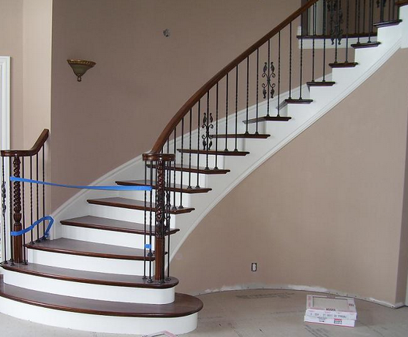
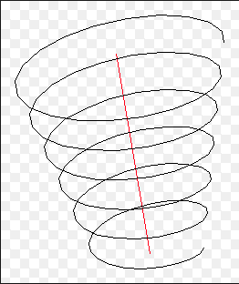
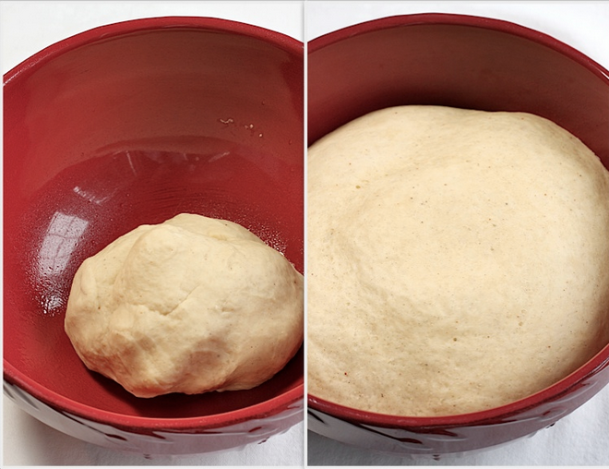
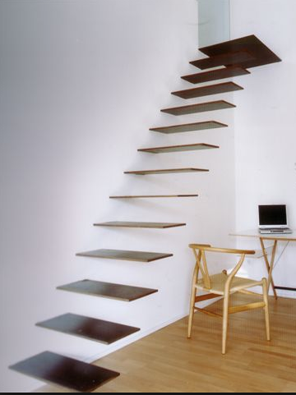
Theories (Ways of Perceiving) Learning
Staircase
Spiral
Maturation

Slide 7
http://cmapspublic3.ihmc.us/rid=1LGVGJY66-CCD5CZ-12G3/Learning%20Theory.cmap
Notes:
http://cmapspublic3.ihmc.us/rid=1LGVGJY66-CCD5CZ-12G3/Learning%20Theory.cmap

Slide 8
What research informs mathematics teaching?
Papers/Sessions …
which provoke attempts to articulate assumptions and values …
So as to bring these to the surface and open to question
which support development of discerning discourse (responsible teaching)
which offer specific practices that participants can imagine carrying out in their own situation

Slide 9
How does this research come to be put into practice?
Resonance & Dissonance
Being able to imagine oneself acting freshly
Working at refreshing the desire and sensitising oneself to the opportunity to act freshly

Slide 10
What are the issues and gaps?
Mediation
Between researchers and policy makers
Between researchers and teachers
Key Ideas in Teaching Mathematics: research-based guidance for ages 9-19
Access to Structure of a Topic
Originating problems
Applications; types of use
Core awarenesses, images and connections
Classic errors and misconceptions
Language patterns (inner & outer) and relation to natural language
Techniques & Incantations
Awarenesses
SoaT

Slide 11
What is a ‘research finding’?
“Subjects can’t …”
→ Subjects didn’t
→ Alerted to Epistemological & Pedagogical Obstacles
“What works”
What seemed to work
What were the conditions?
Situation didiactique
What was the lived experience?
Phenomenon
Task-Exercises
To alert to issue
To provide vocabulary
To suggest possible actions

Slide 12
Proportional Reasoning
If 3 books cost $36, what will 7 books cost?
If 3 books cost $36, what will 12 books cost?
Functional Thinking
Scalar Thinking
1 book costs $12 so 7 books cost $12 x 7
3 books cost $36 so 12 books cost $36 x 4
Probe:
Probe:
What is the 12?
What is the 4?
$ per book
Scale Factor
Notes:
What students don’t do → Being alerted to epistemological & pedagogocal obstacles

Slide 13
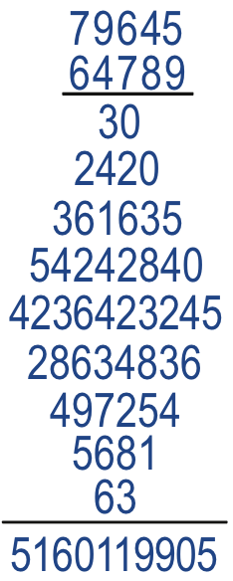
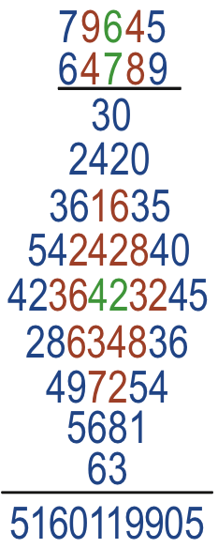
Diamond Multiplication
Holding Wholes (gazing)
Discerning Details
Recognising relationships
Perceiving Properties
Reasoning on the basis of
agreed properties
States to look out for
in yourself
in students

Slide 14
Roles of Researchers
To discern phenomena (of importance!)
To suggest discourse for distinctions
To associate possible actions with those distinctions
To challenge assumptions
As soon as discourse becomes widespread, to introduce fresh discourse to act against trivialisation and the drift to ‘surface interpretations’

Slide 15
Core Awarenesses
Enumeration, Counting, Counting-On, Measure
Multiple meanings eg: a/b
Divide, answer to a division, fraction as operator, fraction as object, value of fraction, value of ratio, …
Changes in meaning over time eg: number
Exchange as central construct to maths

Slide 16
Pre-Counting
I have a pile of blue counters and you have lots of red ones
I want to exchange each of my blue counters for one of your red counters.
What is involved in carrying out the exchange?
How might you ‘lay out the action’ so as to make it easy to see that the exchange has been correctly done?

Slide 17
Arithmetic of Exchange
I have a pile of blue counters. I am going to exchange each for 2 of your red counters…
What mathematical action is taking place on the cardinalities?
I exchange 7 of my blues for 1 of your reds until I can make no more exchanges …
What mathematical action is taking place?
I exchange 5 of my blues for 2 of your reds until I can make no more exchanges …
What mathematical action is taking place?
I exchange 10 blues for 1 red and 10 reds for 1 yellow as far as possible …
What mathematical action is taking place?
What language patterns accompany these actions?
Notes:
First action looks like sacaling if you attend to the exchange and like repeated addition if you attend to the accumulation of reds.
----- Meeting Notes (04/12/2012 18:03) -----
Fairness
if you start with a one-to-one matching, then one for two looks like division!
Role of layout

Slide 18
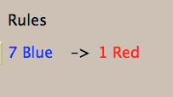
Exchange
What’s the generality?
Notes:
Compare with ‘money’
Flexibility (size isn’t everything)

Slide 19
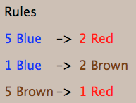
More Exchange
What’s the generality?
Notes:
Place Value is based on exchange

Slide 20
Perimeter Projections
Say What You See

Slide 21
Task Design & Use
Re-flection & Pro-flection
Content
Task
Activity
Potential
Actions
Structure of a Topic
Inner & Outer
Themes
Effectiveness of actions
Powers
3 Only’s
Balance
Interaction
7 phases
Teacher
Peers
6 Modes
Roles
Questioning

Slide 22
Teacher Focus
Teacher-Student interaction
Teacher-Mathematics interaction
Student-Mathematics interaction
Language/technical terms
Examples, Images &
Representations
Enactive Obstacles
Origins
Applications & Uses
Affective Obstacles
Cognitive Obstacles:
common errors, …
Methods & Procedures

Slide 23
Actions
Right-multiplying by an inverse ...
Making a substitution
Differentiating
Iterating
Reading a graph
Invoking a definition
…

Slide 24
Themes
Doing & Undoing
Invariance in the midst of change
Freedom & Constraint
Restricting & Extending

Slide 25
Powers
Imagining & Expressing
Specialising & Generalising (Stressing & Ignoring)
Conjecturing & Convincing
(Re)-Presenting in different modes
Organising & Characterising

Slide 26
Inner & Outer Aspects
Outer
What task actually initiates explicitly
Inner
What mathematical concepts underpinned
What mathematical themes encountered
What mathematical powers invoked
What personal propensities brought to awareness

Slide 27
Challenge
Appropriate Challenge:
Not too great
Not too little
Scope depends on student trust of teacher
Scope depends on teacher support of mathematical thinking not simply getting answers

Slide 28
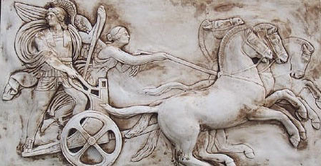
Structure of a Topic
Awareness (cognition)
Imagery
Will
Emotions (affect)
Body (enaction)
Habits Practices

Slide 29
Three Only’s
Language Patterns & prior Skills
Imagery/Sense-of/Awareness; Connections
Root Questions
predispositions
Different Contexts in which likely to arise; dispositions
Standard Confusions & Obstacles
Techniques & Incantations
Emotion
Awareness
Behaviour
Only Emotion is Harnessable
Only Awareness is Educable
Only Behaviour is Trainable

Slide 30
Phases
Getting Started
Initiating
Getting Involved
Mulling
Keeping Going
Sustaining
Insight
Being Sceptical
Concluding
Contemplating

Slide 31
Six Modes of Interaction
Initiating
Sustaining
Concluding
Expounding
Explaining
Exploring
Examining
Exercising
Expressing

Slide 32
Initiating Activity
Silent Start
Particular (to general); General (via particular) Semi-general (via particular to general)
Worked example
Use/Application/Context
Specific-Unspecific
Manipulating:
Material objects (eg cards, counters, …)
Mental images (diagrams, phenomena)
Symbols (familiar & unfamiliar)

Slide 33
Sustaining Activity
Questions & Prompts
Directed–Prompted–Spontaneous Scaffolding & Fading
Energising (praising-challenging)
Conjecturing
Sharing progress/findings

Slide 34
Concluding Activity
Conjectures with evidence
Accounts that others can understand
Reflecting on effective & ineffective actions
Aspcts of inner task (dispositions, …)
Imagining acting differently in the future

Slide 35
Balanced Activity
Affordances
Constraints
Attunements
Outer Task
Inner Task
Intended & Enacted
goals
Implicit
goals
Ends
Ends
Resources
Tasks
Resources
Tasks
Means
Means
Current State
Current State

Slide 36
Expounding
Explaining
Exploring
Examining
Exercising
Expressing

Slide 37
Teacher
Student
Content
Student
Teacher
Student
Content
Content
Teacher
Expounding
Exploring
Exercising
Teacher
Student
Content
Content
Content
Teacher
Student
Teacher
Student
Explaining
Examining
Expressing

Slide 38
Activity
Goals, Aims, Desires, Intentions
Resources: (physical, affective cognitive, attentive)
Tasks (as imagined, enacted, experienced,
…)
Initial State
Affordances– Constraints–Requirements
(Gibson)

Slide 39
Potential
What builds on it (where it is going)
Most it could be
Math’l & Ped’c essence
Least it can be
What it builds on
(previous experiences)
Affordances– Constraints–Requirements
(Gibson)
Directed–Prompted–Spontaneous
Scaffolding & Fading (Brown et al)
ZPD (Vygotsky)
Notes:
Role of reflection in achieving affordances

Slide 40
Thinking Mathematically
CME
Do-Talk-Record (See–Say–Record)
See-Experience-Master
Manipulating–Getting-a-sense-of–Artculating
Enactive–Iconic–Symbolic
Directed–Prompted–Spontaneous
Stuck!: Use of Mathematical Powers
Mathematical Themes (and heuristics)
Inner & Outer Tasks

Slide 41
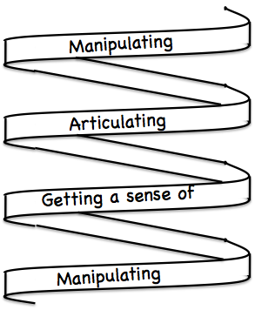
Frameworks
Enactive– Iconic– Symbolic
Doing – Talking – Recording
See – Experience – Master

Slide 42
Follow-Up
Designing & Using Mathematical Tasks (Tarquin/QED)
Thinking Mathematically (Pearson)
Developing Thinking in Algebra, Geometry, Statistics (Sage)
Fundamental Constructs in Mathematics Education (RoutledgeFalmer)
Mathematics Teaching Practice: a guide for university and college lecturers (Horwood Publishing)
Mathematics as a Constructive Activity (Erlbaum)
Questions & Prompts for Mathematical Thinking (ATM)
Thinkers (ATM)
Learning & Doing Mathematics (Tarquin)
Researching Your Own Practice Using The Discipline Of Noticing (RoutledgeFalmer)
j.h.mason @ open.ac.uk
mcs.open.ac.uk/jhm3

Slide 43
Contact
j.h.mason @ open.ac.uk
mcs.open.ac.uk/jhm3

