Slide 1




Noticing
Promoting Mathematical Thinking
John Mason
Stockholm
May 2013
The Open University
Maths Dept
University of Oxford
Dept of Education

Slide 2
It is only after you come to know
the surface of things
that you venture to see what is underneath;
But the surface of things is inexhaustible
(Italo Calvino)
He who loves practice without theory
is like the sailor
who boards ship without a rudder and compass
and never knows where he may cast.
Practice always rests on good theory.
(Leonardo Da Vinci)

Slide 3
Say What You See

Slide 4
Say What You See

Slide 5
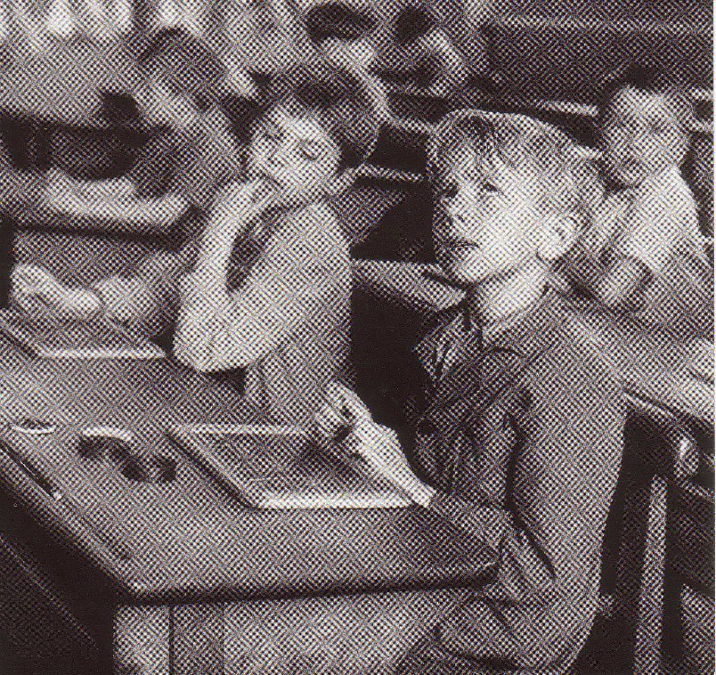
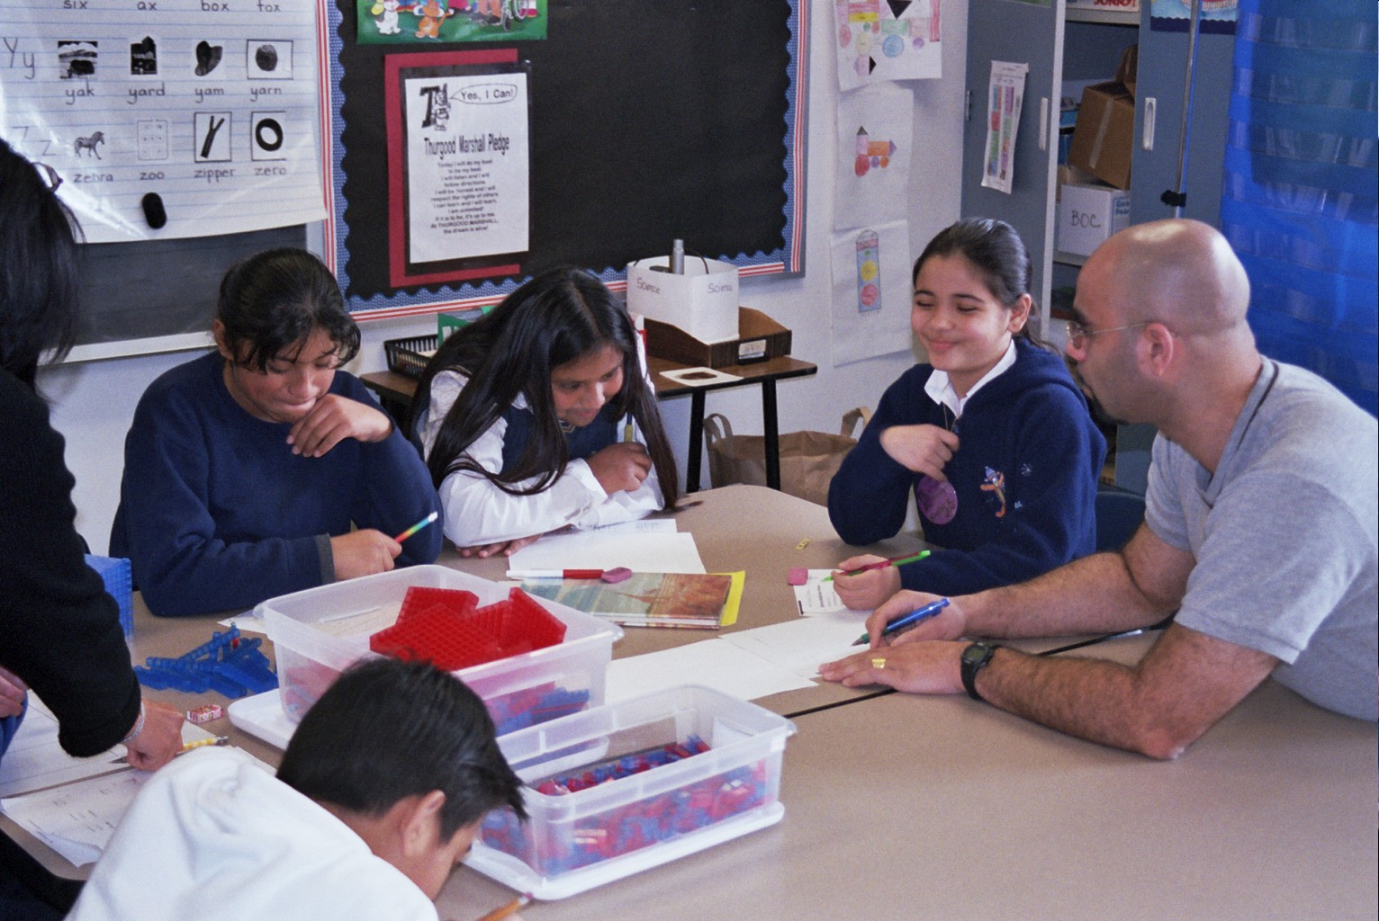
Say What You See

Slide 6
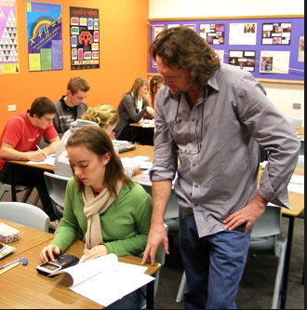
Say What You See

Slide 7
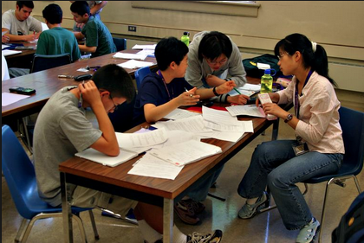
Say What You See

Slide 8

Say What You See
Compare the areas covered by the three colours
Max Bill (artist)

Slide 9
Gasket Sequences

Slide 10
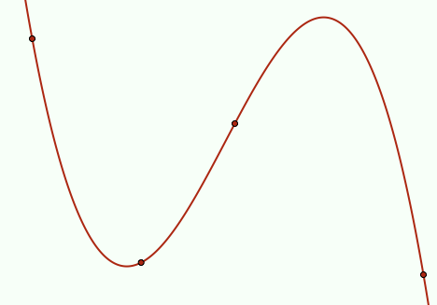
Say What You See
(x – b)(x – c)(x – d)
(x – c)(x – d)(x – a)
y =
A
+
B
(a – b)(a – c)(a – d)
(b – c)(b – d)(b – a)
(x – d)(x – a)(x – b)
(x – a)(x – b)(x – c)
+
C
+
D
(c – d)(c – a)(c – b)
(d – a)(d – b)(d – c)
(a, A)
(c, C)
(b, B)
(d, D)

Slide 11
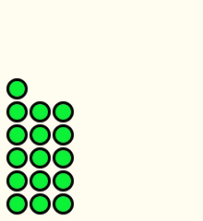
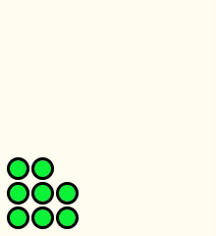
Pebble Arithmetic

Slide 12
Observations About Observations
A name or label immediately shapes what is seen and what is recalled
Frederick Bartlett 1932
Observation is theory laden
George Hanson 1958
We want our theories to be as fact
laden as our facts are theory laden
Nelson Goodman 1978

Slide 13
Reporting Data
Accounting For
Account of
“They couldn’t …”
“They can’t”
“They didn’t display
evidence of …”
“They don’t display
evidence of …”
“I didn’t detect
evidence of …”
“I don’t detect
evidence of …”

Slide 14
Conjectures
Events consist of the stories told
The more precisely the data is specified
and
the more precise the analysis …
… the more we learn about the researcher’s sensitivities to notice
and access to discourse to describe

Slide 15
Protases
I cannot change others;
I can work at changing myself
To express is to over stress
One thing we do not seem to learn from experience …
… is that we do not often learn from experience alone

Slide 16
Natural Epistemology
Noticing – Marking – Recording
Conjecturing
Resonance seeking
  with own experience
  with others
Validity found in
  use by local community of practice
  own future practices informed
Avoid the teaching of
speculators,
whose judgements are
not confirmed
by experience.
(Leonardo Da Vinci)

Slide 17
Systematic Reflection
Keeping
Accounts
Seeking
Threads
Recognising Choices
Distinguishing
Choices
Accumulating
Alternatives
Preparing & Noticing
Identifying & labelling
Imagining
Possibilities
Noticing
Possibilities
Validating with Others
Describing
Moments
Refining
Exercises

Slide 18
Specting
Introspective
Intraspective
Extraspective
Interspective

Slide 19
Essence of Discipline of Noticing
Systematic Reflection
  Past (accounts-of not accounting-for)
Preparing & Noticing
  For Future & Present
Recognising Choices
  Could-have & Could-be
  (not should have or should be)
Validating
  for Self & with Others

Slide 20
Interwoven Worlds
Own
world of experience
Colleague's
world of experience
Reflecting
Trying
Seeking
resonance
Recognising
Possibilities
with others
Preparing
Expressing
World of observations
& theories

Slide 21
The universe is a mirror
in which we can contemplate
only
what we have learned
to know about ourselves
(Italo Calvino)

Slide 22
Adam can get irritable
and moody at times,
so I secretly replaced
his caffeinated coffee
with decaff
Let’s see if he notices
I guess technically
to notice something
you have to be awake

Slide 23
Follow Up
Mason, J. (2002). Researching Your own Practice: The Discipline of Noticing, London: RoutledgeFalmer.
Selected Articles
Mason, J. (2011). Noticing: roots and branches. In M. Sherin & R. Philips. Mathematics Teacher Noticing: Seeing Through Teachers’ Eyes. p.35-50. Mahwah: Erlbaum.

