Slide 1
Exploiting Exercises so as to Enrich Procedural Fluency with Conceptual Appreciation
Promoting Mathematical Thinking
John Mason
OAME Workshop Brock, May 23 2013
The Open University
Maths Dept
University of Oxford
Dept of Education

Slide 2
Outline
Throat Clearing
Work on Exercises
Reflection

Slide 3
Throat Clearing
Conjectures
Everything said is a conjecture, uttered in order to externalise it, consider it, and modify it on the basis of people’s responses
It’s not the task that is rich, but the way that the task is used
Exercising is only one of six fundamental modes of interaction between Mathematics, Learner & Teacher
It requires an upwelling of desire generated, as it were, by the mathematics, experienced by the learner and mediated by the teacher (setting the tasks)
Didactic Contract: if learners attempt the tasks, the required learning will happen

Slide 4
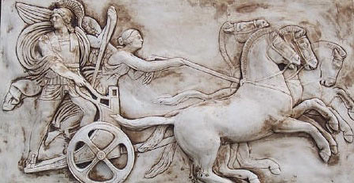
Making Use of the Whole Psyche
Assenting & Asserting
Awareness (cognition)
Imagery
Will
Emotions (affect)
Body (enaction)
Habits Practices

Slide 5
Probing Affordances & Potential
Cognitive
What images, associations, alternative presentations?
What is available to be learned (what is being varied, what is invariant)?
Behavioural
What technical terms used or useful
What inner incantations helpful?
What specific techniques called upon and developed?
Affective (dispositions & purpose/utility)
Where are the techniques useful?
How are exercises seen by learners (epistemic stances)
Attention-Will
What was worth stressing and what ignoring?
What properties called upon
What relationships recognised?

Slide 6
Strategies for Use with Exercises
Sort collection of different contexts, different variants, different parameters
Characterise odd one out from three instances
Put in order of anticipated challenge
Do as many as you need to in orer to be ble to do any question of this type
Construct (and do) an Easy, Hard, Peculiar and where possible, General task of this type
Decide between appropriate and flawed solutions
Describe how to recognise a task ‘of this type’; Tell someone ‘how to do a task of this type’
What are tasks like these accomplishing (narrative about place in mathematics)

Slide 7
Reflection Strategies
What technical terms involved?
What concepts called upon?
What mathematical themes encountered?
What mathematical powers used (and developed)?
What links or associations with other mathematical topics or techniques?

Slide 8
Learner Actions

Slide 9
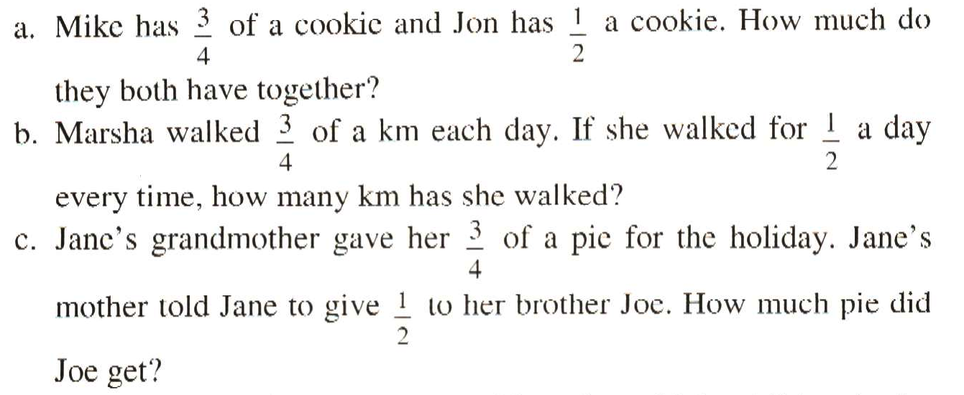
¾ and ½
What distinguishes each from the other two?
What ambiguities might arise?
What misconceptions or errors might surface?

Slide 10
Mini Booklet Folding

Slide 11
Ratio Division
To divide $100 in the ratio of 2 : 3
2 : 3
…
…
2 : 3
2
3
2
3
2 : 3
2
3
2
3
2 : 3
…
2 : 3
…
…
…
…
…
1
1
1
1
1
1
1
1
1
1
1
1
1
1
1
1
1
1
1
1
What is the same, and what different about these three approaches?

Slide 12
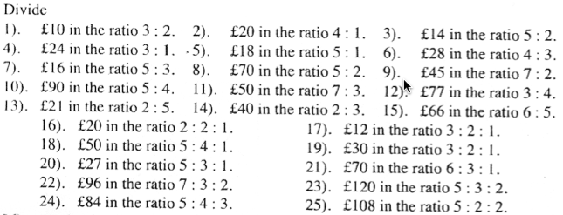
Revision of Ratio Division (yr 10)
After 15 minutes, what question might learners be working on?
What is achieved by ‘doing’ all of these?
What else could be done with these?
Notes:
TenTicks

Slide 13
Exploring Ratio Division
The number 15 has been divided in some ratio and the parts are both integers. In how many different ways can this be done? Generalise!
If some number has been divided in the ratio 3 : 2, and one of the parts is 12, what could the other part be? Generalise!
If some number has been divided in the ratio 5 : 2, and the difference in the parts is 6, what could the original number have been? Generalise!

Slide 14
What is being varied?
Is this a triangle?
What can be done with these exercises?
Notes:
TenTicks

Slide 15
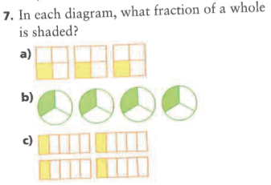
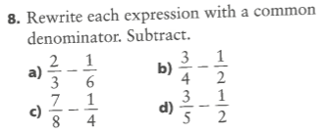
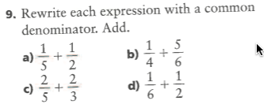
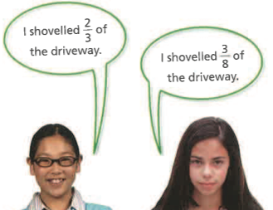
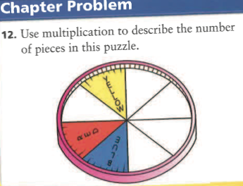
Ontario Grade 7

Slide 16
Raise your hand when you can see …
Something that is 3/5 of something else
Something that is 2/5 of something else
Something that is 2/3 of something else
Something that is 5/3 of something else
What other fractional actions can you see?

Slide 17
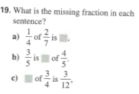
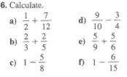
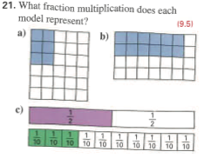
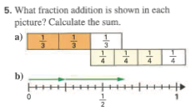
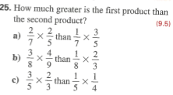
Ontario MHR Practice Qns Ch 9 p307 Grade 8

Slide 18
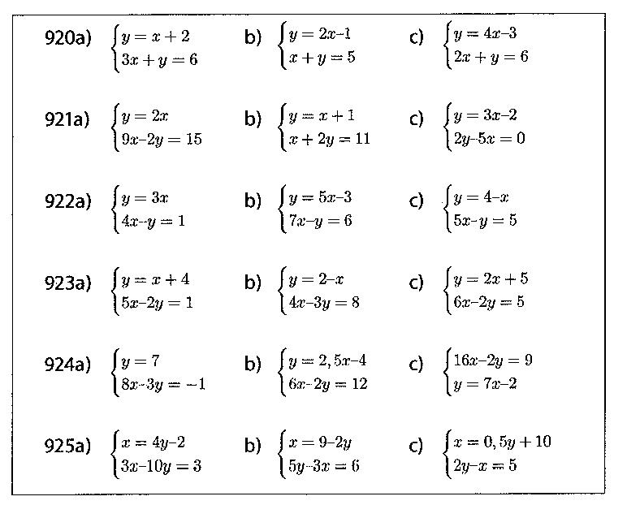
Adapted from Häggström (2008 p90)
Notes:
Bury the Bone!

Slide 19
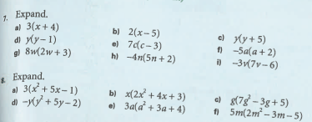
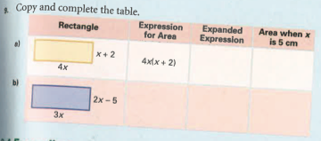
Grade 9 Applied

Slide 20
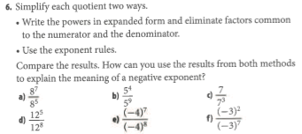
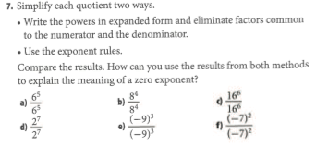
Powers
How long is a micro-century?
Ontario Grade 11
Notes:
Invitation to tell a mathematical story
Usurps the students’ power to speciailise for themselve!

Slide 21
Theoretical Background

Slide 22
Task Design & Use
Re-flection & Pro-flection
Content
Task
Activity
Potential
Actions
Structure of a Topic
Inner & Outer
Themes
Effectiveness of actions
Powers
3 Only’s
Balance
Interaction
7 phases
Teacher
Peers
6 Modes
Roles
Questioning

Slide 23
Teacher Focus
Teacher-Student interaction
Teacher-Mathematics interaction
Student-Mathematics interaction
Language/technical terms
Examples, Images &
Representations
Enactive Obstacles
Origins
Applications & Uses
Affective Obstacles
Cognitive Obstacles:
common errors, …
Methods & Procedures

Slide 24
Actions
Right-multiplying by an inverse ...
Making a substitution
Differentiating
Iterating
Reading a graph
Invoking a definition
…

Slide 25
Themes
Doing & Undoing
Invariance in the midst of change
Freedom & Constraint
Restricting & Extending

Slide 26
Powers
Imagining & Expressing
Specialising & Generalising (Stressing & Ignoring)
Conjecturing & Convincing
(Re)-Presenting in different modes
Organising & Characterising

Slide 27
Inner & Outer Aspects
Outer
What task actually initiates explicitly
Inner
What mathematical concepts underpinned
What mathematical themes encountered
What mathematical powers invoked
What personal propensities brought to awareness

Slide 28
Challenge
Appropriate Challenge:
Not too great
Not too little
Scope depends on student trust of teacher
Scope depends on teacher support of mathematical thinking not simply getting answers

Slide 29
Structure of a Topic
Awareness (cognition)
Imagery
Will
Emotions (affect)
Body (enaction)
Habits Practices

Slide 30
Three Only’s
Language Patterns & prior Skills
Imagery/Sense-of/Awareness; Connections
Root Questions
predispositions
Different Contexts in which likely to arise; dispositions
Standard Confusions & Obstacles
Techniques & Incantations
Emotion
Awareness
Behaviour
Only Emotion is Harnessable
Only Awareness is Educable
Only Behaviour is Trainable

Slide 31
Phases
Getting Started
Initiating
Getting Involved
Mulling
Keeping Going
Sustaining
Insight
Being Sceptical
Concluding
Contemplating

Slide 32
Six Modes of Interaction
Initiating
Sustaining
Concluding
Expounding
Explaining
Exploring
Examining
Exercising
Expressing

Slide 33
Initiating Activity
Silent Start
Particular (to general); General (via particular) Semi-general (via particular to general)
Worked example
Use/Application/Context
Specific-Unspecific
Manipulating:
Material objects (eg cards, counters, …)
Mental images (diagrams, phenomena)
Symbols (familiar & unfamiliar)

Slide 34
Sustaining Activity
Questions & Prompts
Directed–Prompted–Spontaneous Scaffolding & Fading
Energising (praising-challenging)
Conjecturing
Sharing progress/findings

Slide 35
Concluding Activity
Conjectures with evidence
Accounts that others can understand
Reflecting on effective & ineffective actions
Aspcts of inner task (dispositions, …)
Imagining acting differently in the future

Slide 36
Balanced Activity
Affordances
Constraints
Attunements
Outer Task
Inner Task
Intended & Enacted
goals
Implicit
goals
Ends
Ends
Resources
Tasks
Resources
Tasks
Means
Means
Current State
Current State

Slide 37
Expounding
Explaining
Exploring
Examining
Exercising
Expressing

Slide 38
Teacher
Student
Content
Student
Teacher
Student
Content
Content
Teacher
Expounding
Exploring
Exercising
Teacher
Student
Content
Content
Content
Teacher
Student
Teacher
Student
Explaining
Examining
Expressing

Slide 39
Activity
Goals, Aims, Desires, Intentions
Resources: (physical, affective cognitive, attentive)
Tasks (as imagined, enacted, experienced,
…)
Initial State
Affordances– Constraints–Requirements
(Gibson)

Slide 40
Potential
What builds on it (where it is going)
Most it could be
Math’l & Ped’c essence
Least it can be
What it builds on
(previous experiences)
Affordances– Constraints–Requirements
(Gibson)
Directed–Prompted–Spontaneous
Scaffolding & Fading (Brown et al)
ZPD (Vygotsky)
Notes:
Role of reflection in achieving affordances

Slide 41
Thinking Mathematically
CME
Do-Talk-Record (See–Say–Record)
See-Experience-Master
Manipulating–Getting-a-sense-of–Artculating
Enactive–Iconic–Symbolic
Directed–Prompted–Spontaneous
Stuck!: Use of Mathematical Powers
Mathematical Themes (and heuristics)
Inner & Outer Tasks

Slide 42
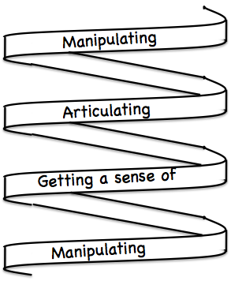
Frameworks (틀)
Enactive– Iconic– Symbolic
Doing – Talking – Recording
See – Experience – Master

Slide 43
Follow-Up
Designing & Using Mathematical Tasks (Tarquin/QED)
Thinking Mathematically (Pearson)
Developing Thinking in Algebra, Geometry, Statistics (Sage)
Fundamental Constructs in Mathematics Education (RoutledgeFalmer)
Mathematics Teaching Practice: a guide for university and college lecturers (Horwood Publishing)
Mathematics as a Constructive Activity (Erlbaum)
Questions & Prompts for Mathematical Thinking (ATM)
Thinkers (ATM)
Learning & Doing Mathematics (Tarquin)
Researching Your Own Practice Using The Discipline Of Noticing (RoutledgeFalmer)
j.h.mason @ open.ac.uk
mcs.open.ac.uk/jhm3

