Slide 1




Celebrating Human Powers and
Using Them to Think Mathematically
Promoting Mathematical Thinking
John Mason
MaST Celebration
Northampton
April 2013
The Open University
Maths Dept
University of Oxford
Dept of Education

Slide 2
Conjectures
Everything said here today is a conjecture … to be tested in your experience
Arithmetic is the study of
  Actions on numbers
  Properties of those actions …
    and hence properties of numbers
Calculations are a by-product
The best way to sensitise yourself to learners
  is to experience parallel phenomena yourself
So, what you get from this session is what you notice happening inside you!

Slide 3
Outline
Lesson without opportunity to use powers, especially generalising …
Importance of working together ON MATHEMATICS in order to remain sensitive to learner’s lived experience.
Pre-counting
Counting
Fractions
When does algebraic thinking begin?

Slide 4

Repeating Patterns
5.0 yrs
5.1 yrs
model
4.1 yrs
5.4 yrs
Marina Papic (2007)

Slide 5
Say What You See (SWYS)
Where did you start?:
Specific squares
‘at the beginning’?
Analyse ‘pattern’?
‘Bottom up’
(details)
‘Top down’?
(overview)
Different propensities:
Become aware so as to
Develop flexibility

Slide 6
Copying with Exchange
Make a copy but exchange:
Yellow for Blue;
Red for Green;
Blue for Red
First Action:
How did you do that?
First square that your attention discerned?
Analyse ‘pattern’ first?
Discerning colours?
Recognising positions (relationships)?
Once repeating pattern established …

Slide 7
Skip Counting
Use of mental imagery?
1 2 3 4
A taste of obstacles to counting?
2 3 4 5
Split attention?
3 4 5 6
4 5 6 7
Pattern?
…
Start at 101;
count down in steps of
Rhythm?
A taste of obstacles to counting?
Trained Behaviour?
Notes:
Similar to Fizz-Buzz in the movements of attention

Slide 8
How Many Rectangles Can You Discern?
FIRST:
Say What You See (SWYS)
You need to discern what it is you are to count!
Notes:
Tangrams could help develop flexibility, but this is the’ undoing’ of a tangram ‘doing’
To count it is necessary to discern; when children count incorrectly, perhaps they are not discerning stably?

Slide 9
Working with Patterns
…
A repeating pattern has appeared at least twice
…
Extend both sequences
What colour will the 100th square be in each?
What square will have the 37th green square in each?
At what squares will the first of a pair of greens in the second sequence align with a green in the first sequence?
What colour should the missing square be?
…

Slide 10
Pattern Continuation
Notes:
Clapping
Pattern wheels
What happens if/when the horizontals match the verticals?.

Slide 11
What’s The Difference?
–
=
First, add one to each
What then
would be
the difference?
What then
would be
the difference?
First,
add one to the larger and subtract one from the smaller
What could
be varied?
Notes:
• 153 – 87 = ? Orally; visibly;
•That is arithmetic; Now let’s do some mathematics!
Two volunteers: think of a three digit number and a two digit number.
• We’re going to subtract the smaller from the larger but before we do, lets add one to both.
What’s the difference now?

Slide 12
Don’t be So Negative!
The driver did not deny that he refrained from avoiding the prevention of the failure to miss flattening the badger”
Was the badger flattened or not?
The driver did not deny
that he refrained from avoiding
the prevention of the failure
to miss flattening the badger
it happened:
it happened;
it happened;
the badger was safe!
Make up your own!
Ilam Samson DeMathtifying Demystifying Maths p98 (Tarquin)

Slide 13
Raise your hand up when you can see …
Something that is 3/5 of something else
Something that is 2/5 of something else
Something that is 2/3 of something else
Something that is 5/3 of something else
What other fractional actions can you see?

Slide 14
Stepping Stones
Raise your hand when you can see
something that is 1/4 – 1/5
of something else
R
…
What needs to change so as to ‘see’ that
…
R+1

Slide 15
SWYS

Slide 16
Describe to Someone How to See something that is …
1/3 of something else
1/5 of something else
1/7 of something else
1/15 of something else
1/21 of something else
1/35 of something else

Slide 17
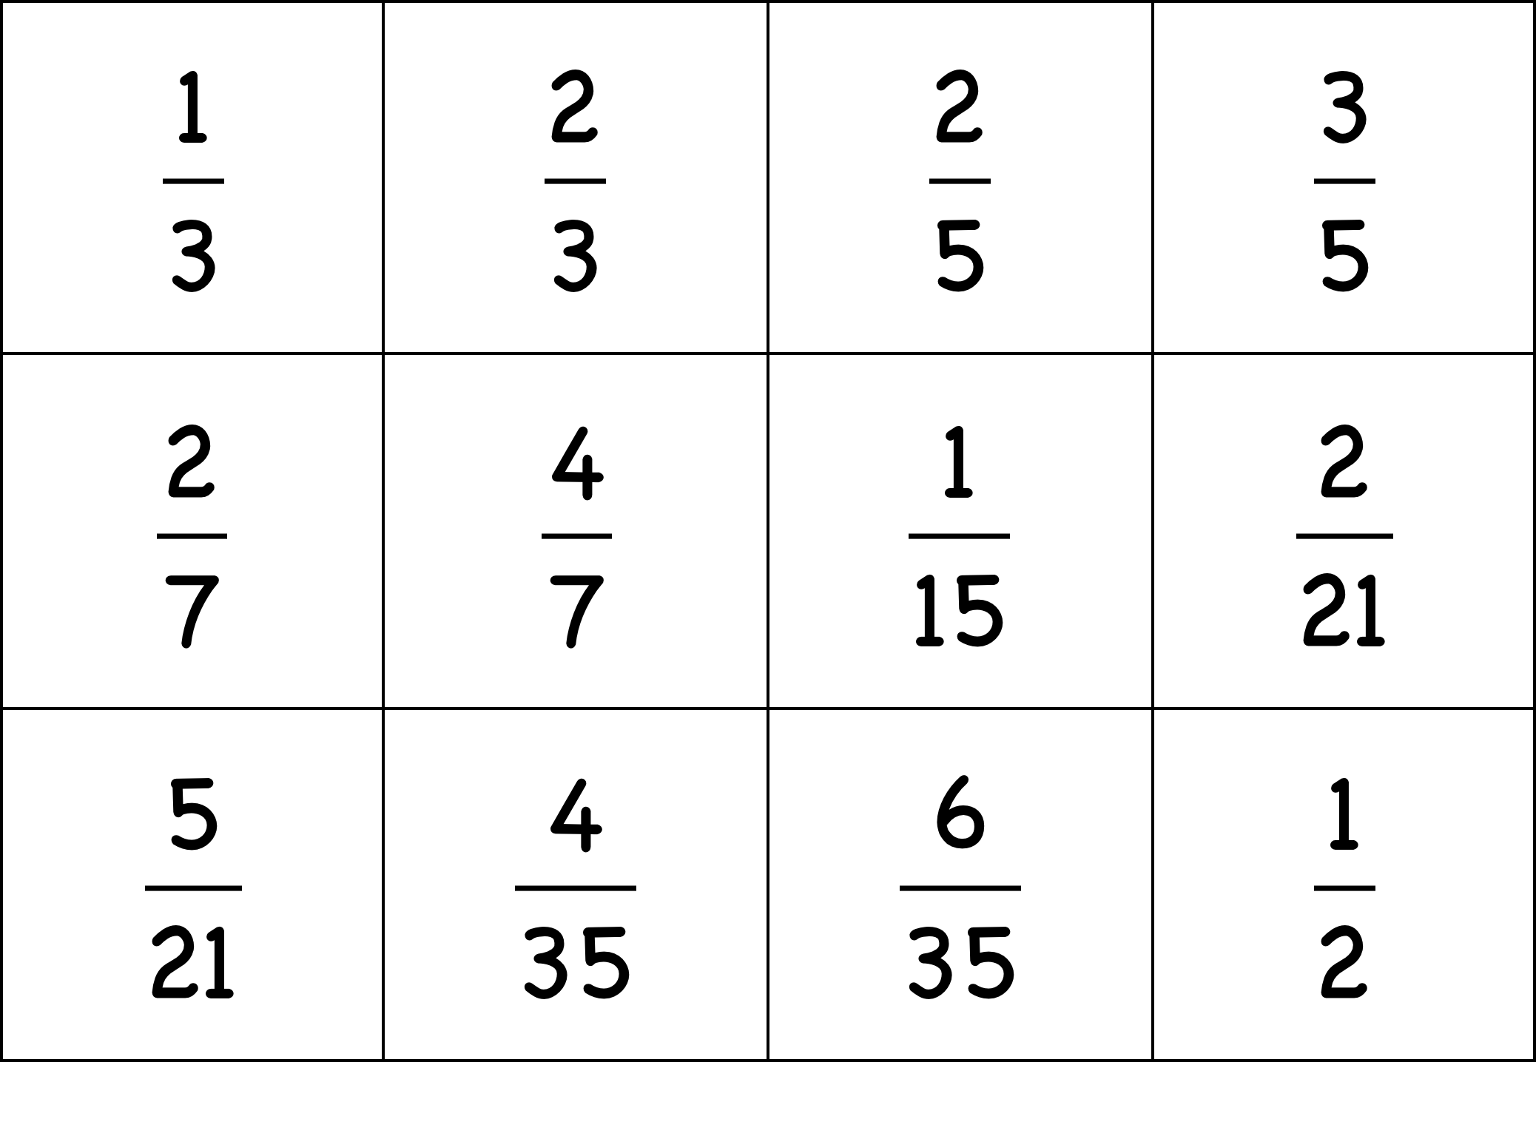
Sorts of Sorts
Sort them into two classes
Make up another one for each of your classes
Notes:
Sorting and Matching tasks reveal a good deal about what learners are attending to.
Construction tasks are even more revealing

Slide 18
Sorts of Sorts
Make up a set of 6 fractions which you think other people will not put correctly in number-line order
Put your fraction cards in numberline order
Notes:
Sorting and Matching tasks reveal a good deal about what learners are attending to.
Construction tasks are even more revealing

Slide 19
Sorts of Relationships
How many different multiplicative relations can you find?
How many different additive relations can you find?
What other mathematical content could you use in this type of task?
How many different subtractive relations can you find?
How many different divisive relations can you find?
Notes:
Sorting and Matching tasks reveal a good deal about what learners are attending to.
Construction tasks are even more revealing

Slide 20


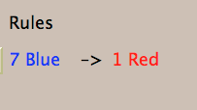

Exchange
1 Large –> 5 Small
3 Large –> 1 Small
Notes:
Compare with ‘money’
Flexibility (size isn’t everything)

Slide 21


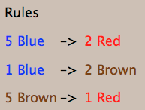
More Exchange

Slide 22
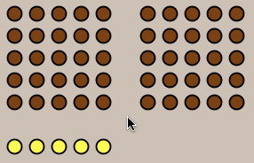
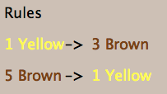
Maslanka’s Monkey
Challenge: can you reach a state of equal numbers of bananas and peanuts?

Slide 23

Number Necklaces
www.datapointed.net/visualizations/math/factorization/animated-diagrams/

Slide 24
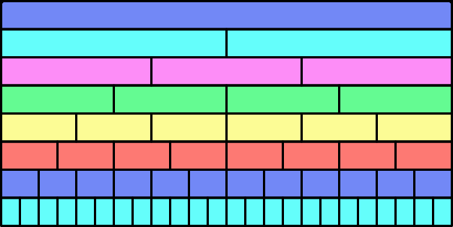
Wall Tiles

Slide 25
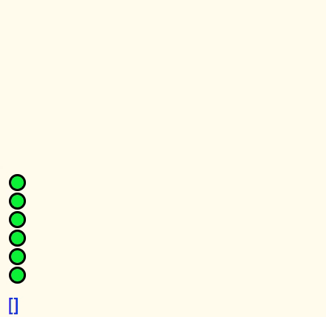
Pebble Arithmetic

Slide 26
Understanding Division
234234 is divisible by 13 and 7 and 11;
  What is the remainder on dividing 23423426 by 13?
  By 7? By 11?
Make up your own!

Slide 27
Doing & Undoing
What operation undoes ‘adding 3’?
What operation undoes ‘subtracting 4’?
What operation undoes ‘subtracting from 7’?
What are the analogues for multiplication?
  What undoes ‘multiplying by 3’?
  What undoes ‘dividing by 4’?
  What undoes ‘multiplying by 3/4’?
    Two different expressions!
    Dividing by 3/4
    or Multiplying by 4 and dividing by 3
What operation undoes dividing into 12?
Notes:
Dave Hewitt’s THOAN sequences

Slide 28
Composite Doing & Undoing
I am thinking of a number …
What’s my number?
I add 8 and the answer is 13.
What’s my number?
I add 8 and then multiply by 2;
the answer is 26.
I add 8; multiply by 2; subtract 5;
the answer is 21.
What’s my number?
I add 8; multiply by 2; subtract 5; divide by 3;
the answer is 7.
What’s my number?
HOW do you turn +8, x2, -5, ÷3 answer into a solution?
7
Generalise!

Slide 29

Differing Sums of Products
Write down four numbers in a 2 by 2 grid
4
7
5
3
Add together the products along the rows
28 + 15 = 43
Add together the products down the columns
20 + 21 = 41
43 – 41 = 2
Calculate the difference
That is the ‘doing’
What is an undoing?
What other grids will give the answer 2?
Choose positive numbers so that the difference is 7
Notes:
Tracking Arithmetic

Slide 30
Differing Sums & Products
4
7
Tracking Arithmetic
5
3
4x7 + 5x3
4x5 + 7x3
4x(7–5) + (5–7)x3
= 4x(7–5) – (7–5)x3
= (4-3) x (7–5)
So in how many essentially different ways can 2 be the difference?
What about 7?
So in how many essentially different ways can n be the difference?
Notes:
Revealing Structure by attending to relationships not calculations
Numerals as placeholders

Slide 31

Think Of A Number (ThOAN)
Think of a number
Add 2
Multiply by 3
Subtract 4
Multiply by 2
Add 2
Divide by 6
Subtract the number you first thought of
Your answer is 1
7
7
+ 2
3x + 6
7
7
3x + 2
6x + 4
7
6x + 6
7
+ 1
7
1

Slide 32
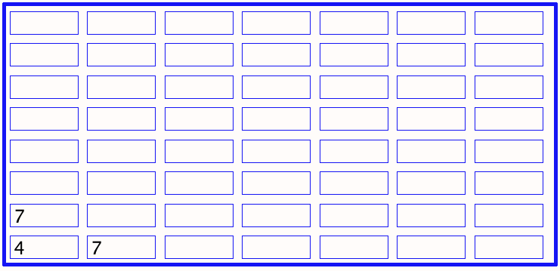
Sundaram Grids
What are the missing entries?
Notes:
Drc=6, Dr=4 Dc=3 S=1 –> numbers that are the product of two numbers, one odd, the other congruent to 1 mod 3
Drc*rc+r(Dr-Drc)+c(Dc-Drc)+Drc-Dr-Dc+S
Disturbance; challenge + Trust that it is not excessive

Slide 33
Outer & Inner Tasks
Outer Task
  What author imagines
  What teacher intends
  What students construe
  What students actually do
Inner Task
  What powers might be used?
  What themes might be encountered?
  What connections might be made?
  What reasoning might be called upon?
  What personal dispositions might be challenged?

Slide 34
Powers & Themes
Powers
Themes
Imagining & Expressing
Specialising & Generalising
Conjecturing & Convincing
Stressing & Ignoring
Organising & Characterising
Doing & Undoing
Invariance in the midst of change
Freedom & Constraint
Extending & Restricting
Are students being encouraged
to use their own powers?
or
are their powers being usurped by textbook, worksheets and … ?

Slide 35
Teaching students to think mathematically …
involves developing a disposition to
  think mathematically, to use powers mathematically, to be mathematical
  to attend to situations mathematically
How often do you think mathematically
  with and in front of students?
What are they attending to? (and how?)
What are you attending to when interacting with students? (and how?)

Slide 36
Attention
Holding Wholes (gazing)
Discerning Details
Recognising Relationships
Perceiving Properties
Reasoning on the basis of properties

Slide 37
Reflection
It is not the task that is rich
  but the way the task is used
Teachers can guide and direct learner attention
What are teachers attending to?
  powers
  themes
  Heuristics
  The nature of their own attention

Slide 38
To Follow Up
http://mcs.open.ac.uk/jhm3
j.h.mason@open.ac.uk
Thinking Mathematically (new edition 2010)
Developing Thinking in Algebra (Sage)
Designing & Using Mathematical Tasks (Tarquin)
Questions and Prompts: primary (ATM)

