Slide 1
Functioning with Functions: What is the Function of Functions?
Promoting Mathematical Thinking
John Mason
Grahamstown
2013
The Open University
Maths Dept
University of Oxford
Dept of Education

Slide 2
Conjectures
Everything said here today is a conjecture … to be tested in your experience
The best way to sensitise yourself to learners …
is to experience parallel phenomena yourself
So, what you get from this session is what you notice happening inside you!

Slide 3
Ratio
If 3 notebooks cost R12, what will 7 books cost?
If 3 notebooks cost R12, what will 7 books cost?
Functional Thinking
Scalar Thinking
1 book costs R4 so 7 books cost R4 x 7
3 books cost R12 so 7 books cost R12 x 7/3
Probe:
Probe:
What is the 7/3?
What is the 4?
R per book
Scale Factor

Slide 4
Ratio Variants
If 3 notebooks cost R12, what will 7 books cost?
If 3 notebooks cost R12, what will 7 books cost?
If 3 notebooks cost R11, what will 7 books cost?
If 3 notebooks cost R11, what will 7 books cost?
If 3 notebooks cost R11, what will 9 books cost?
If 3 notebooks cost R11, what will 9 books cost?
If 3 notebooks cost R12, what will 9 books cost?
If 3 notebooks cost R12, what will 9 books cost?

Slide 5
Costings
I want 45 notebooks for participants in a workshop I am planning. I find suitable ones at R5 each or 6 for R27, but to get the reduced price I have to buy a loyalty card for R5. How much will I have left over from R350 for other purchases?
What could vary?
What functional relationships are involved?

Slide 6
Think Of A Number (ThOANs)
Think of a number
Add 2
Multiply by 3
Subtract 4
Multiply by 2
Add 2
Divide by 6
Subtract the number you first thought of
Your answer is 1
7
7
+ 2
3x + 6
7
7
3x + 2
6x + 4
7
6x + 6
7
+ 1
7
1

Slide 7
Pebble Arithmetic (basic)

Slide 8
JSMill Pebble Arithmetic

Slide 9
Tunja Sequences
-1 x -1 – 1 =
-2 x 0
0 x 0 – 1 =
-1 x 1
With the Grain
1 x 1 – 1 =
0 x 2
2 x 2 – 1 =
1 x 3
3 x 3 – 1 =
2 x 4
Across the Grain
4 x 4 – 1 =
3 x 5
Notes:
Structured Variation Grids

Slide 10
Structured Variation Grids
Tunja

Slide 11
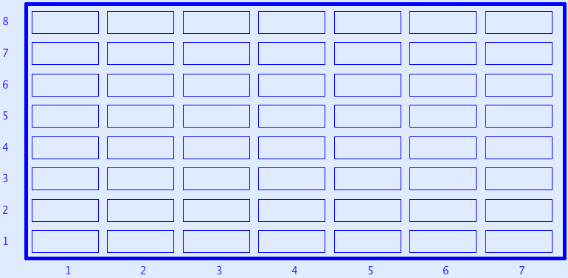
Sundaram Grids
All rows and columns are arithmetic progressions
How many entries do you need to fill out the grid?
Notes:
Drc=6, Dr=4 Dc=3 S=1 –> numbers that are the product of two numbers, one odd, the other congruent to 1 mod 3
Drc*rc+r(Dr-Drc)+c(Dc-Drc)+Drc-Dr-Dc+S
Disturbance; challenge + Trust that it is not excessive

Slide 12
Perimeter Projections
Say What You See

Slide 13
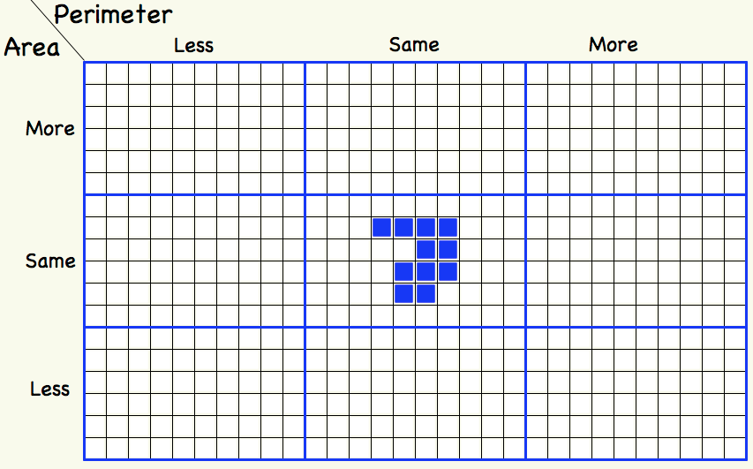
Tabled Variations

Slide 14
Differing Sums of Products
Write down four numbers in a 2 by 2 grid
4
7
5
3
Add together the products along the rows
28 + 15 = 43
Add together the products down the columns
20 + 21 = 41
43 – 41 = 2
Calculate the difference
That is the ‘doing’ What is an ‘undoing’?
Now choose positive numbers so that the difference is 11
Notes:
Mathematical context
What probaby matters most is not the context, but whether students ‘think’ they can solve the problem!
Result of an action signals the presence of a function!

Slide 15
Differing Sums & Products
4
7
Tracking Arithmetic
5
3
4x7 + 5x3
4x5 + 7x3
4x(7–5) + (5–7)x3
= (4-3)x (7–5)
So in how many essentially different ways can 11 be the difference?
So in how many essentially different ways can n be the difference?
Notes:
Revealing Structure by attending to relationships not calculations

Slide 16
Function of Functions
To express awareness of co-variation
To enable multiple presentations:
Expressions, tables, graphs
To encompass many different situations
A way of perceiving the world

Slide 17
Reflection
Say What You See (SWYS)
How Do You Know (HDYKn)
Same & Different (S&D)
Variation
Expressing Generality
Tracking arithmetic
Attention, Action & Awareness
Teacher’s
Students’

Slide 18
Tasks
Tasks promote Activity;
Activity involves Actions;
Actions generate Experience;
but one thing we don’t learn from experience is that we don’t often learn from experience alone
It is not the task that is rich …
but whether it is used richly

Slide 19
Follow Up
j.h.mason @ open.ac.uk
mcs.open.ac.uk/jhm3 → Presentations
Questions & Prompts (ATM)
Key ideas in Mathematics (OUP)
Learning & Doing Mathematics (Tarquin)
Thinking Mathematically (Pearson)
Developing Thinking in Algebra

