Slide 1




Who Knows How To Study Mathematics?
Promoting Mathematical Thinking
John Mason
FM Workshop
July 5 2013
The Open University
Maths Dept
University of Oxford
Dept of Education

Slide 2
Throat Clearing
Conjectures
  Everything said is a conjecture, uttered in order to externalise it, consider it, and modify it on the basis of people’s responses
It’s not the task that is rich, but the way that the task is used
It’s not practice that makes perfect, but how you practice that matters

Slide 3
Studying (for tests & exams)
How did you study for exams?
What would you like students to do when studying?

Slide 4
Responses

Slide 5
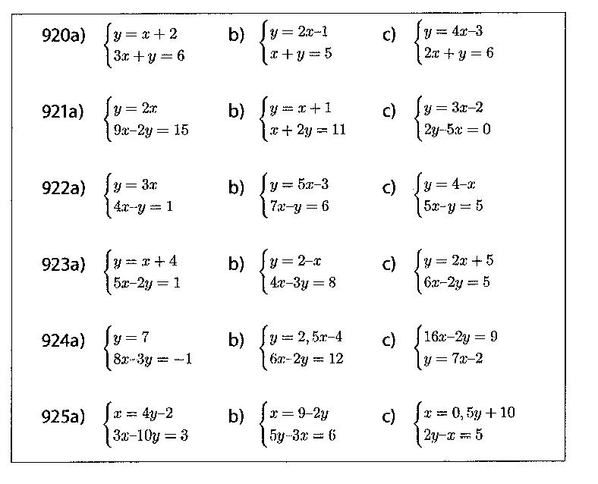
What is being achieved by practicing these?
What else could be done with them?
What is being varied?
Adapted from Häggström (2008 p90)

Slide 6
Sorting & Ordering Quadratics
Sort these quadratics by their inter-rootal distance
(x – 1)(x + 2)
x² + 6x + 8
etc.
Put each group in order of increasing extremal value
Inter-rootal distances
0
1
2
Construct quadratics to fit in the cells
Extremal
value
–1
0
Construct or sketch quadratics to meet constraints:
  Given inter-rootal value
  Given extreme value
  Through given point
  …
2

Slide 7
Lee Minor’s Mutual Factors
x² + 5x + 6 = (x + 3)(x + 2)
x² + 5x – 6 = (x + 6)(x – 1)
x² + 13x + 30 = (x + 10)(x + 3)
x² + 13x – 30 = (x + 15)(x – 2)
x² + 25x + 84 = (x + 21)(x + 4)
x² + 25x – 84 = (x + 28)(x – 3)
x² + 41x + 180 = (x + 36)(x + 5)
x² + 41x – 180 = (x + 45)(x – 4)
Notes:
Check; predict next; express general
Are there any others not fitting this particular pattern?

Slide 8
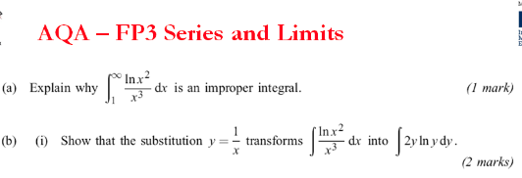
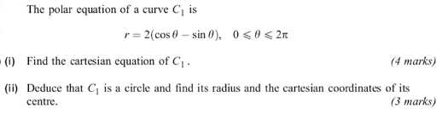
Revision Support
What would you like students
to do with this videocast?
What other substitutions might be considered?
What criteria for ‘effectiveness’?
Generalise!

Slide 9
Construct Another … Like This …
Construct another improper integral like this.
And another, different in a different way…
… and another
is an improper integral
Explain why your integral is improper. In what ways is it like this?
In what ways is it different?
What are the effects of substitutions of the form y = x^{–k} which are intended to simplfy the calculation?
Generalise!

Slide 10
Construct Another … Like This …
Make up another integral like this with the same answer
Make up an integral like this with the same answer but different in some way to your first
Easy
Hard
Peculiar
And another
In what way(s) are your’s the same, and in what way are they different to this?

Slide 11
Making Meaning
Make a collection of cards with technical terms and phrases (one per card) used in the topic on your table
Pick three cards at random and make a mathematically meaningful sentence using them
Exchange cards with another table
Make a mathematically meaningful paragraph that uses all of the words on the cards you have received
Connections across topics

Slide 12
Constrained Examples
Vocabulary:
x-intercept; y-intercept; slope;
Task:
construct a pair of lines
  whose y-intercepts differ by 2
  whose x-intercepts differ by 2
  whose slopes differ by 2
  All three of these

Slide 13
Extending Techniques
Construct a function that requires three uses of integration by parts to find the integral.
  And another, different in some way
  And another, different in some other way
Construct a function that uses integration by parts and substitution
  And another, different in some way
  And another, different in some other way

Slide 14
Comparing Techniques
Methods of integration include
  guess & check; substitution; parts; partial fractions
Make up a function that requires both substitution and parts to integrate it
Make up a function that reuires both substitution and partial fractions
What makes it difficult to spot a …
substitution?
partial fraction?
by parts?

Slide 15
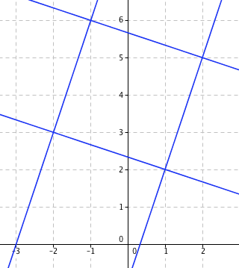
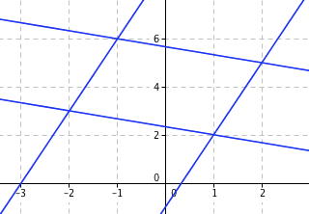
Graphical Reasoning
Say What You See
What is the angle between the lines?
Lines are
  y = 3x - 1
  3y = -x + 7
  y = 3x + 9
  3y = -x+ 17

Slide 16
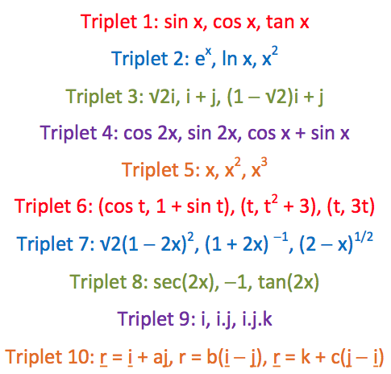
Odd One Out
What feature makes each one the odd one out?
RISP 29 Jonny Griffiths

Slide 17
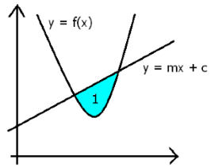
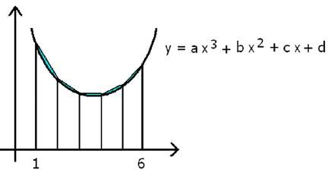
Undoing
What different functions can you find so that the shaded region has area 1?
The trapezium method shown over-estimates the true area by 1 square unit. Find the cubic.

Slide 18

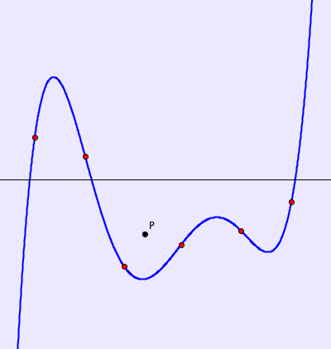
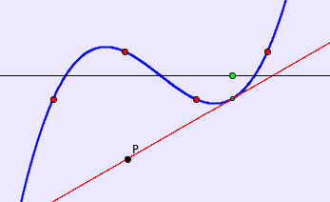
Tangent Power
The tangent power of a point relative to a function is the number of tangents to the function through the point.

Slide 19
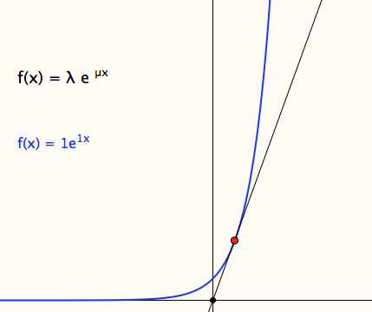
Original Tangents
Imagine the graphs of y=e^{µx}
as µ changes from .5 to 2
What is the locus of points on the curve where the tangent goes through the origin?
Notes:
What is varying in the phenomenon?
Added element: attention to a particular point
Lots of algebra, practice in using coordinates; denoting variables, parameters and constants;
change of attention focus as parameter becomes variable and variable becomes constant.

Slide 20
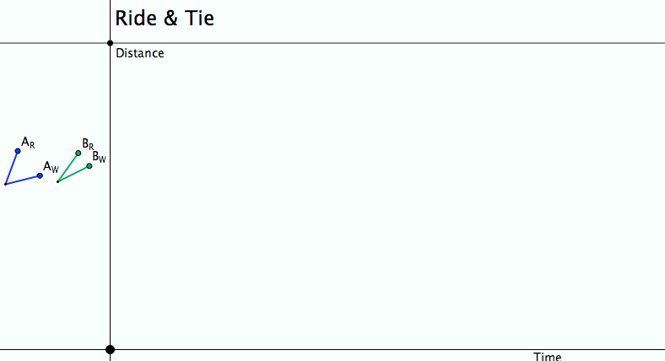
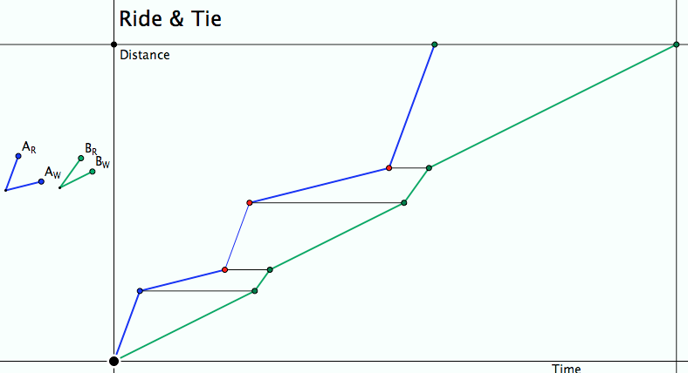
Ride & Tie
Imagine, then draw a diagram!
Seeking Relationships
Does the diagram make sense
(meet the constraints)?
Notes:
Does the diagram meet the constraints?
What can be changed, what choices are there?
What relationships (does it really matter how many times the horse is swapped?)

Slide 21
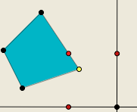
Polygon Perimeter Projections
Imagine a quadrilateral (irregular)
Imagine a point P traversing the perimeter of the quadrilateral at uniform speed.
Imagine the projections of P onto a horizontal and a vertical axis …

Slide 22
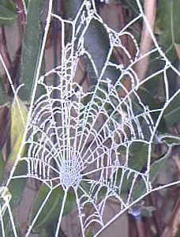
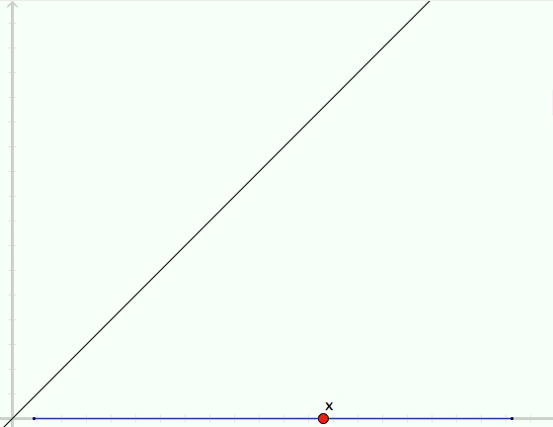
Quadratic Cobwebs

Slide 23
ZigZag Functions
Sketch the graph of
  |x-1|
  | |x-1| - 2|
  …
Relate number of zigs to number of absolute-value functions

Slide 24
Examples of What?
Of what is |x| an example?
Of what is y = x² and example?
  y = b + (x – a)² ?

Slide 25
Constructible Composites
What functions can you achieve by composing functions using only
f(x)= x + 10 and g(x) = x – 6 ?
What functions can you achieve by composing
h(x) = 2x + 3 with itself in all possible ways?
What about composing h with j(x) = 3x + 2 in all possible ways?
What about composing k(x) = x² with m(x) = x – 1 in all possible ways?

Slide 26
Probing Affordances & Potential
Cognitive
  What images, associations, alternative presentations?
  What is available to be learned (what is being varied, what is invariant)?
Behavioural
  What technical terms used or useful
  What inner incantations helpful?
  What specific techniques called upon and developed?
Affective (dispositions & purpose/utility)
  Where are the techniques useful?
  How are exercises seen by learners (epistemic stances)
Attention-Will
  What was worth stressing and what ignoring?
  What properties called upon
  What relationships recognised?

Slide 27
Strategies for Use with Exercises
Sort collection of different contexts, different variants, different parameters
Characterise odd one out from three instances
Put in order of anticipated challenge
Do as many as you need to in orer to be ble to do any question of this type
Construct (and do) an Easy, Hard, Peculiar and where possible, General task of this type
Decide between appropriate and flawed solutions
Describe how to recognise a task ‘of this type’;
Tell someone ‘how to do a task of this type’
What are tasks like these accomplishing (narrative about place in mathematics)

Slide 28
Reflection Strategies
What technical terms involved?
What concepts called upon?
What mathematical themes encountered?
What mathematical powers used (and developed)?
What links or associations with other mathematical topics or techniques?
What cosntruction techniques included in my ‘example space’?

Slide 29
Theoretical Background

Slide 30
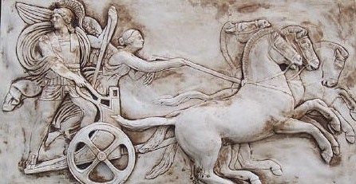
Making Use of the Whole Psyche
Assenting & Asserting
Awareness (cognition)
Imagery
Will
Emotions
(affect)
Body (enaction)
Habits
Practices

Slide 31
Task Design & Use
Re-flection
&
Pro-flection
Content
Task
Activity
Potential
Actions
Structure
of a Topic
Inner & Outer
Themes
Effectiveness of actions
Powers
3 Only’s
Balance
Interaction
7 phases
Teacher
Peers
6 Modes
Roles
Questioning

Slide 32
Teacher Focus
Teacher-Student interaction
Teacher-Mathematics interaction
Student-Mathematics interaction
Language/technical terms
Examples, Images &
Representations
Enactive Obstacles
Origins
Applications & Uses
Affective Obstacles
Cognitive Obstacles:
common errors, …
Methods & Procedures

Slide 33
Actions
Right-multiplying by an inverse ...
Making a substitution
Differentiating
Iterating
Reading a graph
Invoking a definition
…

Slide 34
Themes
Doing & Undoing
Invariance in the midst of change
Freedom & Constraint
Restricting & Extending

Slide 35
Powers
Imagining & Expressing
Specialising & Generalising (Stressing & Ignoring)
Conjecturing & Convincing
(Re)-Presenting in different modes
Organising & Characterising

Slide 36
Inner & Outer Aspects
Outer
  What task actually initiates explicitly
Inner
  What mathematical concepts underpinned
  What mathematical themes encountered
  What mathematical powers invoked
  What personal propensities brought to awareness

Slide 37
Challenge
Appropriate Challenge:
  Not too great
  Not too little
  Scope depends on student trust of teacher
  Scope depends on teacher support of mathematical thinking not simply getting answers

Slide 38
Structure of a Topic
Awareness (cognition)
Imagery
Will
Emotions
(affect)
Body (enaction)
Habits
Practices

Slide 39
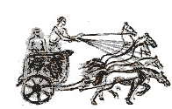
Three Only’s
Language Patterns
& prior Skills
Imagery/Sense-of/Awareness; Connections
Root Questions
predispositions
Different Contexts in which likely to arise;
dispositions
Standard Confusions
& Obstacles
Techniques & Incantations
Emotion
Awareness
Behaviour
Only Emotion is Harnessable
Only Awareness is Educable
Only Behaviour is Trainable

Slide 40
Phases
Getting Started
Initiating
Getting Involved
Mulling
Keeping Going
Sustaining
Insight
Being Sceptical
Concluding
Contemplating

Slide 41
Six Modes of Interaction
Initiating
Sustaining
Concluding
Expounding
Explaining
Exploring
Examining
Exercising
Expressing

Slide 42
Initiating Activity
Silent Start
Particular (to general);
General (via particular)
Semi-general (via particular to general)
Worked example
Use/Application/Context
Specific-Unspecific
Manipulating:
  Material objects (eg cards, counters, …)
  Mental images (diagrams, phenomena)
  Symbols (familiar & unfamiliar)

Slide 43
Sustaining Activity
Questions & Prompts
Directed–Prompted–Spontaneous
Scaffolding & Fading
Energising (praising-challenging)
Conjecturing
Sharing progress/findings

Slide 44
Concluding Activity
Conjectures with evidence
Accounts that others can understand
Reflecting on effective & ineffective actions
  Aspcts of inner task (dispositions, …)
Imagining acting differently in the future

Slide 45
Balanced Activity
Affordances
Constraints
Attunements
Outer
Task
Inner
Task
Intended
& Enacted
goals
Implicit
goals
Ends
Ends
Resources
Tasks
Resources
Tasks
Means
Means
Current
State
Current
State

Slide 46
Expounding
Explaining
Exploring
Examining
Exercising
Expressing

Slide 47
Teacher
Student
Content
Student
Teacher
Student
Content
Content
Teacher
Expounding
Exploring
Exercising
Teacher
Student
Content
Content
Content
Teacher
Student
Teacher
Student
Explaining
Examining
Expressing

Slide 48
Activity
Goals, Aims,
Desires, Intentions
Resources:
(physical, affective cognitive, attentive)
Tasks
(as imagined,
enacted,
experienced,
…)
Initial State
Affordances– Constraints–Requirements
(Gibson)

Slide 49
Potential
What builds on it
(where it is going)
Most it could be
Math’l & Ped’c
essence
Least it
can be
What it builds on
(previous experiences)
Affordances– Constraints–Requirements
(Gibson)
Directed–Prompted–Spontaneous
Scaffolding & Fading (Brown et al)
ZPD (Vygotsky)
Notes:
Role of reflection in achieving affordances

Slide 50
Thinking Mathematically
CME
  Do-Talk-Record
  (See–Say–Record)
  See-Experience-Master
  Manipulating–Getting-a-sense-of–Artculating
  Enactive–Iconic–Symbolic
  Directed–Prompted–Spontaneous
  Stuck!: Use of Mathematical Powers
  Mathematical Themes (and heuristics)
  Inner & Outer Tasks

Slide 51
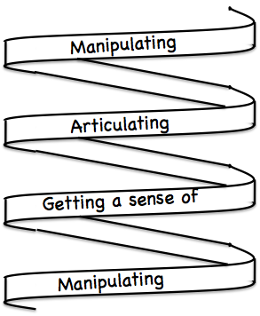
Frameworks (틀)
Enactive– Iconic– Symbolic
Doing – Talking – Recording
See – Experience – Master

Slide 52
Follow-Up
Designing & Using Mathematical Tasks (Tarquin/QED)
Thinking Mathematically (Pearson)
Mathematics as a Constructive Activity (Erlbaum)
Questions & Prompts for Mathematical Thinking (ATM)
Thinkers (ATM)
Learning & Doing Mathematics (Tarquin)
Researching Your Own Practice Using The Discipline Of Noticing (RoutledgeFalmer)
j.h.mason @ open.ac.uk
mcs.open.ac.uk/jhm3

