Slide 1
Reasoning Reasonably in Mathematics
Promoting Mathematical Thinking
John Mason
EARCOME 6
Phuket
2013
The Open University
Maths Dept
University of Oxford
Dept of Education

Slide 2
Conjectures
Everything said here today is a conjecture … to be tested in your experience
The best way to sensitise yourself to learners …
is to experience parallel phenomena yourself
So, what you get from this session is what you notice happening inside you!

Slide 3
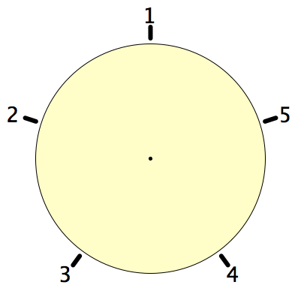
Secret Places
One of these five places has been chosen secretly.
You can get information by clicking on the numbers.
If the place where you click is the secret place, or next to the secret place, it will go red (hot), otherwise it will go blue (cold).
How few clicks can you make and be certain of finding the secret place?
Can you always find it in 2 clicks?

Slide 4
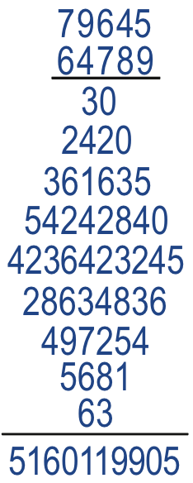
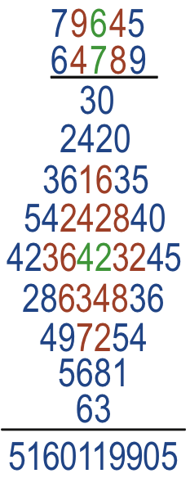
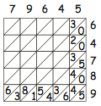
Diamond Multiplication

Slide 5
Set Ratios
In how many different ways can you place 17 objects so that there are equal numbers of objects in each of two sets?
What about requiring that there be twice as many in the left set as in the right set?
What about requiring that the ratio of the numbers in the left set to the right set is 3 : 2?
What is the largest number of objects that CANNOT be placed in the two sets in any way so that the ratio is 5 : 2?
What can be varied?
S₁
S₂

Slide 6
Square Deductions
Each of the inner quadrilaterals is a square.
Can the outer quadrilateral be square?
15a = 6b
4(4a–b) = a+2b
4a–b
Acknowledge ignorance:
denote size of smallest square by a
4a
b
a+b
a
To be a square:
7a+b = 5a+2b
3a+b
So 2a = b
2a+b

Slide 7
31: a game for two players
At each move you choose a whole number from 1 to 5.
Each chosen number is added to the running total. The first person to get the total to be 31 wins.
What is your (best) strategy?
How might you alter the game?

Slide 8
Perimeter Projections
Say What You See

Slide 9
More Perimeter Projections

Slide 10
Bag Reasoning
Axiom: Every bean is in some bag.
Axiom: There are finitely many bags.
Definition: a bean b is loose in a bag B means that although b is in B, b is not in any bag that is in B.
Show that every bean is loose in some bag.
Definition: the number of beans in bag B is the total number of beansthat would be in bag B if all the bags within B disintegrated.
How few beans are needed in order that for k = 1, 2, …, 5, there is exactly one bag with k beans?
What is the most beans there could be?
Can it be done with any number of beans between the least and the most?

Slide 11
Magic Square Reasoning
What other configurations like this give one sum equal to another?
6
7
2
2
1
5
9
Try to describe them in words
2
8
3
4
Any colour-symmetric arrangement?
Sum(
)
–
Sum( )
= 0
Notes:
Think of all the patterns obtained like this one but with different choices of the red line and the blue line.
Sketch a few
Here is another reasoning
What about this pattern: is it true?
did you have difficulty recognising the components? This may be why learners find it hard to remember what they were taught recently!

Slide 12
More Magic Square Reasoning
Sum(
)
–
Sum( )
= 0

Slide 13
Reasoning Conjectures
What blocks children from displaying reasoning is often lack of facility with number.
Reasoning mathematically involves seeking relationships, then justifying why those relationships are actually properties that always hold.
Put another way, you look for invariants (relationships that don’t change) and then express why they must be invariant.
A task like Cover up can be used to get children to practice adding (you could use fractions or decimals!) while trying to work out what is happening, or even while trying to construct their own!

Slide 14
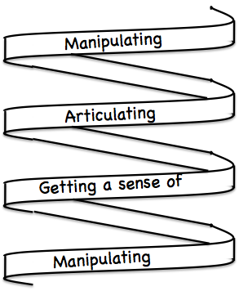
Frameworks
Doing – Talking – Recording (DTR)
(MGA)
See – Experience – Master (SEM)
Enactive – Iconic – Symbolic (EIS)
Specialise … in order to locate structural relationships …
then re-Generalise for yourself
Stuck?
What do I know?
What do I want?

Slide 15
Slogan
A lesson without the opportunity for learners to generalise mathematically …
is not a mathematics lesson!

Slide 16
Mathematical Thinking
How describe the mathematical thinking you have done so far today?
How could you incorporate that into students’ learning?

Slide 17
Possibilities for Action
Trying small things and making small progress; telling colleagues
Pedagogic strategies used today
Provoking mathematical thinks as happened today
Question & Prompts for mathematcal Thinking (ATM)
Group work and Individual work

Slide 18
Money Changing
People who convert currencies offer a ‘buy’ rate and a ‘sell’ rate, and sometimes charge a commission in addition!
Suppose they take c% commission from every transaction, and that they sell s Bat for 1£ but buy back at the rate of b Bat for 1£. How can you calculate the commision that make on each transaction?

Slide 19
Closer
8 < √72.3 < 9
Is √72.3 closer to 8 or to 9?

Slide 20
Follow Up
j.h.mason @ open.ac.uk
mcs.open.ac.uk/jhm3 → Presentations
Questions & Prompts (ATM)
Key ideas in Mathematics (OUP)
Learning & Doing Mathematics (Tarquin)
Thinking Mathematically (Pearson)
Developing Thinking in Algebra

