Slide 1
Exploiting Exercises in order to develop Conceptual Appreciation
Promoting Mathematical Thinking
John Mason
CENEZ High School
Maseru
2013
The Open University
Maths Dept
University of Oxford
Dept of Education

Slide 2
Conjectures
Everything said is a conjecture, uttered in order to externalise it, consider it, and modify it on the basis of people’s responses
It’s not the task that is rich, but the way that the task is used
Exercising is only one of six fundamental modes of interaction between Mathematics, Learner & Teacher
Useful exercise requires an upwelling of desire generated, by the mathematics, experienced by the learner and mediated by the teacher (setting the tasks)
Learners believe that by attempting the tasks they are set, learning will magically happen

Slide 3
Studying
How did you study for mathematics examinations?
What did you try to remember? What did you try to understand?
What could you reconstruct when needed?
What would you like students to be doing when studying for tests?
Practice?
Practice what?
Practice how?

Slide 4
Some Sample Exercises
Experience for YOU!

Slide 5
Relational Thinking
Raise you hand when you have decided whether the following is true
23 – 19 + 17 + 19 = 40
Jumping in and calculating
43 + 79 – 42 = 80
Starting to calculate, then realising you don’t have to
How Do You Know?
37 + 52 – 32 = 57
1453 + 4639 – 1659 – 4433 = 0
Pausing and looking first!
In how many different ways can you …
Make up your own!

Slide 6
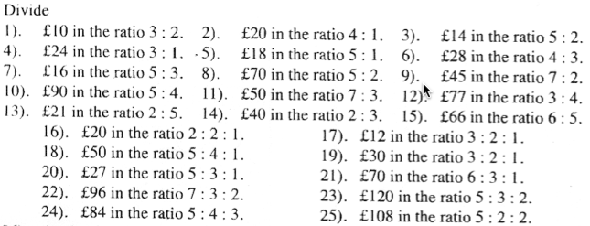
Revision of Ratio Division
After 15 minutes, what question might learners be working on?
What is achieved by ‘doing’ all of these?
What else could be done with these?
Notes:
TenTicks

Slide 7
Exploring Ratio Division
The number 15 has been divided in some ratio and the parts are both integers. In how many different ways can this be done? Generalise!
If some number has been divided in the ratio 3 : 2, and one of the parts is 12, what could the other part be? Generalise!
If some number has been divided in the ratio 5 : 2, and the difference in the parts is 6, what could the original number have been? Generalise!
Student Generated ‘Practice’
Notes:
Exploration of variations that involves learner in lots of ‘practice’ as part of the exploration; student generated!

Slide 8
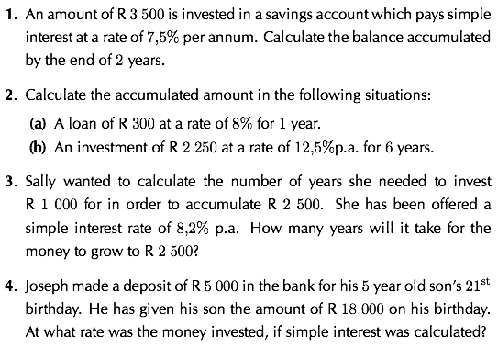
Investments:
What is the same & What is different?
Notes:
Get students to make up their own!

Slide 9
Simple & Compound Interest
What is the same and different about
P(1 + ni) and P(1 + i)^{n}
How do you think about these two formulae?
Any images or diagrams?
How do you know which to use?
What is the relation between simple interest and compound interest?
When are they the same?
SiyVula Grade 10 p192ff, 200ff

Slide 10
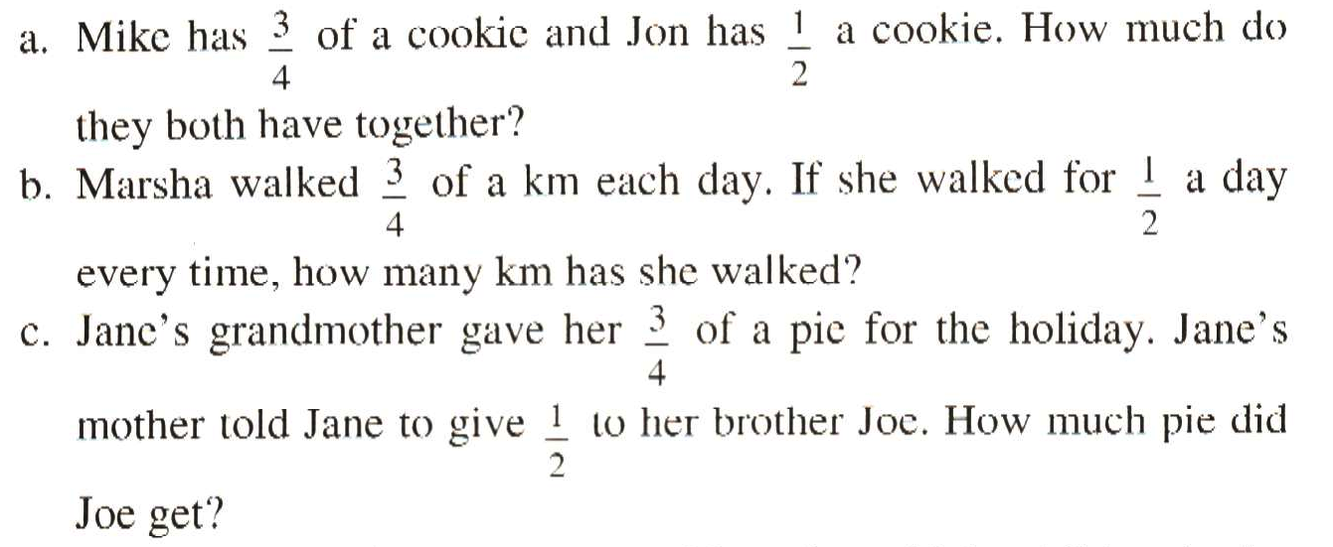
¾ and ½
What distinguishes each from the other two?
What ambiguities might arise?
What misconceptions or errors might surface?

Slide 11
Fraction Addition
Write down three integers …
Their sum has to be 0
Now write out all the mixed fractions that can be formed from these three numbers
Now add them all up.
Example: 3, 4, -7
+
+
+
+
+
–1
–1
–1
Griffiths 2013

Slide 12
Easiest?
Hardest?
Put in order of difficulty
Sort into categories
What is Varying?
Adapted from Häggström (2008 p90)
Notes:
Bury the Bone!

Slide 13
Simultaneous Equations
x = 2, y = -5
x = 2, 3y = -15
x = 2, x + 3y = -13
x = 2, 2x + 3y = -11
2x = 4, 2x + 3y = -11
3x = 6, 2x + 3y = -11
3x – y = 11, 9x + 3y = 4
Doing & Undoing
What actions are available?

Slide 14
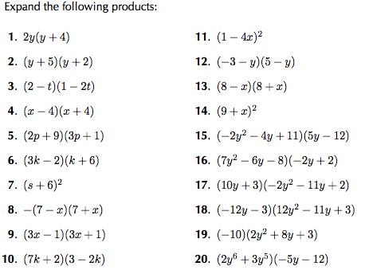
What is being varied?
Construct:
A simple one;
A peculiar one;
A hard one;
As general a one as you can
What is changing?
What is staying the same?
What is developing?
SiyVula Grade 10 1.5 p17

Slide 15
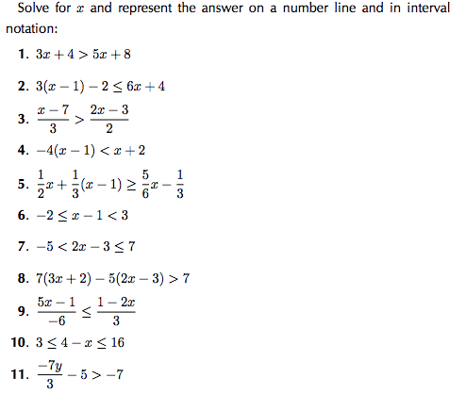
What is being varied?
What is changing?
Construct:
A simple one;
A peculiar one;
A hard one;
As general a one as you can
What is staying the same?
What is developing?

Slide 16
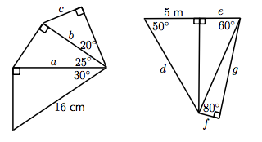
Doing & Undoing
4. Calculate the unknown lengths in the diagrams below:
Construct:
A simple one;
A peculiar one;
A hard one;
As general a one as you can
What is changing?
What is staying the same?
What is developing?
SiyVula Grade 10 p248

Slide 17
Least Common Multiples
Find the Least Common Multiple of each number pair.
18, 15
55, 5
21, 7
7, 28
14, 49
12, 32
5, 35
30, 8
64, 4
15, 21
2x3², 3x5
5x11, 5
3x7, 7
7, 4x7
2x7, 7x7
2²x3, 2⁵
5, 5x7
2x3x5, 2⁵
2⁶, 2²
3x5, 3x7
What exactly is being ‘exercised’?
Make up an ‘easy’ one
Make up a ‘hard’ one
Make up a ‘peculiar’ one
Make up a ‘general’ one
Make up one that shows you know how to do questions like this
Notes:
Test of comprehension? Test of procedure being triggered and followed?
Confusion between factoring and what to do with factors
Is a product of powers of primes actually perceived as a number?

Slide 18
Make Up One … Like This
Hard?
Find the LCM of 180 and 372
Peculiar?
Find the LCM of 2x3²x5³x7⁵ and 2⁷x3⁵x5³x7²
General
Find the LCM of and
In how many different ways can a given number n be the LCM of two numbers?
Powers:
Making choices
Expressing Generality

Slide 19
Doing & Undoing
4. Three sets of data are given:
• Data set 1: {9; 12; 12; 14; 16; 22; 24}
• Data set 2: {7; 7; 8; 11; 13; 15; 16; 16}
• Data set 3: {11; 15; 16; 17; 19; 19; 22; 24; 27}
For each data set ﬁnd:
(a) the range (b) the lower quartile
(c) the interquartile range (d) the semi-interquartile range
(e) the median (f) the upper quartile
Specify one or more features from a to f
Construct your own data set with those properties specified
SiyVula Grade 10 9.4 p313

Slide 20
Of What is This an Example?
3x + 14 = 2(12 - x)
5x – 3 = 5(x – 1) + 2
2 3/7
100(1 + .01n); P(1 + .03)^{n}
y = x³ – x² + x – 1

Slide 21
Practicing Recurring Decimals
5. Write the following using the recurring decimal notation:
(a) 0,11111111 . . .
(b) 0,1212121212 . . .
(c) 0,123123123123 . . .
(d) 0,11414541454145 . . .
6. Write the following in decimal form, using the recurring decimal notation:
(a) 2/3 (b) 1 3/11 (c) 4 5/6 (d) 2 1/9
7. Write the following decimals in fractional form
SiyVula Grade 10 1.3 p2

Slide 22
Constrained Construction
Write down a decimal number between 2 and 3
and which does NOT use the digit 5
and which DOES use the digit 7
and which is as close to 5/2 as possible
2.4999…97
2.47999…9
2.4999…97999…

Slide 23
Another & Another
Write down a pair of numbers
whose difference is two
and another pair
and another pair
Write down a quadratic function whose inter-rootal distance is 2
and another one
and another one
And another one for which the coefficient of x² is negative
Write down the equations of a pair of straight lines…
For which the x-intercepts differ by 2
For which the y intercepts differ by 2
For which the slopes differ by 2
Meeting all three constraints!

Slide 24
Fraction Actions
Raise your hand when you can see (on this slide) …
Something that is 3/5 of something else
Something that is 2/5 of something else
Something that is 2/3 of something else
Something that is 3/2 of something else
Something that is 5/3 of something else
What other fraction actions can you see?
Draw a picture for which you can directly see
3/7 of, 4/3 of and 7/8 of

Slide 25
More Fraction Actions
Raise your hand when you can see
Something that is 1/4 of something else
And another
And another
Something that is 1/5 of something else
And another
And another
Something that is 1/20th of something else
Something that is
1/4 of something else – 1/5 of the same thing
Draw a diagram which enables you to see 1/6 of something – 1/7 of the same thing
Seeking & Expressing Generality

Slide 26
Counting Out
In a selection ‘game’ you start at the left and count forwards and backwards until you get to a specified number (say 37). Which object will you end on?
A
B
C
D
E
1
2
3
4
5
9
8
7
6
10
…
If that object is elimated, you start again from the ‘next’. Which object is the last one left?
Notes:
How do you know?
Generalise!

Slide 27
Doing & Undoing
If adding two numbers is ‘doing’, what is ‘undoing’ a number additively?
If multiplying two numbers is ‘doing’, what is ‘undoing’ a number multiplicatively?
If finding the LCM of two numbers is ‘doing’, what is ‘undoing’ a number LCM-atively?
If adding two fractions is ‘doing’, what is ‘undoing’ a fraction additively?
If multiplying two fractions is ‘doing’, what is ‘undoing’ a fraction multiplicatively?
If raising 10 to a given power is ‘doing’, what is ‘undoing’ a number using base 10?

Slide 28
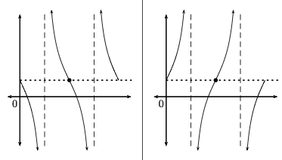
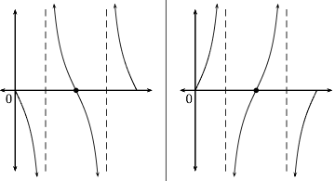
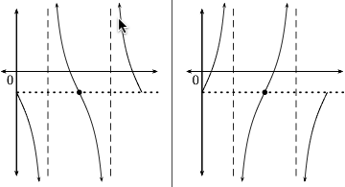
What’s the Same & What’s Different?
y = a tan(θ) + q
Which graph is which?
 | a > 0 | a < 0
q > 0
q = 0
q < 0
Card Sort:
Graphs & Equations
Graphs with 2 parameters
SiyVula Grade 10 5.6 p174

Slide 29
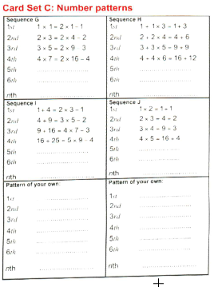
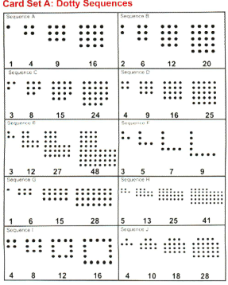
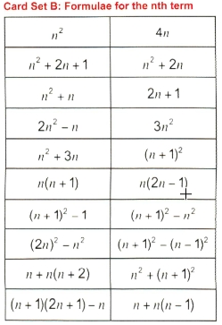
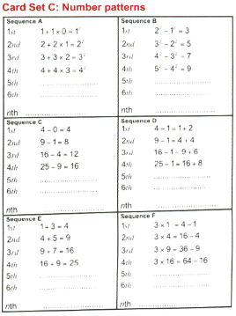
A Card Sorting Tasks

Slide 30
Word Problems
When the bus reached my stop where 4 other people were waiting, we all got on.
+5
At the next stop 9 people got on.
+ 14
At the next stop I got off with 19 others, and noticed that there were now 7 people on the bus.
- 6 = 7
= 13
What was the maximum number of people on the bus at any one time?
+ 14 = 26
What can be varied?
How will the answer change?

Slide 31
Word Problem Variation
When the bus reached my stop where 4 other people were waiting, we all got on.
At the next stop 9 people got on.
At the next stop I got off with 19 others, and noticed that there were now half as many people on the bus as it had when it got to the stop where I got on.
What was the maximum number of people on the bus at any one time?
+5
+ 14
- 6
2( - 6) =
= 12
+ 14 = 26

Slide 32
Reflections & Theoretical Considerations

Slide 33
Epistemology …
What it means “to know”
How we come to ‘know’ something
Knowing that …
Knowing how to …
Knowing when to …
Knowing about
Knowing to act …
Knowing
Is it enough simply to ‘do’?

Slide 34
Epistemological Stances
“Practice makes perfect”?
Attempting the tasks I am set ...
… somehow leads to learning?
Reconstructing for myself?
Do as many questions as you need to do so that you can do any question of this type
Source of confidence!

Slide 35
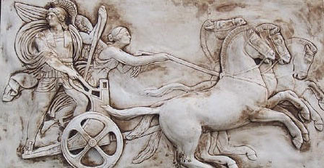
Making Use of the Whole Psyche
Assenting & Asserting
Awareness (cognition)
Imagery
Will
Emotions (affect)
Body (enaction)
Habits Practices

Slide 36
Probing Affordances & Potential
Cognitive
What images, associations, alternative presentations?
What is available to be learned (what is being varied, what is invariant)?
Behavioural
What technical terms used or useful
What inner incantations helpful?
What specific techniques called upon and developed?
Affective (dispositions & purpose/utility)
Where are the techniques useful?
How are exercises seen by learners (epistemic stances)
Attention-Will
What was worth stressing and what ignoring?
What properties called upon
What relationships recognised?

Slide 37
Strategies for Use with Exercises
Sort collection of different contexts, different variants, different parameters
Characterise odd one out from three instances
Put in order of anticipated challenge
Do as many as you need to in order to be able to do any question of this type
Construct (and do) an Easy, Hard, Peculiar and where possible, General task of this type
Decide between appropriate and flawed solutions
Describe how to recognise a task ‘of this type’; Tell someone ‘how to do a task of this type’
What are tasks like these accomplishing (narrative about place in mathematics)

Slide 38
Narratives
Reconstructing
Expressing for themselves
Communicating

Slide 39
Reflection Strategies
What technical terms involved?
What concepts called upon?
What mathematical themes encountered?
What mathematical powers used (and developed)?
What links or associations with other mathematical topics or techniques?

Slide 40
From Practicing to Understanding
Easy (simple), Peculiar, Hard, General
Show me that you know how to do questions like these
Of what is this an example?
From ‘Doing’ to ‘Undoing’
Constrained Construction
Another & Another
Narratives
Card Sorts

Slide 41
Follow Up
Jhm @ open.ac.uk
mcs.open.ac.uk/jhm3 [go to ‘presentations’]
Learning & Doing Mathematics (Tarquin)
Designing & Using Mathematical Tasks (Tarquin)

