Slide 1
Promoting Mathematical Reasoning
Promoting Mathematical Thinking
John Mason
AIMSSEC MTh19 Jan 2013
The Open University
Maths Dept
University of Oxford
Dept of Education

Slide 2
Possibilities
Secret Places
Deduction, Induction, Abduction
What Do I Know; What Do I Want?
Conjecturing & Convincing
Must, May, Cannot
Attribute Reasoning
Sets game at http://www.setgame.com/set/puzzle_frame.htm
ATM “We Can Work It Out”
Cover Up Sums
Magic Square Reasoning
Geometry (Isosceles Triangles)

Slide 3
Ways of Working
Everything said here today is a conjecture
It is uttered so it can be thought about and modified if necessary
What you get from tgis session will mostly be what you notice happening inside you … how you use your mathematical powers.

Slide 4
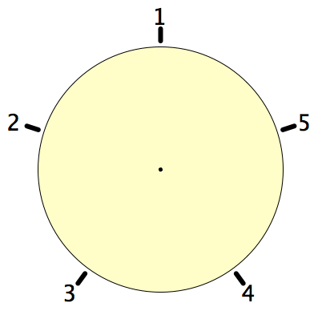
Secret Places
One of these five places has been chosen secretly.
You can get information by clicking on the numbers.
If the place where you click is the secret place, or next to the secret place, it will go red (hot), otherwise it will go blue (cold).
How few clicks can you make and be certain of finding the secret place?
Can you always find it in 2 clicks?

Slide 5
Set Ratios
In how many different ways can you place 17 objects so that there are equal numbers of objects in each of two sets?
What about requiring that there be twice as many in the left set as in the right set?
What about requiring that the ratio of the numbers in the left set to the right set is 3 : 2?
What is the largest number of objects that CANNOT be placed in the two sets in any way so that the ratio is 5 : 2?
What can be varied?

Slide 6
Covered Up Sums
Cover up one entry from each row and each column. Add up the remaining numbers.
The answer is (always) the same!
Why?
0
-2
2
-4
6
4
8
2
3
1
5
-1
Stuck?
Specialise!
1
-1
3
-3
Example of seeking invariant relationships
Example of focusing on actions preserving an invariance
Opportunity to generalise
Notes:
Use fractions to urge practice with fractions
Get students to make up their own with their age or some other number as the answer

Slide 7
Covered Up Sums
How much freedom of choice do you have when making up your own?
a
b
c
d
a
e
b
e
a
b
f
c
f
e
?
g
d
e-(a-b)
g
Opportunity to generalise
Opportunity to quantify freedom of choice
Notes:
Use fractions to urge practice with fractions
Get students to make up their own with their age or some other number as the answer

Slide 8
Chequered Selective Sums
Choose one cell in each row and column.
Add the entries in the dark shaded cells and subtract the entries in the light shaded cells.
What properties make the answer invariant?
What property is sufficient to make the answer invariant?
0
2
-5
-3
-6
4
-1
9
3
-1
-2
-6
-2
0
3
5
Notes:
Why is it suffient that each 2 by 2 subsquare sums to zero for the property to hold?
How does this grid relate to a Covered up Sum grid?

Slide 9
31: a game for two players
At each move you choose a whole number from 1 to 5.
Each chosen number is added to the running total. The first person to get the total to be 31 wins.
What is your (best) strategy?

Slide 10
Counting Out
In a selection ‘game’ you start at the left and count forwards and backwards until you get to a specified number (say 37). Which object will you end on?
A
B
C
D
E
1
2
3
4
5
9
8
7
6
10
…
If that object is eliminated, you start again from the ‘next’. Which object is the last one left?
Notes:
How do you know?
Generalise!

Slide 11
Reasoning Remarks
What blocks children from displaying reasoning is often lack of facility with number.
Reasoning mathematically involves seeking relationships, then justifying why those relationships are actually properties that always hold.
Put another way, you look for invariants (relationships that don’t change) and then express why they must be invariant.
A task like Cover up can be used to get children to practice adding (you could use fractions or decimals!) while trying to work out what is happening, or even while trying to construct their own!

Slide 12
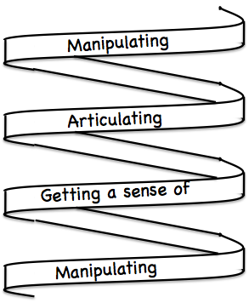
Frameworks
Doing – Talking – Recording (DTR)
(MGA)
See – Experience – Master (SEM)
Enactive – Iconic – Symbolic (EIS)
Specialise … in order to locate structural relationships …
then re-Generalise for yourself
Stuck?
What do I know?
What do I want?

Slide 13
Slogan
A lesson without the opportunity for learners to generalise mathematically …
is not a mathematics lesson!

Slide 14
Follow Up
j.h.mason @ open.ac.uk
mcs.open.ac.uk/jhm3

