Slide 1
Working with the Whole Psyche: what can a teacher do for students? Nurturing Reflective Learners Mathematically in Secondary School
Promoting Mathematical Thinking
John Mason
AME-SMS Singapore
May 2012
The Open University
Maths Dept
University of Oxford
Dept of Education

Slide 2
Assumptions
That which enables action
Tasks –> (mathematical) Activity
–> (mathematical) Actions
–> (mathematical) Experience
–> (mathematical) Awareness
This requires initial engagement in activity
But … One thing we don’t seem to learn from experience …
is that we don’t often learn from experience alone
In order to learn from experience it is often necessary to withdraw from the activity-action
and to reflect on, even reconstruct the action

Slide 3
Arithmetical Relations & Properties
What is 53 + 74 - 29 – 53 + 29 ?
What did you do?
Calculate?
Start calculating?
True or false: 137 + 481 = 481 + 137?
True or false: 37 + 94 = 34 + 97?
Scan & process first??
Say to someone else what the generality is in each case
Notes:
Parking
Make up one Like this

Slide 4
Reflective Withdrawal
What could be generalised?
What did you notice? What struck you?
What actions were effective?
What made them effective?
What would be worth looking out for in the future?
Parking … the first idea that comes to mind

Slide 5
More Relationships
Given that 275275 is divisible by 7, 11 and 13, what is the remainder on dividing 275275021 by 7? By 11? By 13?
Probing the student’s example space
Make up one of your own like this
… and another;
… and another!

Slide 6
Reflective Withdrawal
What could be generalised?
What did you notice? What struck you?
What actions were effective?
What made them effective?
What would be worth looking out for in the future?

Slide 7
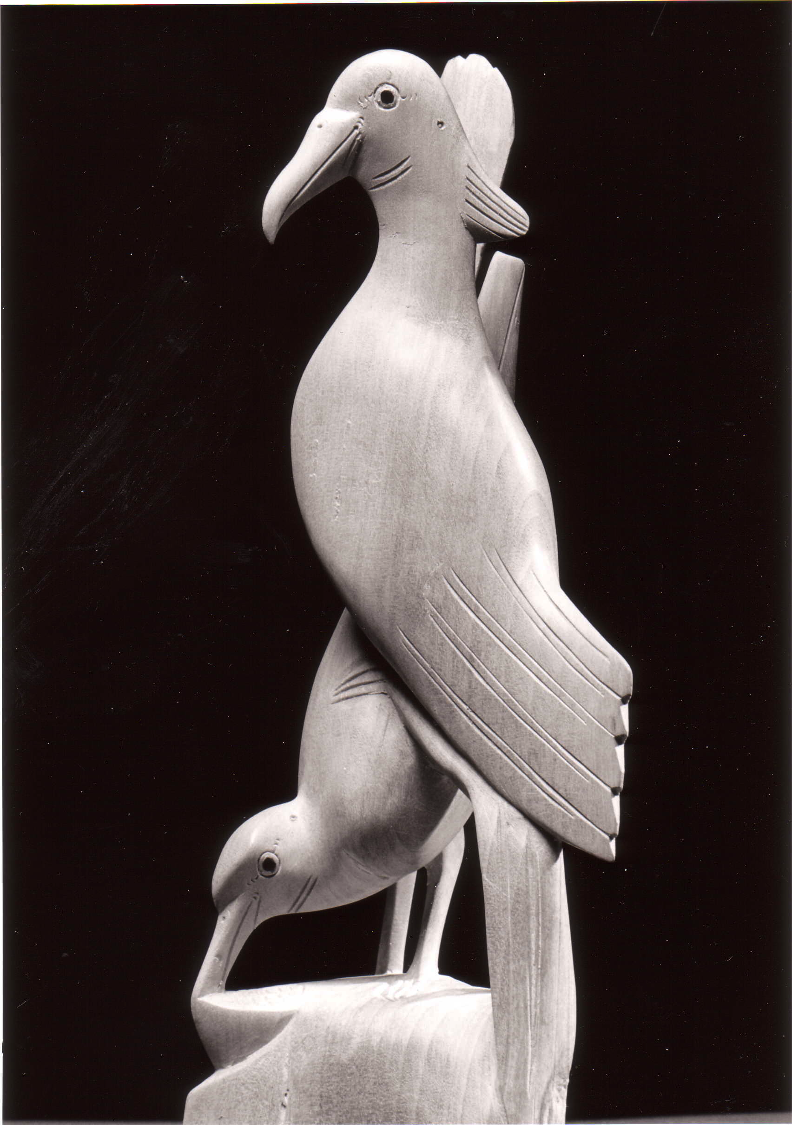
Two Birds
Two birds, close-yoked companions Both clasp the same tree; One eats of the sweet fruit, The other looks on without eating.
[Rg Veda]

Slide 8
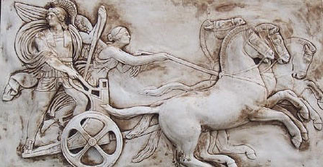
Structure of the Psyche
Awareness (cognition)
Imagery
Will
Emotions (affect)
Body (enaction)
Habits Practices

Slide 9
Doing & Undoing Additively
What operation undoes ‘adding 3’?
What operation undoes ‘subtracting 4’?
What operation sequence undoes adding 3 then subtracting 4?
What single operation does the same?
What operation undoes ‘subtracting from 7’?
Mary Boole:
“acknowledge your ignorance … denote it by something!”
7 –
=
= ?
What can be varied without changing the form?
Notes:
Dave Hewitt’s THOAN sequences
What operation applied four times is the same as ‘adding 3’?

Slide 10
Doing & Undoing Multiplicatively
What are analogues for multiplication?
What undoes ‘multiplying by 3’?
What undoes ‘dividing by 4’?
What undoes ‘multiplying by 3 and then dividing by 4’?
What undoes ‘multiplying by 3/4’?
Two different expressions!
‘Dividing by 3/4’ or ‘multiplying by 4 and dividing by 3’
What operation undoes ‘dividing 24 by’?
What question am I going to ask you next?
Notes:
What about exponentiation?
What operation, performed twice, multiplies by 3?

Slide 11
Reflection on …
What got me stuck? Unstuck?
What actions were effective?
What made them effective?
What actions were ineffective?
What made them ineffective?
What powers called upon?
What themes encountered?
What would be useful to have come-to-mind in the future?

Slide 12
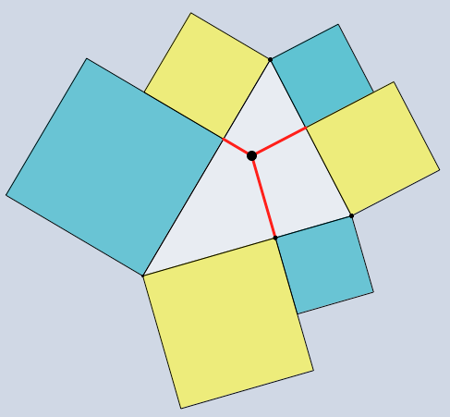
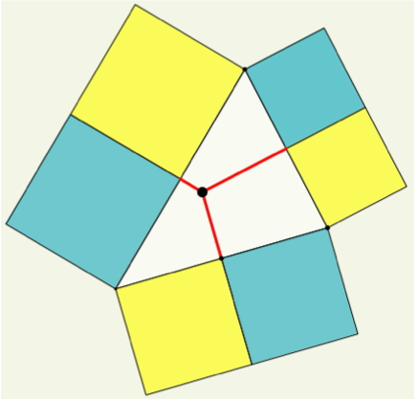
Square Sums
Imagine a triangle …
Imagine the circumcentre;
Drop perpendiculars to the edges;
On each half of each edge, put a square outwards, one yellow, one cyan.

Slide 13
What question am I going to ask you?
What actions were effective?
What made them effective
What would I like to have come to mind in the future?
Example of
Directed – Prompted – Spontaneous
(Scaffolding & Fading)

Slide 14
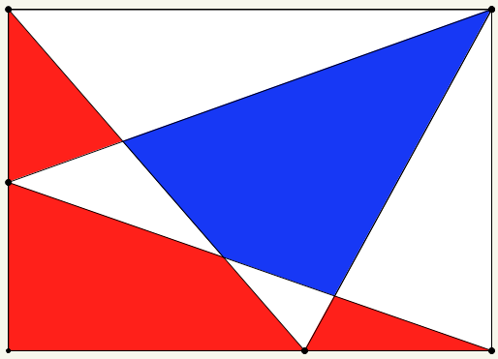
Carpet Theorem
How are the red and blue areas related?
Notes:
Flexibility

Slide 15
Is this slide needed?
What actions were effective?
What made them effective?
What actions were ineffective?
What made them ineffective?
What would I like to have come to mind in the future?
What mathematical themes were encountered?
What mathematical powers played a role?

Slide 16
Put your hand up when you can see …
Something that is the same as 3/5 of something else
Something that is the same as 2/5 of something else
Something that is the same as 2/3 of something else
Something that is the same as 5/3 of something else
…
Something that is the same as 1/4 – 1/5 of something else
Notes:
Flexibility
Generalisation

Slide 17
Patterns From Two
2 + …

Slide 18
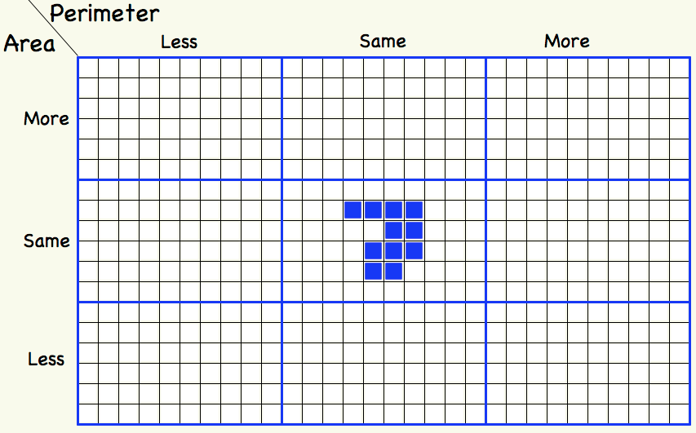
Tabled Variations
Notes:
To promote reflection on the relationship …

Slide 19
Structure of the Psyche
Awareness (cognition)
Imagery
Will
Emotions (affect)
Body (enaction)
Habits Practices

Slide 20
Meta-Reflection
Was there something that struck you, that perhaps you would ike to work on or develop?
Imagine yourself as vividly as possible in the place where you would do that work, working on it
Perhaps in a classroom acting in some fresh manner
Perhaps when preparing a lesson
Using your mental imagery to place yourself in the future, to pre-pare, is the single core technique that human beings have developed.
Researching Your Own Practice Using the Discipline of Noticing (Routledge Falmer 2002)

Slide 21
To Follow Up
http://mcs.open.ac.uk/jhm3
Presentations
Applets
Structured Variation Grids
j.h.mason@open.ac.uk

