Slide 1
To Learn is To Seek: enquiry as a mode of studying mathematics
Promoting Mathematical Thinking
John Mason
Roskilde Denmark
Oct 2012
The Open University
Maths Dept
University of Oxford
Dept of Education

Slide 2
Learning Mathematics Should Mean…
''finding one's way through problems of new sorts, and taking responsiblity for the results”
[Hassler Whitney 1907-1989]
Initiating
Exploring
Revising
Assessing
Conjecture: every topic in school mathematics and in university mathematics into, say, second year can be introduced, deepened, revised and even assessed through making sense of some phenomenon
Notes:
Rasmussen & Kwon (2002). An Enquiry-Oriented Approach to Mathematics Education. J of Math’l Behavior 26 p189-194.

Slide 3
Main Points
Assent-Assert
Responsive Teaching & Responsible Teaching
Mathematics as a Creative Enterprise
Guided Re-Invention (Freudenthal)
Inside Mathematics Itself
Testing conditions; seeking counter-examples
Constructing examples (developing tools for tinkering)
Outside Mathematics Itself
Modelling
Questioning stance towards world (curiosity)

Slide 4
Assent-Assert
Do your students sit there and nod, as if assenting to what they are told?
Do your students make conjectures?
Do they try to validate and justify conjectures?
Issues: Mattering & Muttering

Slide 5
Spondent Teaching
Re-sponding to students in real time or soon thereafter
Listening-to not listening-for
Entering-in as well as Dragging-in
Experiencing parallel struggles as a re-minder
Re-sponsible as a teacher … able to justify choices
of topics,
of tasks,
of modes of interaction with students

Slide 6
Pedagogical Assumptions
Tasks generate activity
Activity produces experience
One thing we don’t often learn from experience is that we don’t often learn from experience alone
Something else is required …
Reflection & Reconstruction

Slide 7
Rolling Polygons
1
2

Slide 8
Rolling Polygon reflections
What attracted your attention?
What powers evoked?

Slide 9
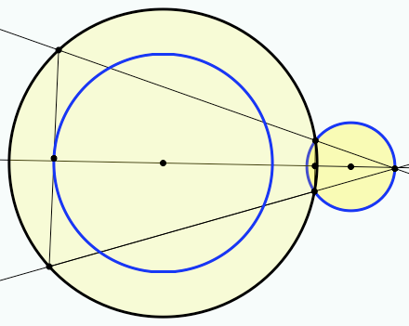
Chord Expansion
What is the phenomenon?

Slide 10
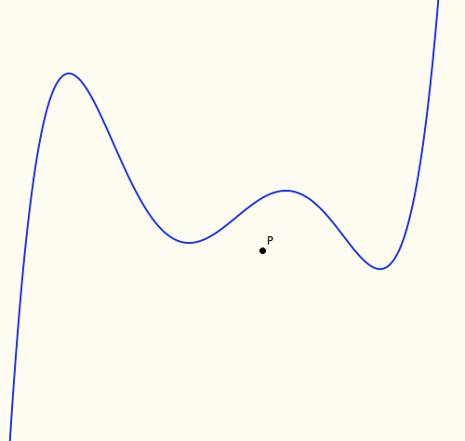
Tangent Power
The tangent power of a point P wrt a function is the number of tangents to f through the point P.
Where is the largest tangent power?

Slide 11
Tangent Power Reviewed
What mathematical concepts were encountered?
What classic obstacles might be challenged?
What actions were effective?

Slide 12
Ordering Lines
In how many different ways can the expressions a_{k}x + b_{k} (k = 1 .. 3) be placed in order and still have a solution for x?
Generalise

Slide 13
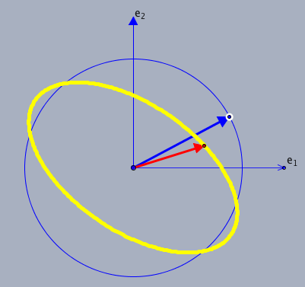
Linear Transformations
What is being exemplified?
How a linear mapping is specified
Relation between vector and image
Action of transformation on a set
Eigenvectors etc
Two dimensions ‘typical’ of higher dimensions
How ICT can be used to support mental imagery
How ICT can be used to prompt questions
What would you want learners to do with this experience?

Slide 14
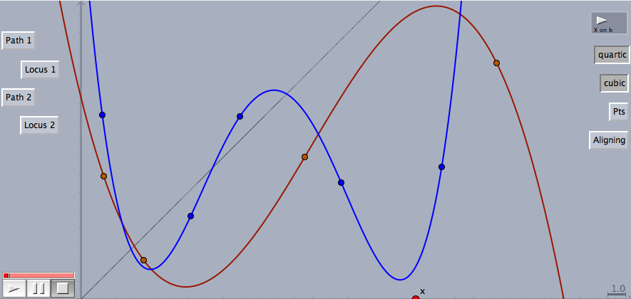
Cobwebs
Notes:
Degree of generality: very specific (numerical); dynamically general; abstractly general

Slide 15
Cobwebs Reviewed
What was being exemplified?
Cubic specified by 4 points, Quartic by 5
Any cubic; Any quartic
Cobweb constructions and reading graphs
Way to imagine composite functions
Properties of composite functions

Slide 16
Original Tangents
At what point does the tangent to y = e^{x} pass though the origin?
What about y = e^{2x} ?
Generalise
What is the locus as the parameter varies?
At what point does the tangent to y = (mx)² + 1 pass through the origin for different values of m?
At what point does the tangent to y = m(x² + 1) pass through the origin for different values of m?
Explain the general phenomenon

Slide 17
Constant Sum
Add up any 4 entries, one taken from each row and each column.
The answer is (always) 6
Why?
0
-2
2
-4
6
4
8
2
3
1
5
-1
1
-1
3
-3
Example of (use of) permutations
Example of seeking invariant relationships
Example of focusing on actions preserving an invariance
Opportunity to generalise
Arithmetic practice

Slide 18
Rectangular Max-Min
In any rectangular grid of numbers,
Let m_{c} be the minimum of the entries in column c and m the maximum of the m_{c}.
Let M_{r} be the maximum of the entries in row r and let M be the minimum of the M_{r}.
Is there any general relationship between m and M?
What happens if you change max and min to arithmetic and geometric means respectively?
To other ‘statistics’?
Notes:
What can be varied?
What about an infinite array (Least Upper Bounds and Greatest Lower Bounds)?

Slide 19
Preparing the Ground
Construct a function F : [a, b] --> R
which is continuous and differentiable on (a, b)
for which f(a) = f(b)
but nowhere on (a, b) is f’(x) = 0
Notes:
Setting an impossible task in order to prompt possibility and significance of a theorem

Slide 20
Set Ratios
In how many different ways can you place 17 objects so that there are equal numbers of objects in each of two sets?
What about requiring that there be twice as many in the left set as in the right set?
What can be varied?
Scaffolding & Fading …
So that pupils ask this spontaneously

Slide 21
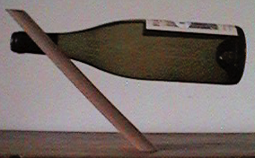
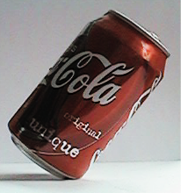
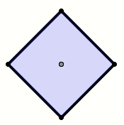
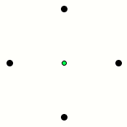
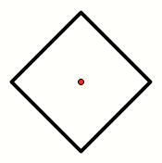
‘Balance Curriculum’

Slide 22
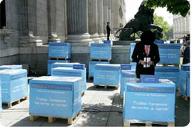
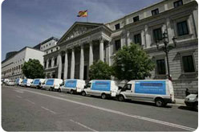
Petitions (LEMA project)
The Spanish opposition party recently presented 4 million signatures against a new law proposed by the government. Newspapers published pictures of the big boxes and 10 vans needed to transport the sheets of paper to the congress. Was that reasonable?

Slide 23
Restoration
The Guardian reported today that a medieval tapestry had taken 3500 hours to restore.
A previously lost painting by van Dyke cost £10 000 to restore.

Slide 24
One Newspaper
Subscribe for 7 days, save 33% subscribe for 6 days, save 25% subscribe for 2 days, save 20%
By buying own-brands and shaving £10 a month off grocery bills, an average household can spend £5 extra on clothes and hobbies and a further £8 on eating out, entertainment & holidays.
Drug O reduced average time to alleviation by 0.68 days Drug Z reduced average time to alleviation by 0.71 days 75mg of O daily was 61% effective compared to placebo 150mg of O daily was 73% effective compared to a placebo
The average Briton has 3 close friends
60.6% if Twitter’s 10m users are over 35 years old 52.4% of Facebook’s 200m users are over 35 years old
Average Facebook user has 120 friends on the site More than 3.5 billion minutes are spent on Facebook each day More than 20 million users update their statuses at least once each day

Slide 25
Black & White
It was announced that in one education authority, although 10% of the students were Black, 40% of the students excluded from school were Black. This meant that Black students were 6 times as likely to be excluded.
Given a collection of objects of different colours in the ratios c₁ : c₂ : … : c_{n} and a sample in which the colours are in the ratios s₁ : s₂ : … : s_{n} what were the probabilities of each colour being drawn for the sample?
Notes:
Surprise;
Use of diagrams
Use of symbols (particular/general)

Slide 26
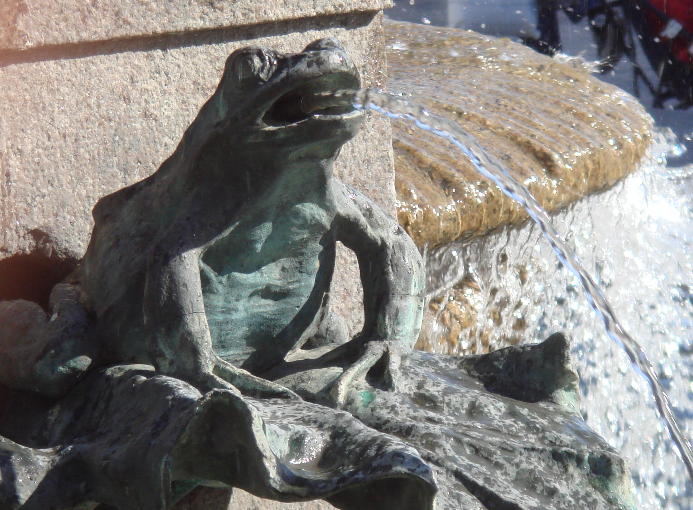
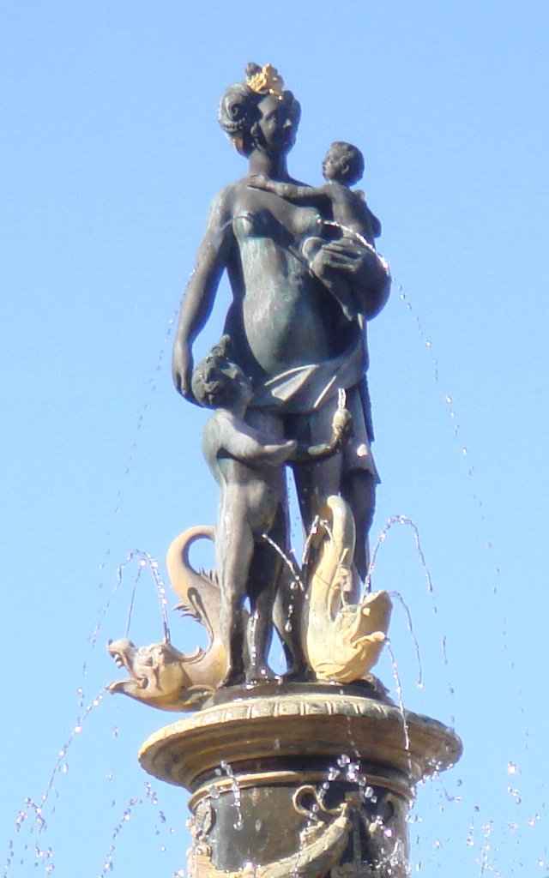
Fountains in Copenhagen
Notes:
Shape of curve
Alternating light and dark patterns

Slide 27
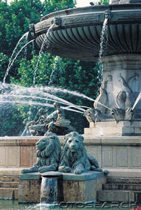
Fountains
A fountain has three spouts: a frog, a dolphin and a lion.
The lion will fill up the cistern in 1 hour, the dolphin in 3 and the frog in 5.
How long will it take all three working together
What dimensions of variation can you detect?

Slide 28
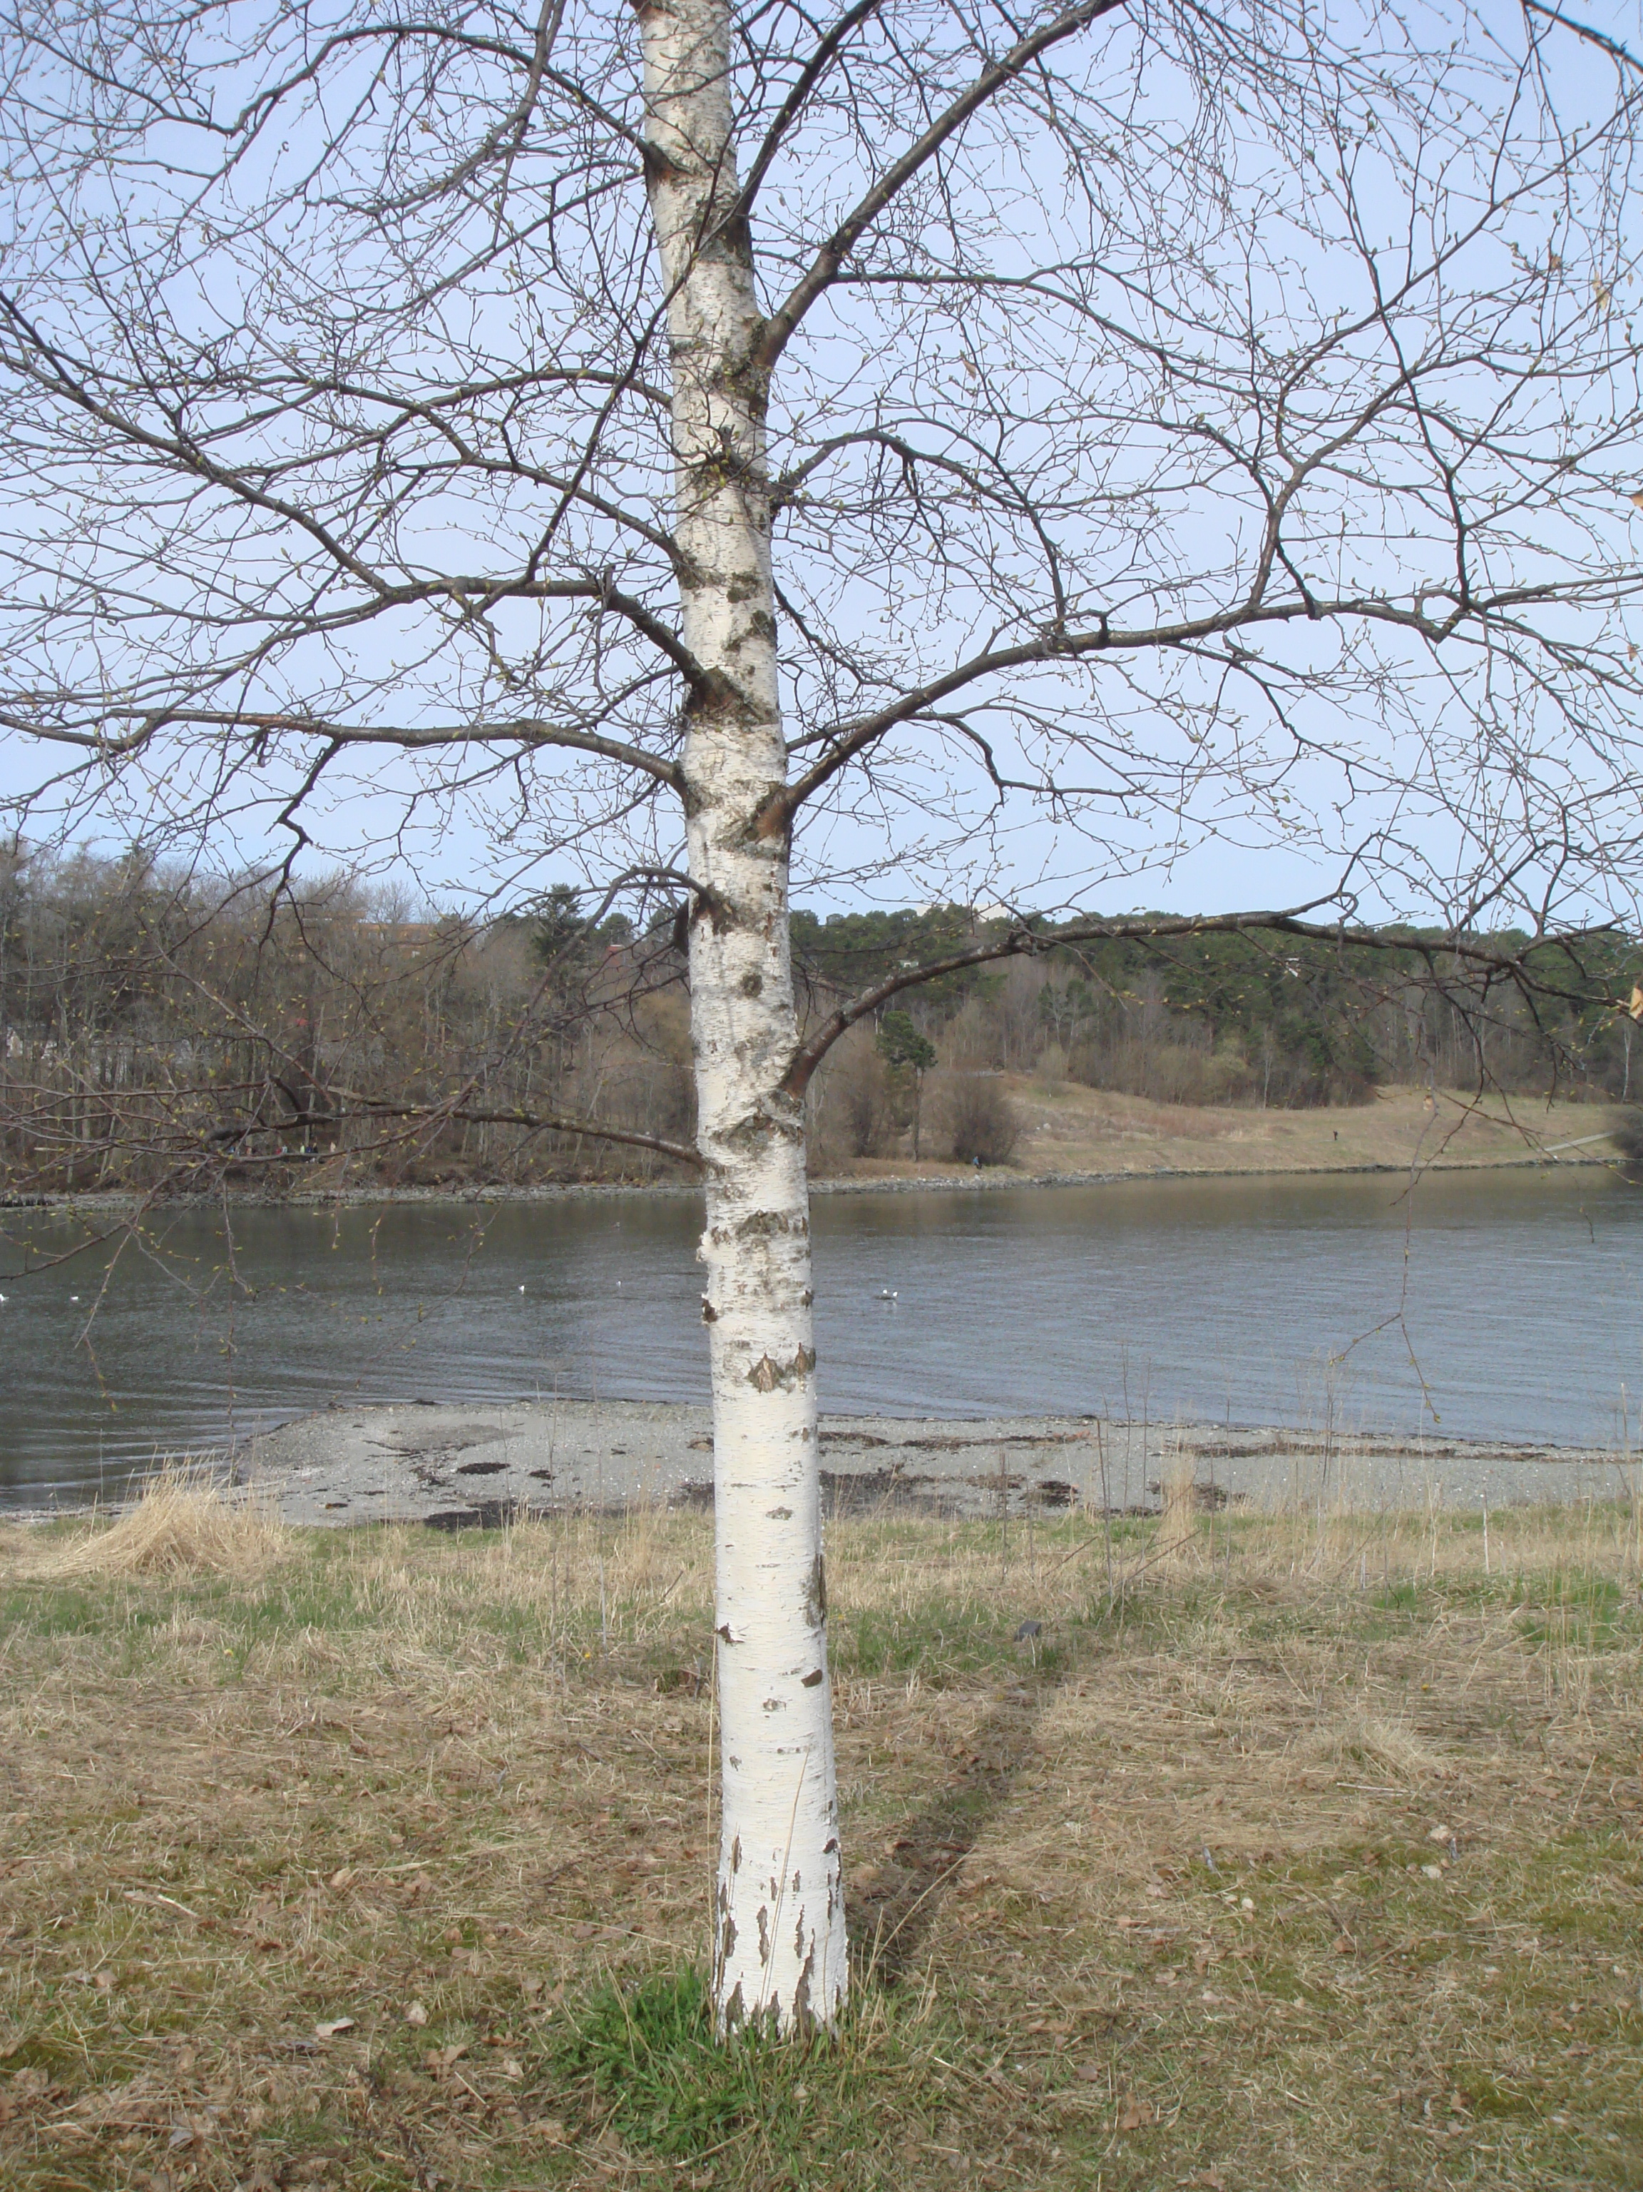
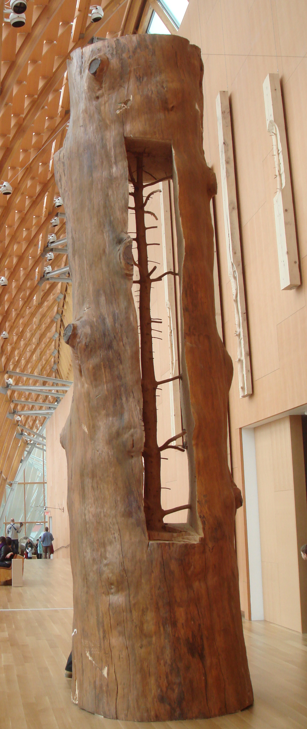
Tree Growth
When a tree grows …
Do the branches rise?
Is there a characteristic relationship between twig positions and branch positions?

Slide 29
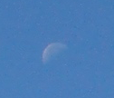
Moon Struck
When can you see a vertical half-moon?
How much does the moon move in an hour?
If you look at the same spot a day later, by how much will the moon have moved?
Can you ever see a horizontal half-moon?

Slide 30
How & Why
How do different hinges work?
How many different kinds can you find?
What problems are they solving?

Slide 31
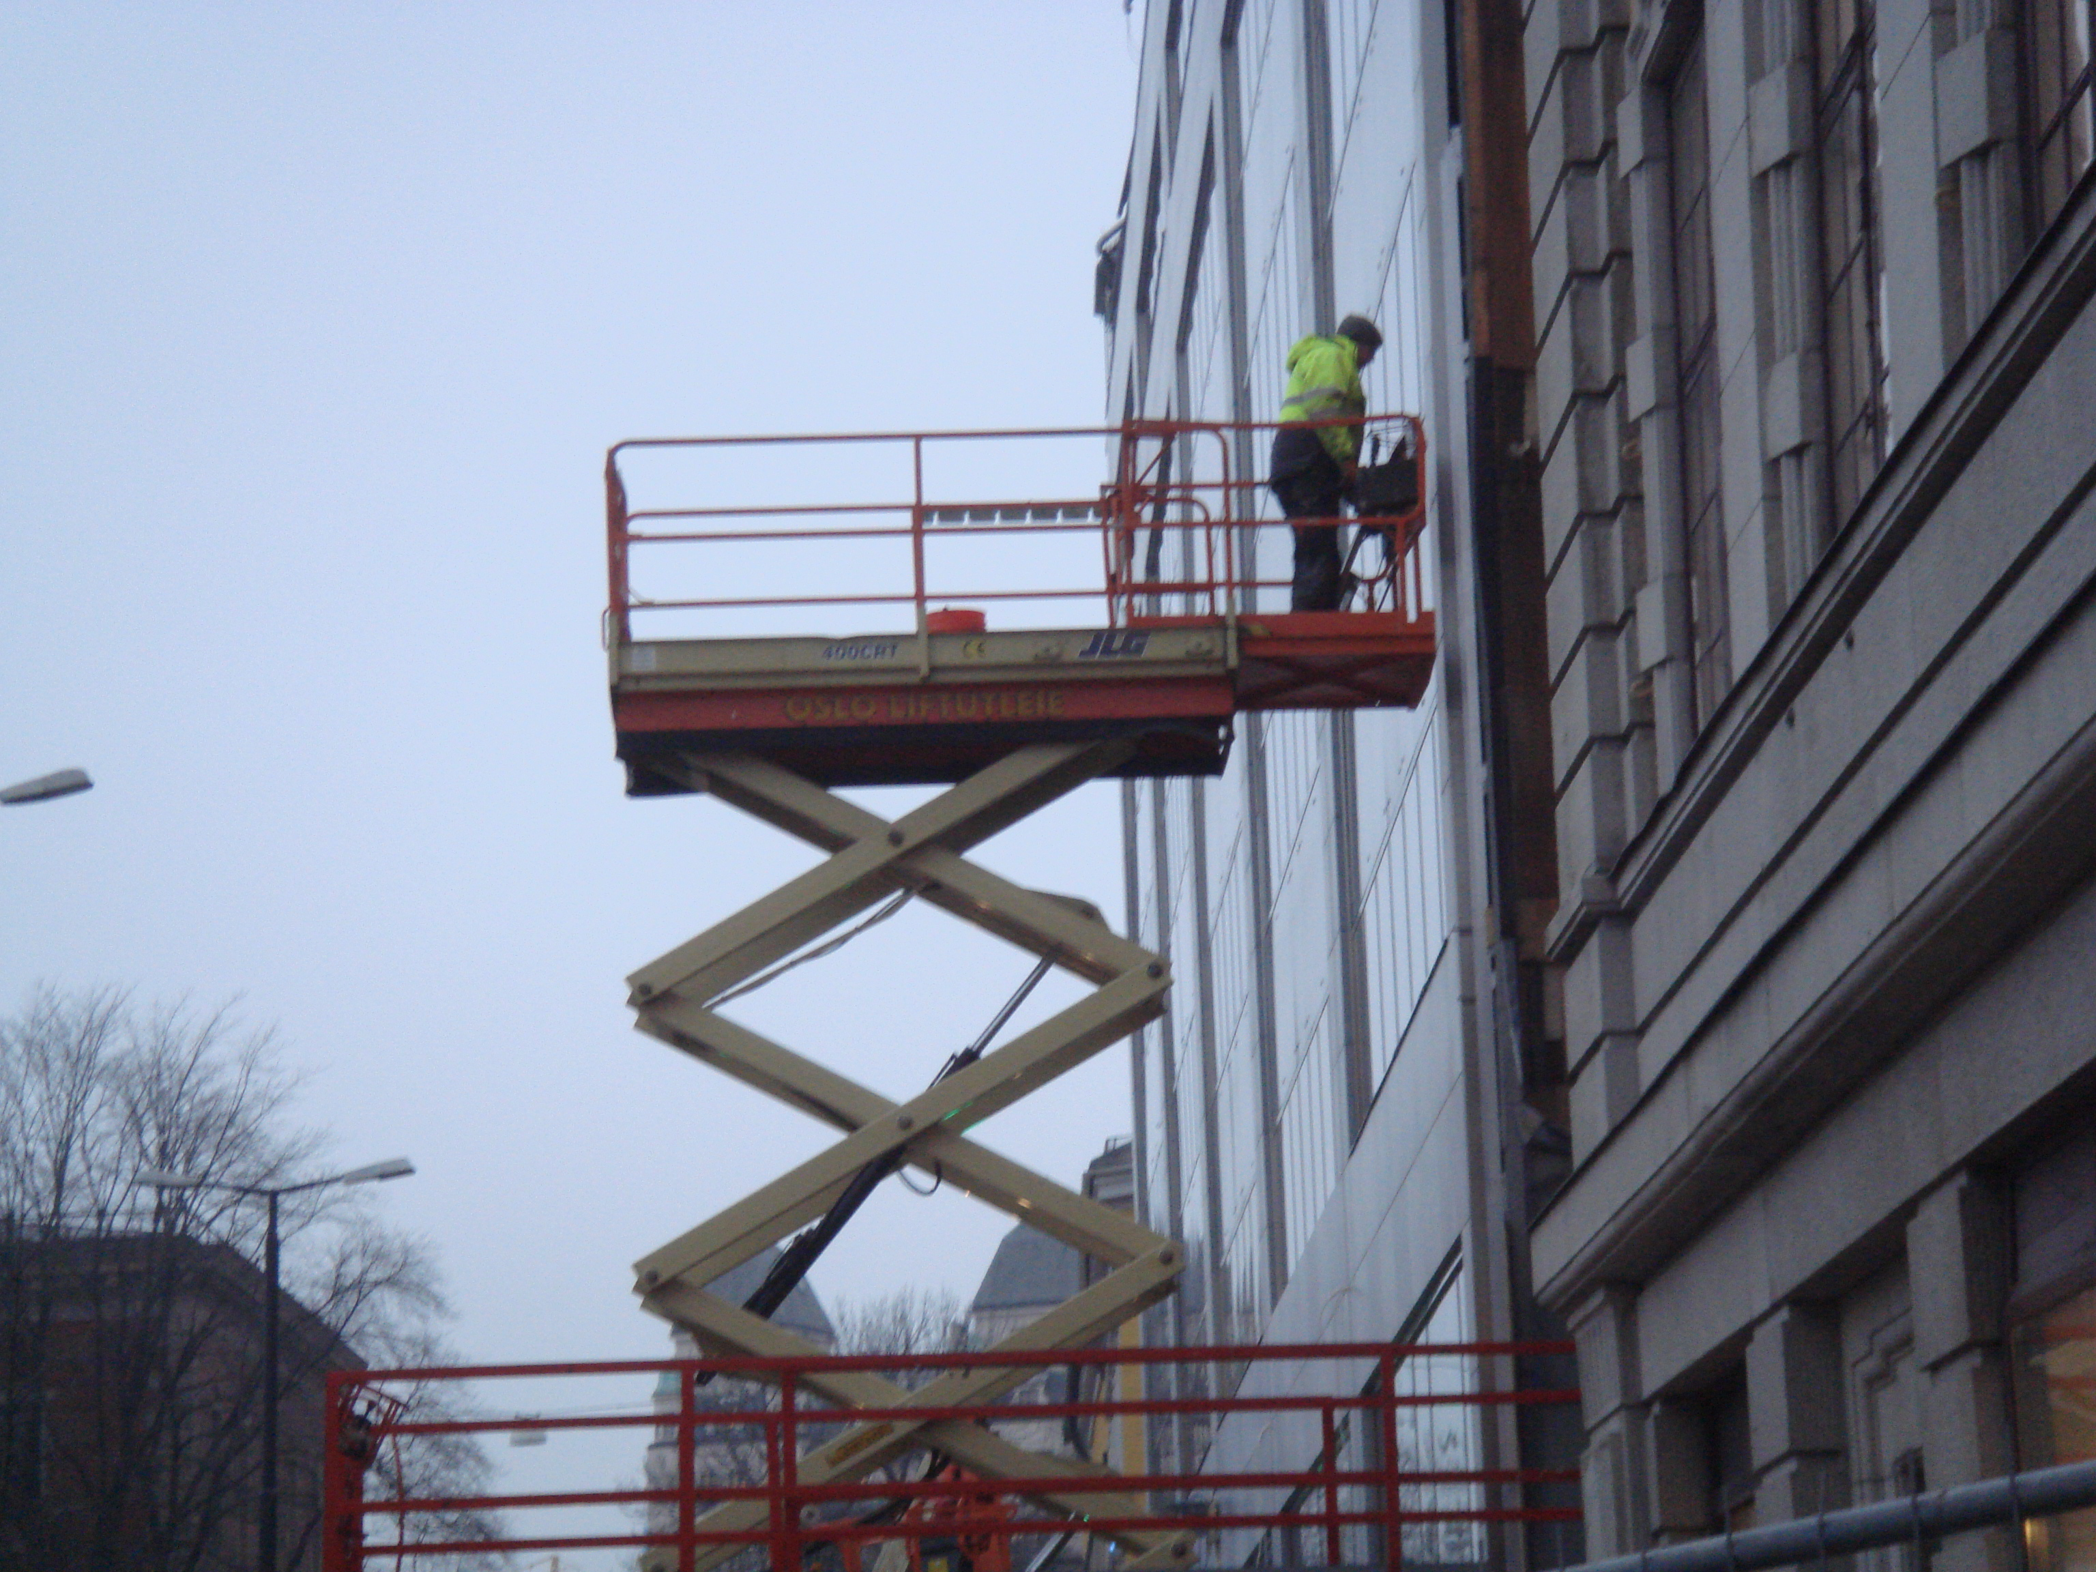
Cherry Picker

Slide 32
Universal Joint

Slide 33
Knotted
By how much is the length of a rope decreased by tying a clove-hitch around a rod?

Slide 34
Fencepost Reasoning
How many birthdays have you had?
If there are 10 steps in a staircase and each riser is 15cm, how high is the first floor above the ground floor?
When you count the stairs going up and the stairs going down, do you count the same things?
If a fence has 20 sets of rails, how many posts are required?

Slide 35
Hinged Dissections (Dudeney)
http://www.cs.purdue.edu/homes/gnf/book2/tab_anims.html
Notes:
Not all phenomena are ‘material world’

Slide 36
Hinged Dissection (Frederickson)
Notes:
Rectangle into a square`/

Slide 37
Ride & Tie
Two people set off on a long journey with only one horse between them. One rides, then ties the horse and walks on, the other walking until reaching the horse, and then riding for a time.
Knowing their different riding and walking speeds, how long will it take them so that they both arrive at the same time?
For how much of the time is the horse resting?
How can they arrange their use of the horse?
What if the horse must rest for a specified time each hour?

Slide 38
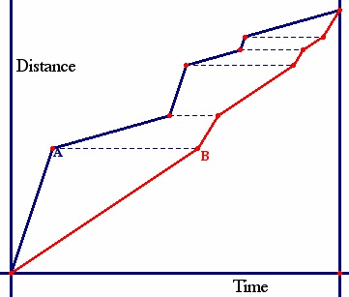
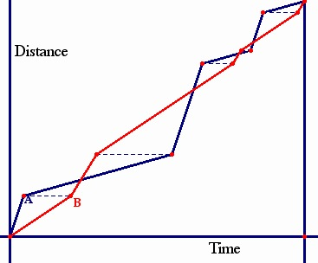
Reading Graphs

Slide 39
Medieval Picking
Tractatus Algorismi, of Jacopo da Firenze (Montpelier 1307)
‘‘I go to a garden, and come to the foot of an orange. And I pick one of them. And then I pick the tenth of the remainder. Then comes another after me, and picks two of them, and again the tenth of the remainder. Then comes another and picks three of them, and again the tenth of the remainder. . . . And then come many. Then the one who comes last, that is, behind, picks all that which he ﬁnds left. And ﬁnds by this neither more nor less than the others got. And one picked as much as the other. And as many men as there were, so many oranges each one got. I want to know how many men there were, and how many oranges they picked (each) one, and how many they picked all together.’’ (Høyrup, 2007, p. 6)

Slide 40
D’Ambrosio
Given problems ––> identifying problems (problem posing)
Individual work ––>cooperative work (teams)
One solution problems ––> open ended problems
Exact solutions ––> approximate solutions

Slide 41
Reflections
Being surprised is a state of mind
Having mathematical possibilities come to mind in the moment
If I expect learners to function mathematically, they must become used to making significant (functional) choices for themselves
Notes:
When in a situation
When confronted with a task, as a learner

Slide 42
Issues
Time
Learning how to learn mathematics
What if I don’t know the answer?
Being mathematical with and in front of students
Motivation

Slide 43
Motivation
Motivation is not a thing
Sense of gap or disturbance
Appropriate challenge + Trust in teacher
What matters: making matter matter
Phenomena to explain using mathematics
Mathematical phenomena to explain things
Making full use of the human psyche

Slide 44
Motives
Asking Why
Cherry Picker; Hinges
Asking How
Ride & Tie
Being Surprised
Black & White
Cultural Tools
Birthdays (fence-posts)
Working backwards

Slide 45
Functioning Mathematically
Meaning: recognising opportunity to use mathematical thinking to make sense of phenomena:
Being surprised and explaining surprises
Recognising problems and resolving problems
Challenging assumptions, reasoning and conclusions
Moving from participant to organiser; from customer to entrepreneur (taking initiative)
Means:
Seek and express relationships
Test generalities against particulars
Acknowledge ignorance and denote:
Physically, Diagrammatically, Symbolically
Develop and exploit powers; encounter themes & heuristics

Slide 46
Learning to Function Mathematically
Exposure to surprise
Growing complexity
Use & development of powers
Appreciation and use of mathematical themes
Integration of useful techniques & heuristics
Cuoco on Habits of Mind

Slide 47
Tensions
Only think to use
Familiar, confidence inspiring tools
Most recently taught techniques (end of chapter syndrome)
Cannot be expected to devise new concepts/techniques without instruction simply from immersion in problems (ignores cultural history)
Little value in only working on problems you can do unless they challenge in some way
School Curriculum abstracts & extracts concepts & techniques others have constructed, as cultural tools
Notes:
e.g. Fence-post argument
e.g working backwards

Slide 48
What problems are worth posing and resolving?
ones which call upon and draw attention to human powers of (mathematical) sense making
ones which illustrate or exemplify mathematical themes
ones which promote learner recognition of how common situations can be understood by posing and resolving (mathematical) problems

Slide 49
Three Worlds
(Enactive)
Material
Mental
Symbolic
Modelling & Real Problem Solving
(Iconic)
(Symbolic)
Enactive
Iconic
Symbolic
Symbolic (Mathematical)
Material
Mental
Symbolic (Mathematical)
Material
Mental
Write-up and Action
Notes:
Three modes of representation (Jerome Bruner)

Slide 50
Task Design & Use
Re-flection & Pro-flection
Content
Task
Activity
Potential
Actions
Structure of a Topic
Challenge
Effectiveness of actions
Themes
Powers
Inner & Outer
3 Only’s
Interaction
7 phases
Teacher
Peers
It is not the task that is rich bbut the way the task is used that is rich
6 Modes
Roles
Questioning

Slide 51
Follow-Up
Questions & Prompts (ATM Derby)
Designing & Using Mathematical Tasks (Tarquin)
Mathematics Teaching Practice: a guide for university lecturers (Horwood)
Counter-Examples in Calculus (College Press)
Various chapters and papers
j.h.mason @ open.ac.uk
mcs.open.ac.uk/jhm3

Slide 52
Actions
Right-multiplying by an inverse ...
Making a substitution
Differentiating
Iterating
Reading a graph
Invoking a definition
…

Slide 53
Themes
Doing & Undoing
Invariance in the midst of change
Freedom & Constraint
Restricting & Extending

Slide 54
Powers
Imagining & Expressing
Specialising & Generalising (Stressing & Ignoring)
Conjecturing & Convincing
(Re)-Presenting in different modes
Organising & Characterising

Slide 55
Inner & Outer Aspects
Outer
What task actually initiates explicitly
Inner
What mathematical concepts underpinned
What mathematical themes encountered
What mathematcical powers invoked
What personal propensities brought to awareness

Slide 56
Challenge
Appropriate Challenge:
Not too great
Not too little
Scope depends on student trust of teacher
Scope depends on teacher support of mathematical thinking not simply getting answers
Notes:
Link through affect to motives

Slide 57
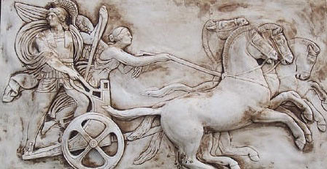
Structure of a Topic
Awareness (cognition)
Imagery
Will
Emotions (affect)
Body (enaction)
Habits Practices

Slide 58
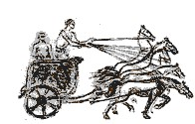
Three Only’s
Language Patterns & prior Skills
Imagery/Sense-of/Awareness; Connections
Root Questions
predispositions
Different Contexts in which likely to arise; dispositions
Standard Confusions & Obstacles
Techniques & Incantations
Emotion
Awareness
Behaviour
Only Emotion is Harnessable
Only Awareness is Educable
Only Behaviour is Trainable

Slide 59
Six Modes
Expounding
Exploring
Explaining
Exercising
Examining
Expressing

Slide 60
Roles
Resources
Communicator (to others)
Keeping Track
Social Interactions
…
Initiating, Responding, Mediating

Slide 61
Phases
Getting Started
Contemplating
Getting Involved
Being Sceptical
Keep Going
Insight
Mulling

