Slide 1
A Lesson Without the Opportunity for Learners to Generalise …is NOT a Mathematics lesson!
Promoting Mathematical Thinking
John Mason
‘Powers’ Norfolk Mathematics Conference
Norwich
Nov 28 2012
The Open University
Maths Dept
University of Oxford
Dept of Education

Slide 2
Conjectures
Everything said here today is a conjecture … to be tested in your experience
The best way to sensitise yourself to learners …
is to experience parallel phenomena yourself
So, what you get from this session is what you notice happening inside you!

Slide 3
Tasks
Tasks promote Activity;
Activity involves Aactions;
Actions generate Experience;
but one thing we don’t learn from experience is that we don’t often learn from experience alone
It is not the task that is rich …
but whether it is used richly

Slide 4
What’s The Difference?
–
=
What then would be the difference?
First, add one to each
What then would be the difference?
First, add one to the larger and subtract one from the smaller
What could be varied?
Notes:
• 153 – 87 = ? Orally; visibly;
•That is arithmetic; Now let’s do some mathematics!
Two volunteers: think of a three digit number and a two digit number.
• We’re going to subtract the smaller from the larger but before we do, lets add one to both.
What’s the difference now?

Slide 5
Composite Doing & Undoing
What’s my number?
I am thinking of a number …
I add 8 and the answer is 13.
How are you doing it?
What’s my number?
I add 8 and then multiply by 2; the answer is 26.
I add 8; multiply by 2; subtract 5; the answer is 21.
What’s my number?
I add 8; multiply by 2; subtract 5; divide by 3; the answer is 7.
What’s my number?
HOW do you turn +8, x2, -5, ÷3 answer into a solution?
7
Generalise!

Slide 6
Selective Sums
Add up any 3 entries, one taken from each row and each column.
The answer is (always) 15
Why?
8
2
5
7
1
4
8 + 1 = 7 + 2
9
3
6
8 – 2 = 7 – 1
Where is there generality?
What can be varied? What must remain invariant?
Make up your own with a different sum (eg. your age?)

Slide 7
Selective Sums
Add up any 4 entries, one taken from each row and each column.
The answer is (always) 6
Why?
0
-2
2
-4
6
4
8
2
3
1
5
-1
1
-1
3
-3
Example of seeking invariant relationships
Opportunity to generalise
Arithmetic practice

Slide 8
Selective Sums
Add up any 4 entries, one taken from each row and each column.
The answer is (always) 6
Why?
0
-2
2
-4
6
4
8
2
3
1
5
-1
1
-1
3
-3
Example of (use of) permutations
Example of seeking invariant relationships
Example of focusing on actions preserving an invariance
Opportunity to generalise
Notes:
Use fractions to urge practice with fractions
Get students to make up their own with their age or some other number as the answer

Slide 9
Selective Sums
Add up any 4 entries, one taken from each row and each column.
Is the answer always the same?
Why?

Slide 10
Two Numbers
I have written down two whole numbers that differ by 2. I multiply them together and add 1.
What properties must my answer have?
How do you know?
Turning to some ‘thing’ that is confidence inspiring
Specialising
In order to generalise
Manipulating
Getting a sense of
Articulating
Alternative ways to introduce a task

Slide 11
Working with Differences
Think of a number (not too large!)

Slide 12
Understanding Division
234234 is divisible by 13 and 7 and 11;
What is the remainder on dividing 23423426 by 13?
By 7? By 11?
Make up your own!
What is the general principle?
Telling a ‘story’; having a narrative

Slide 13
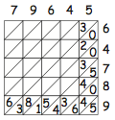
Find the error!
79645
79645
64789
64789
30
30
2420
2420
361635
361635
54242840
54242840
4230423245
4230423245
28634836
28634836
497254
497254
5681
5681
63
63
63
How did your attention shift?
How did your attention shift?
5160119905
5160119905

Slide 14
Working with Patterns
…
A repeating pattern has appeared at least twice
…
Extend both sequences
What colour will the 100th square be in each?
What square will have the 37th green square in each?
At what squares will the first of a pair of greens in the second sequence align with a green in the first sequence?
What colour should the missing square be?
…
How do you know?

Slide 15
Substitution Pattern Spotting
W
WBB
WBB BW BW
⬆
⬆
⬆
⬆
⬆
⬆
⬆
WBB BW BW BW WBB BW WBB
⬆
⬆
⬆
⬆
⬆
⬆
⬆
WBB BW BW BW WBB BW WBB BW WBB WBB BW BW BW WBB WBB BW BW

Slide 16
Gasket Sequences

Slide 17
Two + Two
2
+
1
=
2
x
1
2
+
2
=
2
x
2
+
=
x
1
+
1
=
3
x
1
17
1
17
3
with the grain
1
1
4
+
1
=
4
x
1
+
1
=
x
1
-
1
-
1
5
+
1
=
5
x
1
+
1
=
6
x
1
√17
+
1
=
√17
x
1
6
...
Watch What You Do!
across the grain

Slide 18
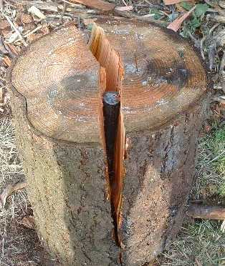
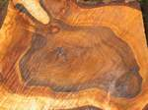
With and Across the Grain

Slide 19
Extending & Varying

Slide 20
Four Numbers
I have written down four consecutive whole numbers.
I multiply them together and add 1.
What sort of a number is the answer?

Slide 21
Adding Consecutives
If you add any three consecutive numbers, you always get a number that is divisible by 3.
If you add any four consecutive numbers, you always get a number that is divisible by … but never divisible by … .
Generalise!

Slide 22
Differing Sums of Products
Write down four numbers in a 2 by 2 grid
4
7
5
3
Add together the products along the rows
28 + 15 = 43
Add together the products down the columns
20 + 21 = 41
43 – 41 = 2
Calculate the difference
That is the ‘doing’ What is an undoing?
Now choose positive numbers so that the difference is 11
Notes:
Mathematical context
What probaby matters most is not eh context, but whether students ‘think’ they can solve the problem!

Slide 23
Differing Sums & Products
4
7
Tracking Arithmetic
5
3
4x7 + 5x3
4x5 + 7x3
4x(7–5) + (5–7)x3
= 4x(7–5) – (7–5)x3
= (4-3) x (7–5)
So in how many essentially different ways can 11 be the difference?
So in how many essentially different ways can n be the difference?
Notes:
Revealing Structure by attending to relationships not calculations

Slide 24
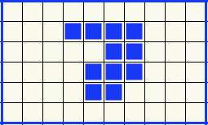
More or Less grids
Perimeter
More
Same
Less
Area
More
Same
Less
With as little change as possible from the original!

Slide 25
Put your hand up when you can see …
Something that is 3/5 of something else
Something that is 2/5 of something else
Something that is 2/3 of something else
Something that is 5/3 of something else
What other fraction-actions can you see?
How did your attention shift?
Notes:
Generalise!

Slide 26
Put your hand up when you can see …
Something that is 1/4 – 1/5 of something else
Did you look for something that is 1/4 of something else
and for
something that is 1/5 of the same thing?
What did you have to do with your attention?
Can you generalise?
Notes:
Generalise!

Slide 27
Why is two-thirds of three-quarters of something the same as three-quarters of two-thirds of the same thing?

Slide 28
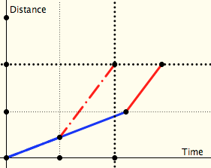
Two Journeys
Which journey over the same distance at two different speeds takes longer:
One in which both halves of the distance are done at the specified speeds
One in which both halves of the time taken are done at the specified speeds
distance
time

Slide 29
Named Ratios
Now take a named ratio (eg density) and recast this task in that language
Which mass made up of two densities has the larger volume:
One in which both halves of the mass have the fixed densities
One in which both halves of the volume have the same densities?

Slide 30
Counting Out
In a selection ‘game’ you start at the left and count forwards and backwards until you get to a specified number (say 37). Which object will you end on?
A
B
C
D
E
1
2
3
4
5
9
8
7
6
10
…
If that object is elimated, you start again from the ‘next’. Which object is the last one left?
Notes:
How do you know?
Generalise!

Slide 31
Pre-Counting
I have a pile of red counters and you have lots of yellow ones
I want to exchange each of my red counters for one of your yellow counters.
What is involved in carrying out the exchange?

Slide 32
Arithmetic of Exchange
I have a pile of blue counters. I am going to exchange each for 2 of your red counters…
What mathematical action is taking place on the cardinalities?
I exchange 7 of my blues for 1 of your reds until I can make no more exchanges …
What mathematical action is taking place?
I exchange 5 of my blues for 2 of your reds until I can make no more exchanges …
What mathematical action is taking place?
I exchange 10 blues for 1 red and 10 reds for 1 yellow as far as possible …
What mathematical action is taking place?
What language patterns accomany these actions?
Notes:
First action looks like sacaling if you attend to the exchange and like repeated addition if you attend to the accumulation of reds.

Slide 33
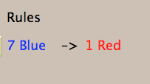
Exchange
What’s the generality?
1 Large –> 5 Small
3 Large –> 1 Small
Notes:
Compare with ‘money’
Flexibility (size isn’t everything)

Slide 34
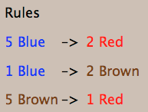
More Exchange
What’s the generality?
Notes:
Place Value is based on exchange

Slide 35
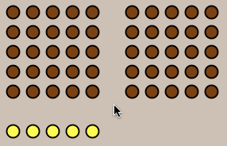
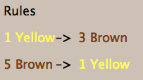
Maslanka’s Monkey
Challenge: can you reach a state of equal numbers of yellow and brown?

Slide 36
Outer & Inner Tasks
Outer Task
What author imagines
What teacher intends
What students construe
What students actually do
Inner Task
What powers might be used?
What themes might be encountered?
What connections might be made?
What reasoning might be called upon?
What personal dispositions might be challenged?

Slide 37
Follow Up
j.h.mason @ open.ac.uk
mcs.open.ac.uk/jhm3 → Presentations
Thinking Mathematically (Pearson)
Questions & Prompts (ATM)
Learning & Doing Mathematics (Tarquin)
Developing Thinking in Algebra

