Slide 1




Imagine That!
Promoting Mathematical Thinking
John Mason
ATM branch
Bath
Nov 13 2012
The Open University
Maths Dept
University of Oxford
Dept of Education

Slide 2
Conjectures
Everything said here today is a conjecture … to be tested in your experience
The best way to sensitise yourself to learners …
  is to experience parallel phenomena yourself
So, what you get from this session is what you notice happening inside you!

Slide 3
Tasks
Tasks promote Activity;
Activity involves Aactions;
Actions generate Experience;
  but one thing we don’t learn from experience is that we don’t often learn from experience alone
It is not the task that is rich …
  but whether it is used richly

Slide 4
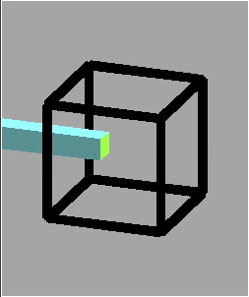
Necker Cube

Slide 5
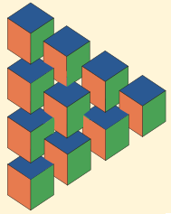
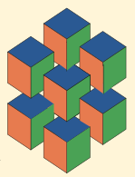
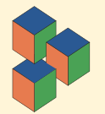
Stacked Cubes

Slide 6
What Do You See?

Slide 7
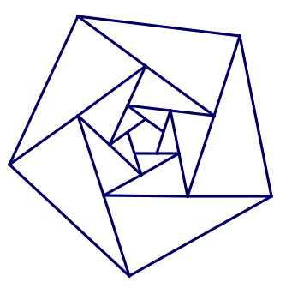
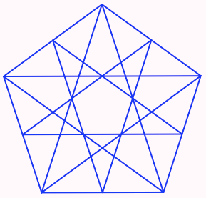
Say What You See
Sketch what you think you saw
Compare with what others drew
How did you go about it?

Slide 8
Triangular Reflections
Imagine a triangle
Now imagine a more interesting triangle!
  Label the vertices A, B and C
Choose a point P in the plane somewhere
Reflect P in the point A to get the point PA
Reflect PA in the point B to get the point PAB
Reflect PAB in the point C to get the point PABC
What is the geometric relation between P and PABC?
Repeat starting from PABC to end with PABCABC
Now what is the relation between P and PABCABC?

Slide 9
Triangle Movements
Imagine a triangle
Now imagine a more interesting triangle!
Mark the midpoints of its edges (A, B, C)
Rotate a copy of your trianglethrough 180° around the point A and note where the copy B’ of B is.
Now rotate a copy of the copy through 180° around the point B’, noting the image A’ of A.
Keep rotating alternately about the new positions of B and of A to produce a collection of triangles.

Slide 10
Ride & Tie
Imagine that you and a friend have a single horse (bicycle) and that you both want to get to a town some distance away.
In common with folks in the 17th century, one of you sets off on the horse while the other walks. At some point the first dismounts, ties the horse and walks on. When you get to the horse you mount and ride on past your friend. Then you too tie the horse and walk on…
Supposing you both ride faster than you walk but at different speeds, how do you decide when and where to tie the horse so that you both arrive at your destination at the same time?

Slide 11
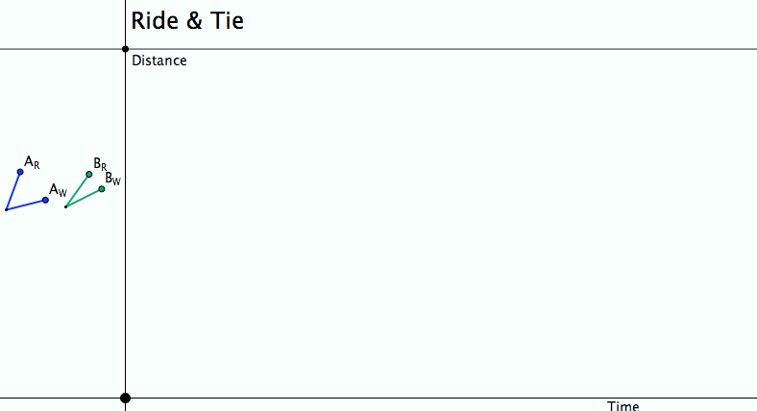
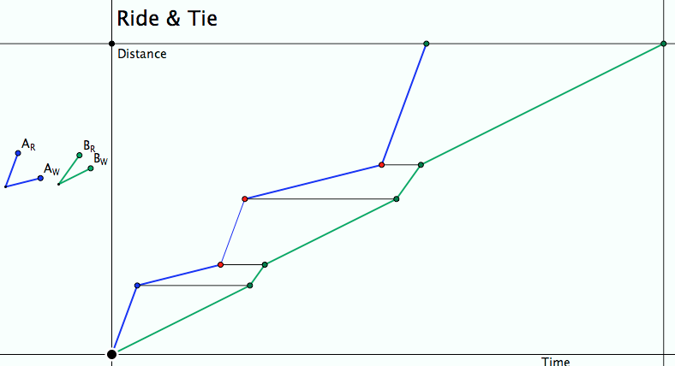
Ride & Tie
Imagine, then draw a diagram!
Seeking Relationships
Does the diagram make sense
(meet the constraints)?
Notes:
Does the diagram meet the constraints?
What can be changed, what choices are there?
What relationships (does it really matter how many times the horse is swapped?)

Slide 12

Gasket Sequences

Slide 13
Two + Two
2
+
1
=
2
x
1
2
+
2
=
2
x
2
+
=
x
1
+
1
=
3
x
1
17
1
17
3
with
the
grain
1
1
4
+
1
=
4
x
1
+
1
=
x
1
-
1
-
1
5
+
1
=
5
x
1
+
1
=
6
x
1
√17
+
1
=
√17
x
1
6
...
Watch What You Do!
across
the
grain

Slide 14
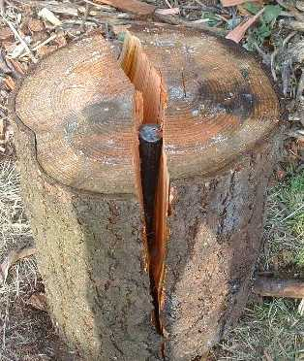
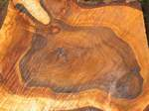
With and Across the Grain

Slide 15







Extending & Varying

Slide 16
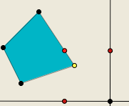
Polygon Perimeter Projections
Imagine a quadrilateral (irregular)
Imagine a point P traversing the perimeter of the quadrilateral at uniform speed.
Imagine the projections of P onto a horizontal and a vertical axis …

Slide 17
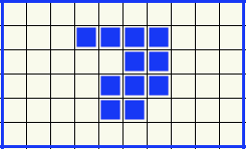
More or Less grids
Perimeter
More
Same
Less
Area
More
Same
Less
With as little change as possible from the original!

Slide 18
Put your hand up when you can see …
Something that is 3/5 of something else
Something that is 2/5 of something else
Something that is 2/3 of something else
Something that is 5/3 of something else
What other fraction-actions can you see?
How did your attention shift?
Notes:
Generalise!

Slide 19
Put your hand up when you can see …
Something that is 1/4 – 1/5
of something else
Did you look for
something that is 1/4 of something else
and for
something that is 1/5 of the same thing?
What did you have to do with your attention?
Can you generalise?
Notes:
Generalise!

Slide 20
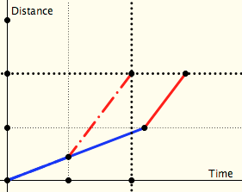
Two Journeys
Which journey over the same distance at two different speeds takes longer:
  One in which both halves of the distance are done at the specified speeds
  One in which both halves of the time taken are done at the specified speeds
distance
time

Slide 21
Named Ratios
Now take a named ratio (eg density) and recast this task in that language
Which mass made up of two densities has the larger volume:
  One in which both halves of the mass have the fixed densities
  One in which both halves of the volume have the same densities?

Slide 22
Counting Out
In a selection ‘game’ you start at the left and count forwards and backwards until you get to a specified number (say 37). Which object will you end on?
A
B
C
D
E
1
2
3
4
5
9
8
7
6
10
…
If that object is elimated, you start again from the ‘next’. Which object is the last one left?
Notes:
How do you know?
Generalise!

Slide 23
If I have included visibility in my list of values to be saved, it is to give warning of the danger we run in losing a basic human faculty: the power of bringing visions into focus with our eyes shut, of bringing forth forms and colours from the lines of black letters on a white page, and in fact of thinking in terms of images. I have in mind some possible pedagogy of the imagination that would accustom us to control our own inner vision without suffocating it or letting it fall, on the other hand, into confused, ephemeral daydreams, but would enable the images to crystallize into a well-defined, memorable, and self-sufficient form, the icastic form. This is of course a form of pedagogy that we can only exercise upon ourselves, according to methods invented for the occasion and with unpredictable results.
(Calvino 1988, p. 92). Six memos for the next millennium

Slide 24
Outer & Inner Tasks
Outer Task
  What author imagines
  What teacher intends
  What students construe
  What students actually do
Inner Task
  What powers might be used?
  What themes might be encountered?
  What connections might be made?
  What reasoning might be called upon?
  What personal dispositions might be challenged?

Slide 25
Imagining
Basis of Geometric Thinking
Basis of Anticipating
Basis of ‘Realising’
Basis of Accessing & Enriching Example Spaces
Basis of Planning
Geometric Images
ATM

