Slide 1
Functioning Mathematically
John Mason
St Patrick’s College Dublin
Feb 2010
Notes:
What you get will be what you notice happening for you,
Which in turn may inform your choices in the future

Slide 2
Conjecturing Atmosphere
Everything said is said in order to consider modifications that may be needed
Those who ‘know’ support those who are unsure by holding back or by asking revealing questions

Slide 3
Inter-Rootal Distances
Sketch a quadratic for which the inter-rootal distance is 2.
and another
and another
How much freedom do you have?
What are the dimensions of possible variation and the ranges of permissible change?
What sets of numbers can be the set of inter-rootal distances for a polynomial?
Notes:
[roots 2 then 1 then 3 apart]
Change within; change without; characterising

Slide 4
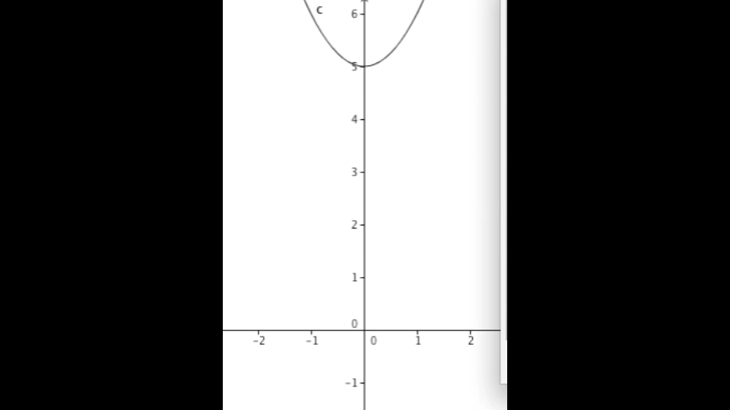
Zig Zags

Slide 5
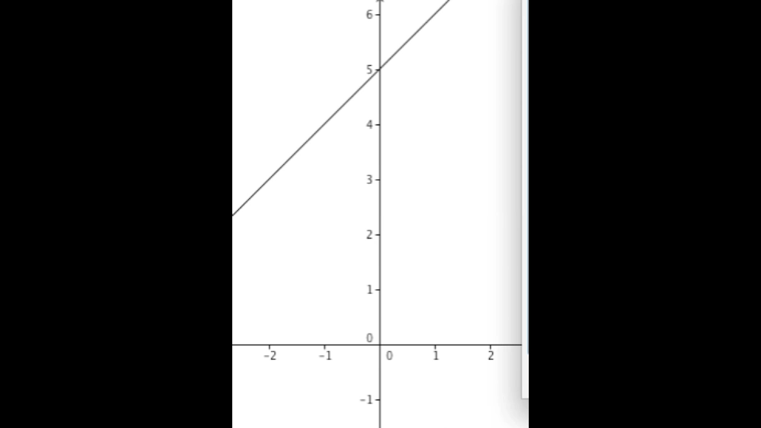
Zig Zags

Slide 6
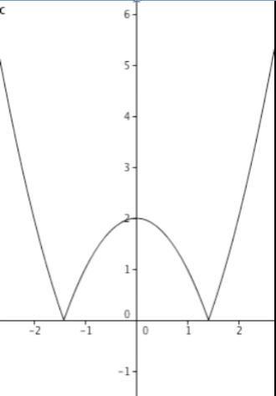
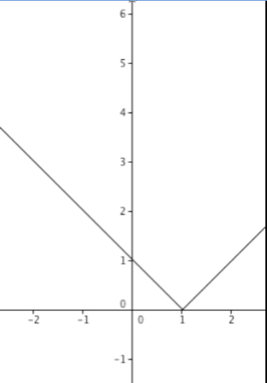
Notation
y = |x² – a|
y = |x – a|
What might the graph of
y = ||x-1|-2| look like?

Slide 7
ZigZags
Can you make these?
What can and cannot be made?
Characterising

Slide 8
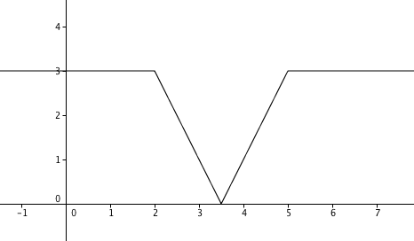
Zig Zags
What might the graph of y = ||x-2| – |x-5|| look like?

Slide 9
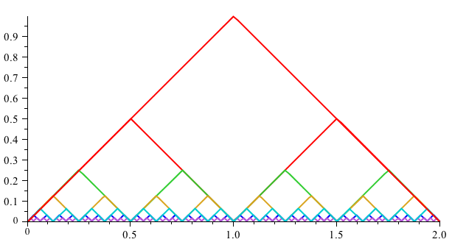
Towards the Blanc Mange function
Notes:
Go To Movie

Slide 10
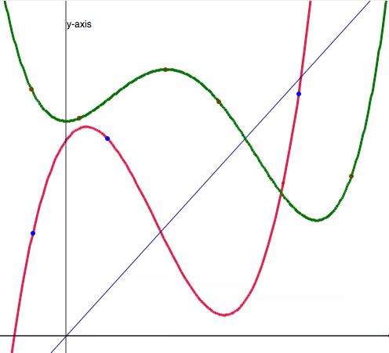
Reading Graphs

Slide 11
Powers
Specialising & Generalising
Conjecturing & Convincing
Imagining & Expressing
Characterising
Distinguishing & Connecting
Assenting & Asserting

Slide 12
Didactic Transposition
Expert awareness
is transposed/transformed into
instruction in behaviour (Yves Chevellard)

Slide 13
More Ideas
For Students
(1998) Learning & Doing Mathematics (Second revised edition), QED Books, York.
(1982/2010). Thinking Mathematically, Pearson, London
For Lecturers
(2002) Mathematics Teaching Practice: a guide for university and college lecturers, Horwood Publishing, Chichester.
(2008). Counter Examples in Calculus. College Press, London.
http://mcs.open.ac.uk/jhm3
j.h.mason@open.ac.uk

