Slide 1
Asking Questions At A-Level
The Open University
Maths Dept
University of Oxford
Dept of Education
John Mason
BCME
March 2010

Slide 2
Core Shifts at A-level
Functions:
Notation; composite functions
Extending & Restricting Meaning
Remainders and negatives
Reals ––> Complex numbers, including as exponents

Slide 3
Outline
Work on some tasks together which illustrate rich questioning
Reflect on the more general use of these as types
Note that this mirrors what is needed at A-Level particularly
I hope that you get stuck at some point, so that you can become aware of what sorts of questions get you moving again!

Slide 4
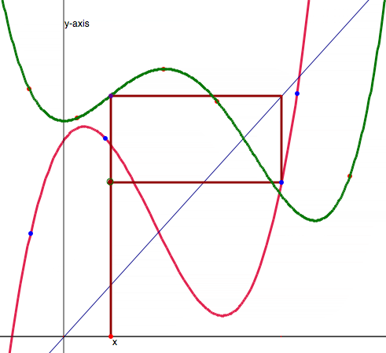
Combining Functions
Making mathematical sense of phenomena
Using coordinates to read graphs
Getting a sense of composite functions
Generating further exploration

Slide 5
Generating Functions
What functions can you make by composing f and g repeatedly?
What functions can you make by composing f and g repeatedly?

Slide 6
Drawing Back
What types of questions seemed to be rich or fruitful?
Learning from experience
One thing we don’t seem to learn from experience …
is that we don’t often learn from experience alone!

Slide 7
Remainders of the Day (1)
Write down a number which when you subtract 1 is divisible by 7
and another
and another
Write down one which you think no-one else here will write down
Multiply two of your numbers together and find the remainder on dividing by 7
Notes:
Draw a diagram that displays this invariance

Slide 8
Multiplicative Invariance of remainder 1
…
…
Dimensions of possible variation Range of permissible change

Slide 9
Remainders of the Day (2)
Write down a definition of what ‘remainder on dividing N by 7 means’
Write down a negative number that leaves a remainder of 1 on dividing by 7
And another; and another
Write down a definition of what ‘remainder on dividing N by m means’
Write down a number that leaves a remainder of 1 on dividing by -7
Modify your definition of ‘remainder on dividing N by m’ to take account of these case
Dimensions of Possible Variation Range of Permissible Change

Slide 10
Remainders of the Day (3)
Write down a number which when you subtract 1 is divisible by 2
and when you subtract 1 from the quotient, the result is divisible by 3
and when you subtract 1 from that quotient the result is divisible by 4
Why must any such number be divisible by 3?
Dimensions of Possible variation Range of Permissible Change
Notes:
Attending to generality at each stage
Working backwards

Slide 11
More Or Less: Functions
Sketch a smooth function that has 3 distinct zeros and 4 local extrema
No. of zeros
No. of local extrema
more
same
fewer
more
more extrema more zeros
more extrema same zeros
more extrema fewer zeros
same
same extrema more zeros
same extrema fewer zeros
fewer extrema more zeros
fewer extrema same zeros
fewer extrema fewer zeros
What variations are possible??
fewer
What relationships must hold?
Notes:
Can you have 4 local extrema and exactly 4 distinct zeros?
Recognising Relationships

Slide 12
Possibilities
Smooth functions
No. of zeros
No. of local extrema
1
2
3
6
4
5
1
2
3
4
Notes:
How to modify one example in order to generate others

Slide 13
Question-Task Types
Generating Stories; Narratives; Making Personal Sense
Conjecturing and modifying conjectures
Practicing through exploring
Generating mathematical objects in order to learn to recognise them
Composite functions; remainders
Another & Another

Slide 14
My Website & Further Reading
J.h.mason@open.ac.uk
Mcs.open.ac.uk/jhm3 go to Presentations
New Edition of Thinking Mathematically due end of April this year 77 new problems related to the curriculum
Special conference price of £20 regularly £25

