Slide 1
Developing Problem Solving Skills
Promoting Mathematical Thinking
John Mason
NCETM July 10 2013
The Open University
Maths Dept
University of Oxford
Dept of Education

Slide 2
Throat Clearing
Conjectures
Everything said is a conjecture, uttered in order to externalise it, consider it, and modify it on the basis of people’s responses
What you get will be mostly what you notice yourself doing (or not doing)
It’s not the task that is rich, but the way that the task is used
Student ‘theory of learning’
If I attempt the tasks I am set, the required learning will happen.
But more than this is required!

Slide 3
What Comes to Mind…
When you see the words ‘Problem Solving’?
National Curriculum
Exercises at the end of a topic (‘word problems’)
Aspects of mathematical thinking
The essence and heart of mathematics
encountering,
developing facility with
using appropriately
techniques,
ways of thinking
Basis for

Slide 4
Problem Solving Skills
Not acting on the first thought that comes to mind
Imagining the situation/phenomenon
Discerning relevant quantities
Recognising Relationships between these
Acknowledging Ignorance (Mary Boole)
Checking!
Using Sketches & Diagrams

Slide 5
Costings
I want 45 notebooks for participants in a workshop I am planning. I find suitable ones at £2.25 each or 6 for £11, but to get the reduced price I have to buy a loyalty card for £2. I will then have £9.25 left over from £95 for other purchases.
?
?
?
What could vary?
What functional relationships are involved?
Make up your own like this
In what way is yours like this one and in what way is it different?
Notes:
What charge for the loyalty card would make the discount not worthwhile?

Slide 6
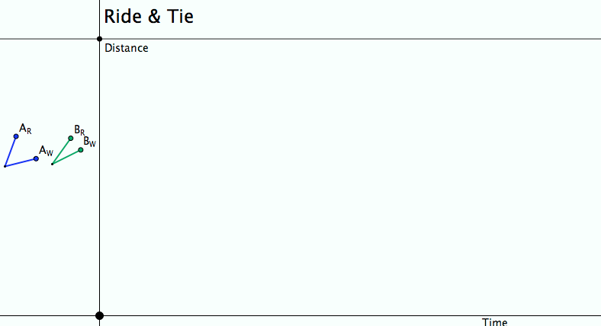
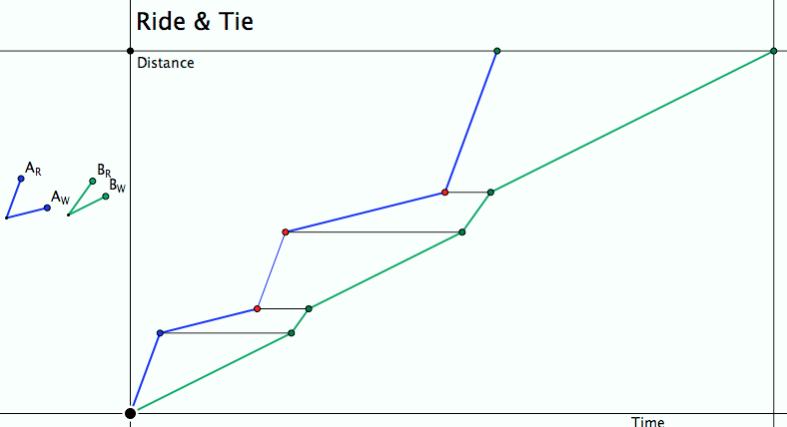
Ride & Tie
Imagine, then draw a diagram!
Seeking Relationships
Does the diagram make sense (meet the constraints)?
Notes:
Does the diagram meet the constraints?
What can be changed, what choices are there?
What relationships (does it really matter how many times the horse is swapped?)

Slide 7
Incidences & Coincidences
On a square piece of paper, mark a point on one edge and draw a straight line through that point
Mark the diagonals and midlines
Fold each edge onto the chosen line and make a crease.
Mark where these creases intersect
All of your points lie on the diagonals or mid-lines of your square
Notes:
What geometrically is the crease formed by folding one line onto another?
Could this be an introduction to angle bisectors and the fact that they coincide at the incentre?

Slide 8
Currency Exchange
At the airport, you see rates for buying and selling another currency in terms of your own.
Euros Sell: 1.224 Buy: 1.32
Rand: Sell: 13.237 Buy: 17.549
If there are no other fees, how do you find the actual exchange rate and the percentage commission they charge on each transaction?

Slide 9
Currency Exchange
Suppose £1 of your currency will exchange for $s of another and the buy back will be £1 for $b. Suppose the true exchange rate is £1 for $e.
Let 100p% be the commission they charge, assuming the same in each transaction
Then £1 yields $s
To convert back, $s yields £s/b
In terms of commission, 1£ yields, (1–p)e, which converted back is (1–p)e(1–p)/e = (1–p)²
So (1–p)² = s/b making p = 1 - √(s/b)
Making the commission to be 100(1 – √(b/s))
What is the actual exchange rate they are using?
Contrast this with what is on the internet
Euros Sell: 1.136 Buy: 1.32 Commission: 7.2%
Rand: Sell: 13.237 Buy: 17.549 Commission: 13.2%

Slide 10
What’s Wrong at Wonga?
Wonga is a payday loans company
Loans of up to £1000 for periods of up to 45 days
APR based on loan of £150 for 18 days requires payment back of £333.49 (including fees etc.)
Interest rate calculated over 1 year is 5853%
Previously quoted 4214% on loans over a longer period.
What is going on?
Is APR a suitable measure?
Notes:
APR = Annual Percentage Rate
Guardian June 22 2013

Slide 11
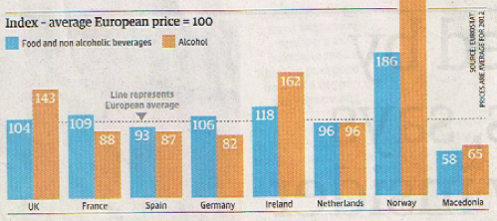
Say What You See
What does it mean?

Slide 12
Temperature Change
It was reported in a holiday brochure that the temperature in one place can change by 10°C (50°F) in the course of a day.
Notes:
Surprise! Leading to a ‘problem’ to explain or account for something

Slide 13
Compound %
At a discount store, I can get a discount of 30%
Should I prefer to calculate the VAT of 20% before or after calculating the discount?
What would Customs and Revenue prefer?
Simpler Question:
If VAT is 20% and there is a local tax of 10%, what is the overall tax?
To whom does it matter in which order they are calculated?

Slide 14
Likelihood
The results of a medical test show that 10% of the population exhibit a particular characteristic but 40% of the people who develop a particular syndrome also exhibit that characteristic. This means that people with that characteristic are 6 times as likely to develop the syndrome as people not exhibiting that characteristic.

Slide 15
Likelihood
Syndrome
10%
With
40%
Let S be the number of people developing the syndrome
60%
90%
Without
40/100 x S
10/100 x P
40 x 90
=
60/100 x S
60 x 10
90/100 x P

Slide 16
Likelihood Generalised
10% of the population has the disease, but 40% of the people working in a certain industry have the disease: Likelihood …
Given a collection of objects of different colours in the ratios c₁ : c₂ : … : c_{n} and a sample in which the colours are in the ratios s₁ : s₂ : … : s_{n} what were the probabilities of each colour being drawn for the sample?

Slide 17
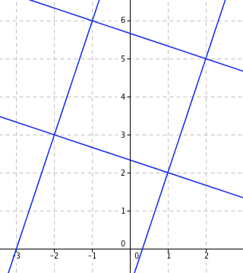
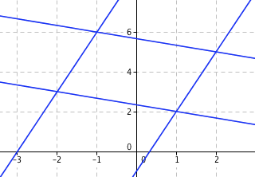
Graphical Reasoning
Say What You See
Lines are
y = 3x - 1
3y = -x + 7
y = 3x + 9
3y = -x+ 17

Slide 18
What is Available to be Learned from ‘solving a problem’?
Developing a repertoire of effective actions
Becoming aware of and developing natural powers
Encountering pervasive mathematic themes
Re-encountering specific topics, concepts, techniques
Becoming acquainted with how mathematical thinking can be used effectively
Developing a disposition to think mathematically
Reinforcing and building curiosity

Slide 19
Introducing Problem Solving Vocabulary
Use a task that is likely to provoke students to act in some desired manner
Use a particular question or prompt repeatedly
How do you know?
What’s the same & what different?
What is varying and what is not?
Specialise
Generalise
Be systematic
Recognise relationships
Scaffolding &
Fading
Draw attention to it, perhaps using a succinct label
Use increasingly indirect prompts to bring that action to mind

Slide 20
Qualities to Develop
Curiosity
‘have a go’ attitude
Resilience
Repertoire of useful ways of thinking:
Imagining & Expressing
Specialising & Generalising
Conjecturing & Convincing
Organising & Characterising
Experience of key mathematical themes
Doing & Undoing
Freedom & Constraint
Invariance in the midst of change
Modelling

Slide 21
Theoretical Background

Slide 22
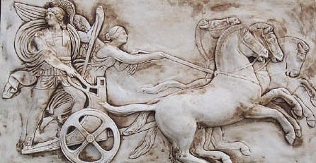
Making Use of the Whole Psyche
Assenting & Asserting
Awareness (cognition)
Imagery
Will
Emotions (affect)
Body (enaction)
Habits Practices

Slide 23
Probing Affordances & Potential
Cognitive
What images, associations, alternative presentations?
What is available to be learned (what is being varied, what is invariant)?
Behavioural
What technical terms used or useful
What inner incantations helpful?
What specific techniques called upon and developed?
Affective (dispositions & purpose/utility)
Where are the techniques useful?
How are exercises seen by learners (epistemic stances)
Attention-Will
What was worth stressing and what ignoring?
What properties called upon
What relationships recognised?

Slide 24
Strategies for Use with Exercises
Sort collection of different contexts, different variants, different parameters
Characterise odd one out from three instances
Put in order of anticipated challenge
Do as many as you need to in orer to be ble to do any question of this type
Construct (and do) an Easy, Hard, Peculiar and where possible, General task of this type
Decide between appropriate and flawed solutions
Describe how to recognise a task ‘of this type’; Tell someone ‘how to do a task of this type’
What are tasks like these accomplishing (narrative about place in mathematics)

Slide 25
Reflection Strategies
What technical terms involved?
What concepts called upon?
What mathematical themes encountered?
What mathematical powers used (and developed)?
What links or associations with other mathematical topics or techniques?

Slide 26
Task Design & Use
Re-flection & Pro-flection
Content
Task
Activity
Potential
Actions
Structure of a Topic
Inner & Outer
Themes
Effectiveness of actions
Powers
3 Only’s
Balance
Interaction
7 phases
Teacher
Peers
6 Modes
Roles
Questioning

Slide 27
Teacher Focus
Teacher-Student interaction
Teacher-Mathematics interaction
Student-Mathematics interaction
Language/technical terms
Examples, Images &
Representations
Enactive Obstacles
Origins
Applications & Uses
Affective Obstacles
Cognitive Obstacles:
common errors, …
Methods & Procedures

Slide 28
Actions
Right-multiplying by an inverse ...
Making a substitution
Differentiating
Iterating
Reading a graph
Invoking a definition
…

Slide 29
Themes
Doing & Undoing
Invariance in the midst of change
Freedom & Constraint
Restricting & Extending

Slide 30
Powers
Imagining & Expressing
Specialising & Generalising (Stressing & Ignoring)
Conjecturing & Convincing
(Re)-Presenting in different modes
Organising & Characterising

Slide 31
Inner & Outer Aspects
Outer
What task actually initiates explicitly
Inner
What mathematical concepts underpinned
What mathematical themes encountered
What mathematical powers invoked
What personal propensities brought to awareness

Slide 32
Challenge
Appropriate Challenge:
Not too great
Not too little
Scope depends on student trust of teacher
Scope depends on teacher support of mathematical thinking not simply getting answers

Slide 33
Structure of a Topic
Awareness (cognition)
Imagery
Will
Emotions (affect)
Body (enaction)
Habits Practices

Slide 34
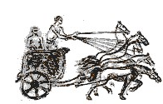
Three Only’s
Language Patterns & prior Skills
Imagery/Sense-of/Awareness; Connections
Root Questions
predispositions
Different Contexts in which likely to arise; dispositions
Standard Confusions & Obstacles
Techniques & Incantations
Emotion
Awareness
Behaviour
Only Emotion is Harnessable
Only Awareness is Educable
Only Behaviour is Trainable

Slide 35
Phases
Getting Started
Initiating
Getting Involved
Mulling
Keeping Going
Sustaining
Insight
Being Sceptical
Concluding
Contemplating

Slide 36
Six Modes of Interaction
Initiating
Sustaining
Concluding
Expounding
Explaining
Exploring
Examining
Exercising
Expressing

Slide 37
Initiating Activity
Silent Start
Particular (to general); General (via particular) Semi-general (via particular to general)
Worked example
Use/Application/Context
Specific-Unspecific
Manipulating:
Material objects (eg cards, counters, …)
Mental images (diagrams, phenomena)
Symbols (familiar & unfamiliar)

Slide 38
Sustaining Activity
Questions & Prompts
Directed–Prompted–Spontaneous Scaffolding & Fading
Energising (praising-challenging)
Conjecturing
Sharing progress/findings

Slide 39
Concluding Activity
Conjectures with evidence
Accounts that others can understand
Reflecting on effective & ineffective actions
Aspcts of inner task (dispositions, …)
Imagining acting differently in the future

Slide 40
Balanced Activity
Affordances
Constraints
Attunements
Outer Task
Inner Task
Intended & Enacted
goals
Implicit
goals
Ends
Ends
Resources
Tasks
Resources
Tasks
Means
Means
Current State
Current State

Slide 41
Expounding
Explaining
Exploring
Examining
Exercising
Expressing

Slide 42
Teacher
Student
Content
Student
Teacher
Student
Content
Content
Teacher
Expounding
Exploring
Exercising
Teacher
Student
Content
Content
Content
Teacher
Student
Teacher
Student
Explaining
Examining
Expressing

Slide 43
Activity
Goals, Aims, Desires, Intentions
Resources: (physical, affective cognitive, attentive)
Tasks (as imagined, enacted, experienced,
…)
Initial State
Affordances– Constraints–Requirements
(Gibson)

Slide 44
Potential
What builds on it (where it is going)
Most it could be
Math’l & Ped’c essence
Least it can be
What it builds on
(previous experiences)
Affordances– Constraints–Requirements
(Gibson)
Directed–Prompted–Spontaneous
Scaffolding & Fading (Brown et al)
ZPD (Vygotsky)
Notes:
Role of reflection in achieving affordances

Slide 45
Thinking Mathematically
CME
Do-Talk-Record (See–Say–Record)
See-Experience-Master
Manipulating–Getting-a-sense-of–Artculating
Enactive–Iconic–Symbolic
Directed–Prompted–Spontaneous
Stuck!: Use of Mathematical Powers
Mathematical Themes (and heuristics)
Inner & Outer Tasks

Slide 46
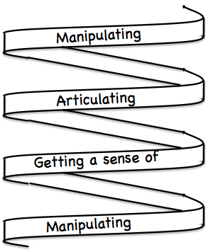
Frameworks (틀)
Enactive– Iconic– Symbolic
Doing – Talking – Recording
See – Experience – Master

Slide 47
Follow-Up
Designing & Using Mathematical Tasks (Tarquin/QED)
Thinking Mathematically (Pearson)
Mathematics as a Constructive Activity (Erlbaum)
Questions & Prompts for Mathematical Thinking (ATM)
Thinkers (ATM)
Learning & Doing Mathematics (Tarquin)
Researching Your Own Practice Using The Discipline Of Noticing (RoutledgeFalmer)
j.h.mason @ open.ac.uk
mcs.open.ac.uk/jhm3

