Slide 1
Energy research at Cranfield: four years overview
Dr Kumar Patchigolla & Dr Stuart Wagland
Institute of Energy & Resource Technology, School of Applied Sciences

Slide 2
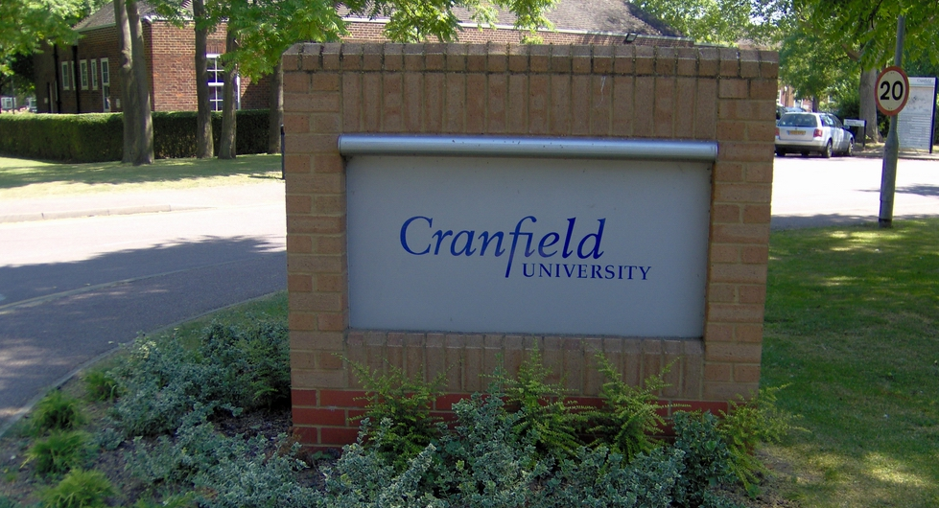
Firstly….
A bit about Cranfield
Located in Bedfordshire, over the other side of the M1
Postgraduate only, with 3,400 students (approx 700 of which working towards a PhD)
Research intensive institution with a heavy industrial and commercial focus

Slide 3
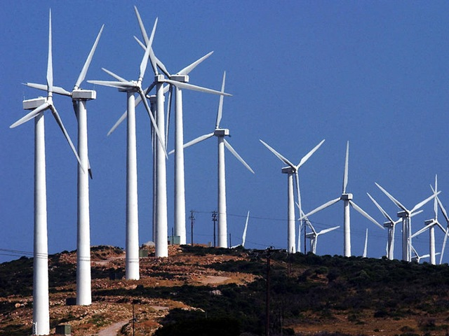
Institute of Energy & Resource Technology [IERT]
Multi-discipline institute looking at the full spectrum of-
Resource management;
Energy systems and energy
recovery;
Environmental impacts
Masters level courses, including-
MSc Renewable Energy Technologies
MSc Energy Supply for Low Carbon Futures
MSc Waste and Resource Management;
MSc Environmental Engineering

Slide 4
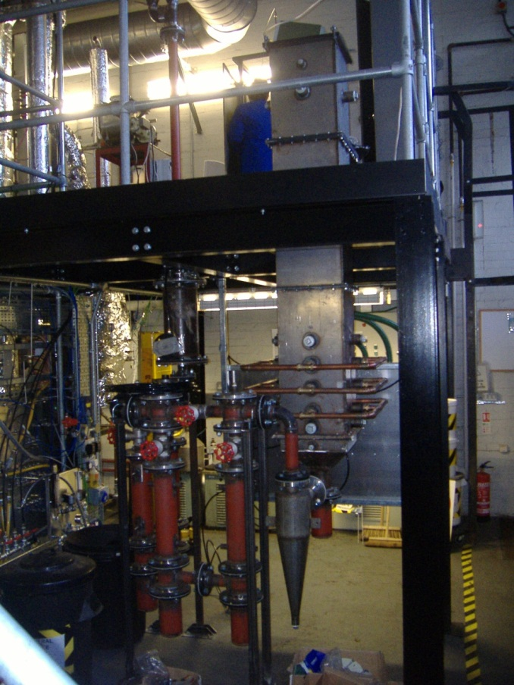
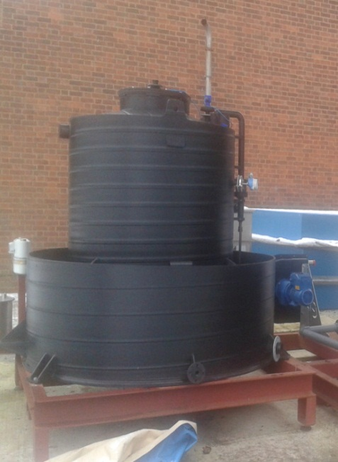
Institute of Energy & Resource Technology [IERT]
Pilot-scale thermal facilities
Downdraft gasifier (75 kW)
Updraft gasifier (75 kW)
Fluidised bed combustor (150 kW)
Low carbon technology systems
Materials testing suite for power systems
Pilot-scale anaerobic digestor

Slide 5
Recent projects-Thermal
Gasification tests with sewage sludge (Yorkshire water)
Next generation energy from waste technologies [ETI]
Steam/O2 gasification tests [Broadcrown]
Biogenic fraction and renewable energy yield from mixed wastes [TSB, Defra, DECC]
Gasification- a technology review [Chartered Institution for Wastes Management, CIWM]
Feasibility of compressed biomethane use in waste collection vehicles [Milton Keynes Council]
Scaling up towards a sustainable recycling incentive scheme in Milton Keynes [Milton Keynes Council]

Slide 6
Recent projects-Low carbon systems
Biomass co-firing [DECC]
UK/China H2 network [EPSRC]
Oxy-fuel combustion [E.ON, EPSRC]
Materials for next generation CO2 transport systems [E.ON, EPSRC]
Gas-FACTS [EPSRC]
H2-IGCC [EU FP7]
Dense phase corrosion tests [National Grid]
Chemical looping for oxygen uncoupling [UKCCSRC]

Slide 7
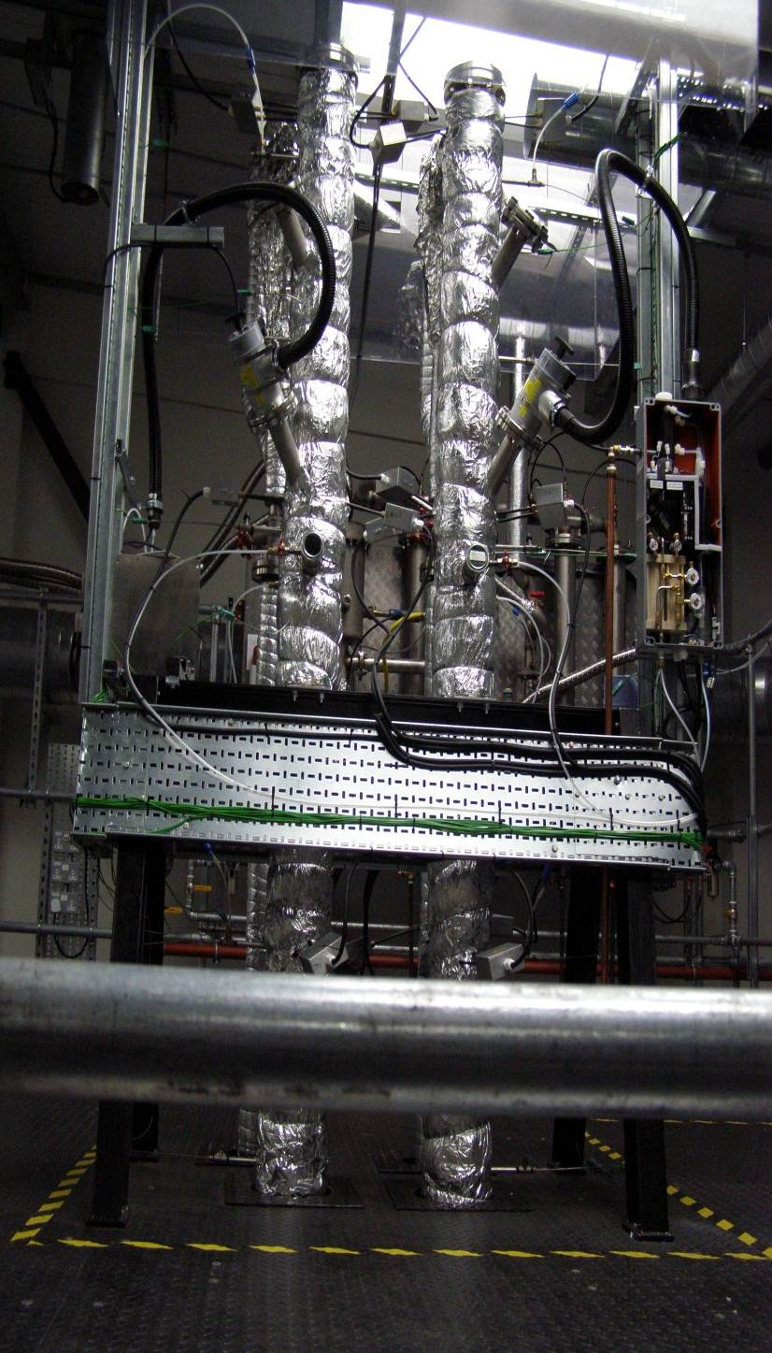
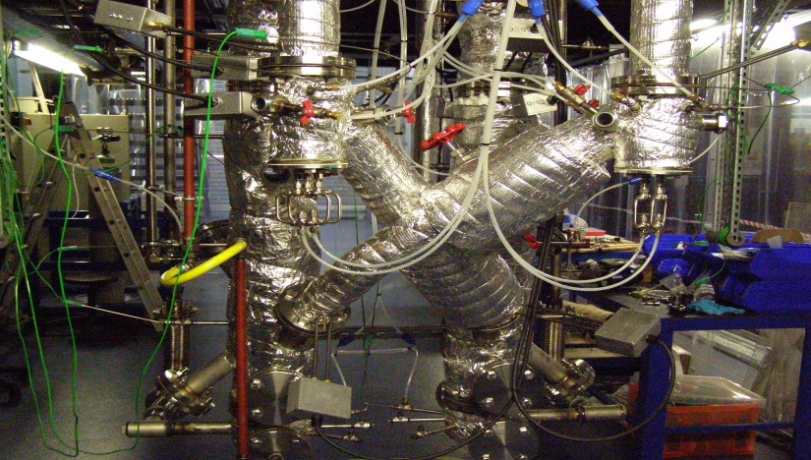
PACT Facilities: Chemical Looping
Approx. 75 KW_{th} pilot scale chemical looping facility-largest UK facility
100 mm ID riser for chemical (adjustable height to assess the scale up effects ,7.3 m ht) and Ca looping (4.3 m ht)
Flexible in configuration, either as
Twin CFB legs or
Single entrained flow riser with bubbling bed (2nd reactor)
Chemical looping mode-either for oxy-combustion or for H₂ production
Flexible controls to enable a range of operating modes
Rig supplied with different bulk gas mixtures--O₂, CO₂, N₂, H₂ and CO
Dedicated MFCs for each bulk gas
Dedicated safety system with controls

Slide 8
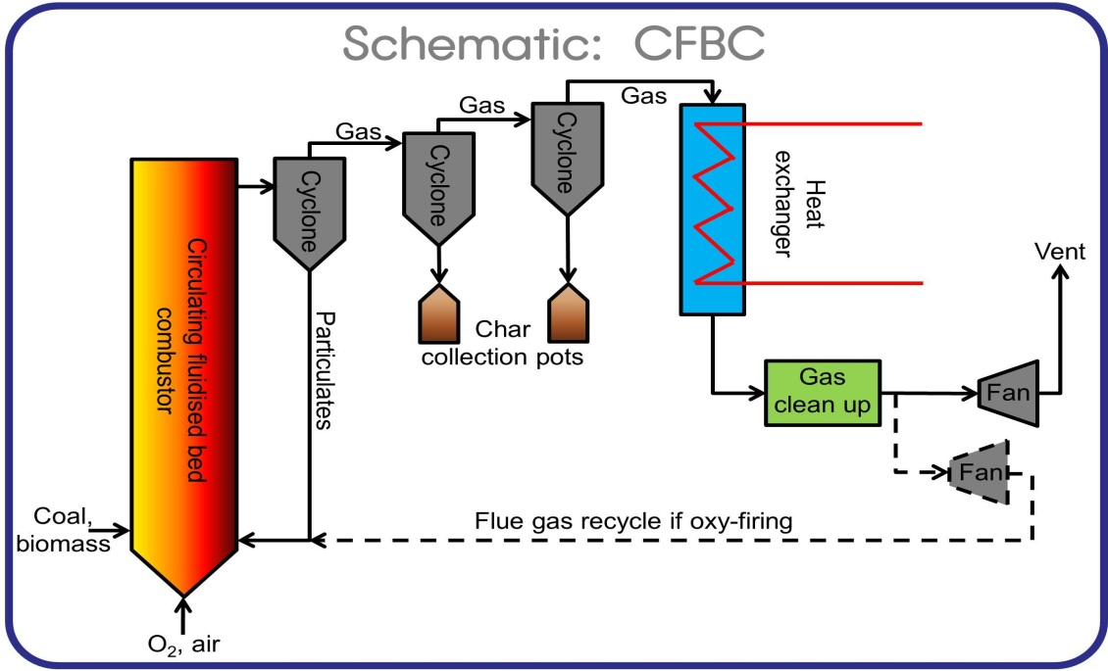
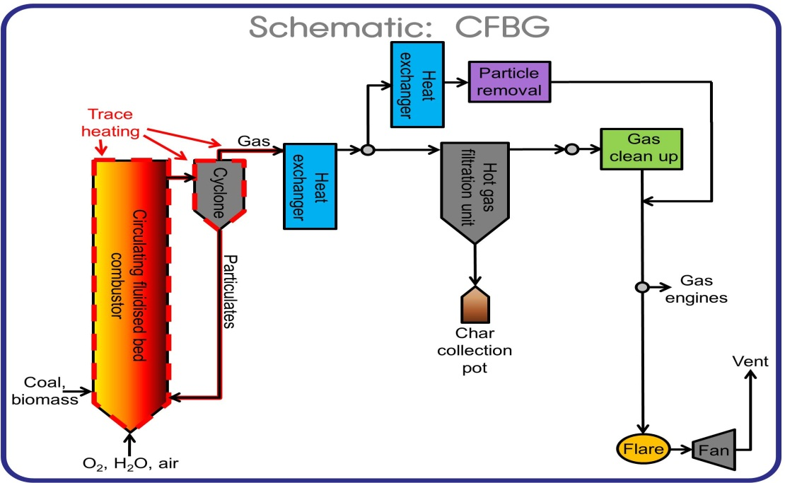
PACT facilities-Circulating fluidised bed combustor/gasifier
This rig can be operated either as a circulating fluidised bed combustor (CFBC) or a circulating fluidised bed gasifier (CFBG):
CFBC studies both air- & oxy-fired combustion of various fuels.
CFBG produces syngas (synthesis gas) from various fuels which can be cleaned and used in gas engines.
Can be fed with Air, O2, Steam and CO2
Different gas cleaning methods exist:
Using a hot gas filtration unit (HGFU), particles can be removed at high temperatures
Using a heat exchanger allows low temperature particle removal.
Specification:
800 – 1000 °C
300 kWth
Atmospheric pressure
Gas analysis
Temperature monitoring

Slide 9
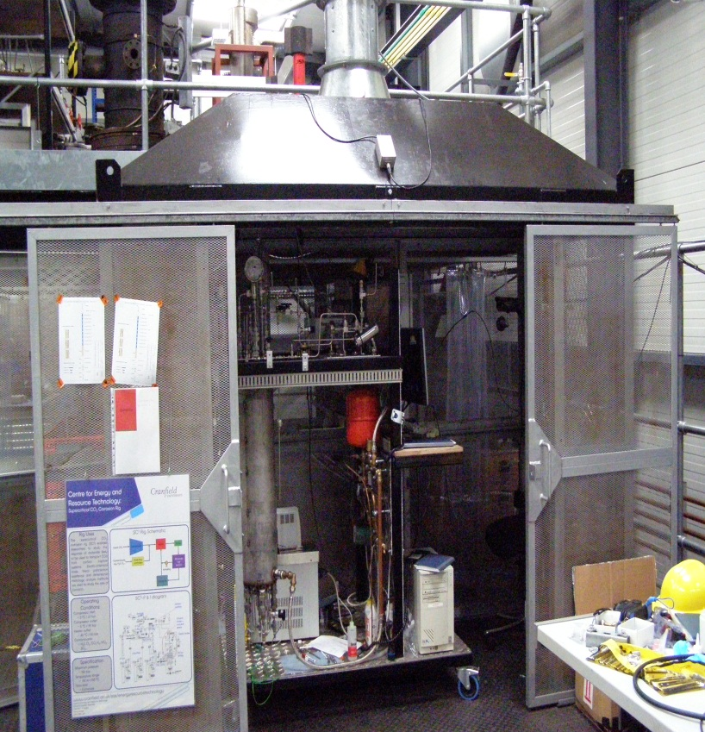
PACT facilities - CO₂ transport flow rig
Facility operates above 90 bar, 40 deg (capable for up to 700 bar & -50 to 150ºC) in flow mode (fluid flow rates up to 5l/min)
High pressure observation window-provide detailed information on phase separation, hydrodynamic flows, contamination etc.
Runs for several hundred hours depends on material corrosion and environment
Continuous monitoring of corrosion by electro chemical noise & Linear polarization resistance
Offline/online gas composition measurement (infrared, mass spec)
Measurement and monitoring of physical properties- density, pH, temp, pressure
Impurities– H₂O, H₂, H₂S, NOx, SO₂and O₂ etc..; dedicated MFCs to maintain the proportions

Slide 10
Dense Phase CO₂- Observation window
Charging from the bottle cylinder
~ 57 bar
~5 deg
Dense phase CO₂
~ 90 bar
~40 deg

Slide 11
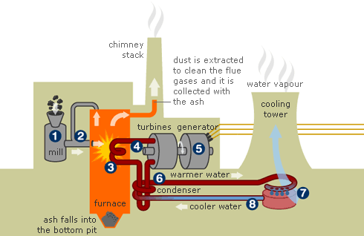
…the future, more sustainable resource use…
Bioaerosol emissions
Boiler material corrosion
offshore structures and energy processes
Biomass energy
Material recycle and product safety
Soil structure & ecology
Solid waste management
Biochemical energy processes
Mass-flow of waste materials
Offshore ecology
Energy from waste
Nanotechnology
Co-firing & alternative fuels
Marine environment
Biodiversity loss
Climate change
Soil resources and chemistry

Slide 12
Future innovations
New waste processing technology
New or improved energy recovery technology
Advanced thermal treatment
More efficient combustion
Along with more drastic solutions
Landfill mining??
“Landfills are temporary storage spaces”
P.T.Jones et al (2013)

Slide 13
Hands-on Gasification Short course
Practical thermal conversion systems master class
1st July-3rd July 2014
In collaboration with ERDF Bio Thermal Energy Demonstrator

Slide 14
School of Applied Sciences
www.cranfield.ac.uk/sas/energyresourcetechnology/index.html
Kumar Patchigolla
k.patchigolla@cranfield.ac.uk
01234 750111 extn 4124
Stuart Wagland
s.t.wagland@cranfield.ac.uk
01234 750111 extn 2404

