Slide 1
In the Best Families
tracking and relationships
www.vanityfair.com/culture/features/2009/12/addams-family-200912
Clara Mancini
Yvonne Rogers, Keerthi Thomas, Adam Joinson, Blaine Price,
Arosha Bandara, Lukasz Jedrzejczyk, Bashar Nuseibeh
Department of Computing, The Open University, UK
School of Management, University of Bath, UK
Lero, University of Limerick, Ireland
Notes:
This talk discusses how location-tracking technology can impact on the way family members negotiate the mutual accountabilities that explicitly or implicitly define their relations and the trade-offs that being a family involves.

Slide 2
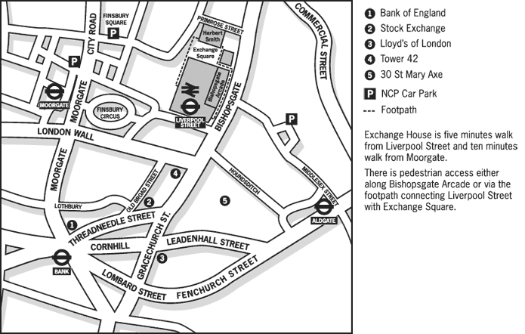
Why yet another location tracking study?
Notes:
Over the past ten years there has been a lot of work on location tracking technology. So, why yet another location tracking study?

Slide 3
Some implicit assumptions
close knit tracking is safer
news.bbc.co.uk/cbbcnews/hi/newsid_6540000/newsid_6549400/6549495.stm
Notes:
For one thing, in this work there tends to be an assumption that location tracking among close knit relations is safer than location tracking among loose relations…

Slide 4
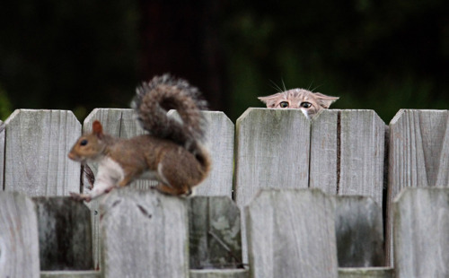
Some implicit assumptions
the tracked is the vulnerable one
imgfave.com/search/someone%20deleted%20my%20tag
Notes:
Another assumption seems to be that between the tracker and the tracked, the latter is the most vulnerable one…

Slide 5
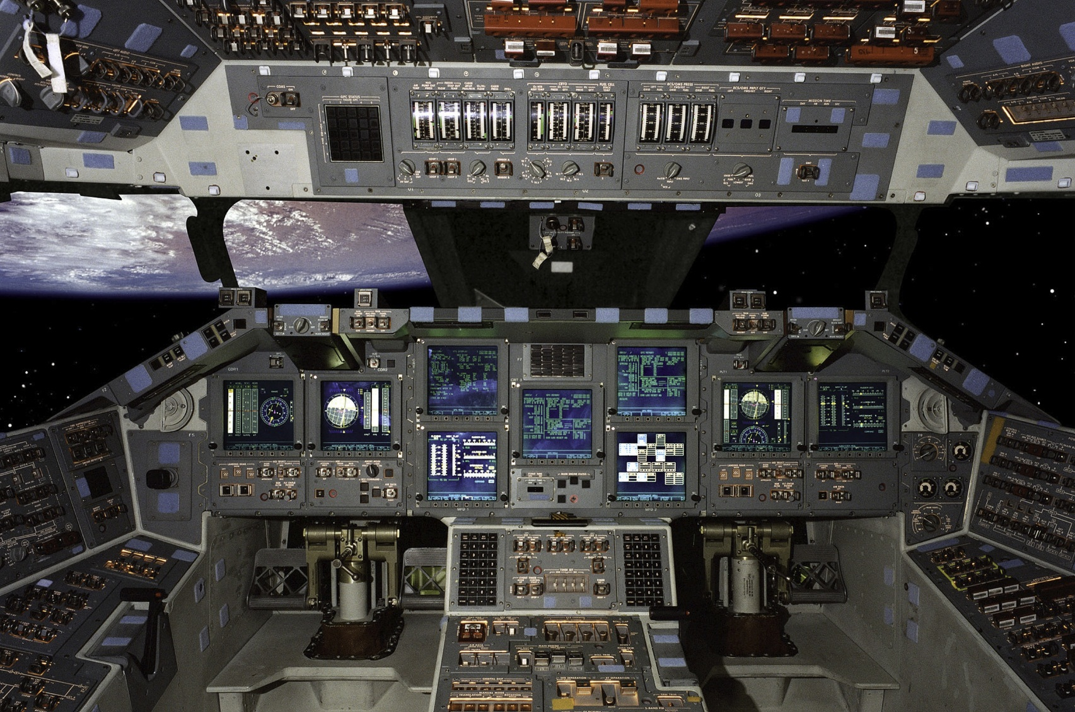
Some implicit assumptions
controls will set one free
en.wikipedia.org/wiki/File:STSCPanel.jpg
Notes:
Finally, there also seems to be an assumption that providing appropriate control mechanisms such as privacy preferences or real time feedback can resolve the problem of managing social boundaries.

Slide 6
Our study
Notes:
To further explore these issues, we run a study of location tracking with two extended families…

Slide 7
Our study
F1
Mother & father
Daughter1 & partner
Daughter2 & boyfriend
Daughter3
Notes:
The first family comprised a mother and father; three daughters respectively in their mid twenties, early twenties and late teens; plus the long-term partner of the eldest daughter and the recently acquired boyfriend of the middle daughter…

Slide 8
Our study
F1
F2
Mother & father
Daughter1 & partner
Daughter2 & boyfriend
Daughter3
Mother & father
Son & friend
Daughter
Notes:
The second family comprised a mother and father; a son and daughter respectively in their mid and early twenties; plus a close friend of the son.

Slide 9
Our study
F1
F2
Mother & father
Daughter1 & partner
Daughter2 & boyfriend
Daughter3
Mother & father
Son & friend
Daughter
3 weeks, 1092 unique tracking events
Notes:
The families used a custom-built location tracking application newly installed on their mobile phone for the purposes of the study, for a period of three weeks, producing over a thousand unique location tracking events.

Slide 10
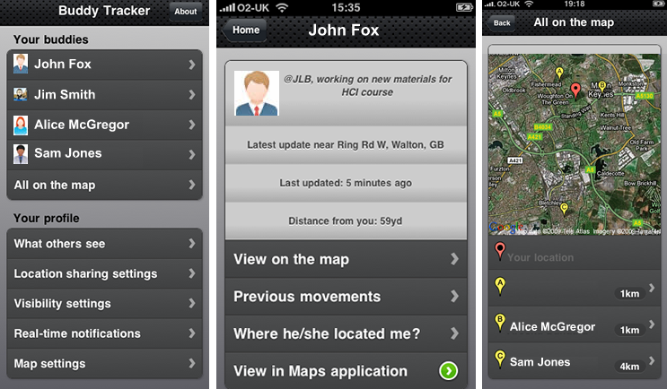
Buddy Tracker
Notes:
Buddy Tracker combined various functionalities found in location tracking applications currently available…

Slide 11
Buddy Tracker
Notes:
…it allowed participants to see the list of their buddies…

Slide 12
Buddy Tracker
Notes:
…view each one’s profile, current and previous location addresses, as well as previous tracking actions…

Slide 13
Buddy Tracker
Notes:
…and visualise their geographical position on a map.

Slide 14
Buddy Tracker
Notes:
Buddy Tracker also allowed participants to receive real-time feedback notifications whenever someone tracked them, and to set location sharing preferences to limit their own visibility.

Slide 15
Buddy Tracker
Notes:
The location information was automatically updated every ten minutes and we were able to monitor the participants’ activity via a web-based administration panel.

Slide 16
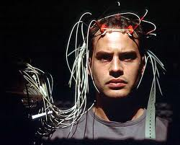
Conditions and questions
jordanhoffman.com/2007/03/08/das-experiment-2001-oliver-hirschbiegel-b
Notes:
To explore any perturbing effects of the newly introduced technology on our families’ interactions, we set up different conditions through different phases of the study.

Slide 17
Conditions and questions
complete visibility run/chase?
Notes:
For most of the duration of the study, participants were completely visible to their buddies all the time. We wanted to see if they would take advantage of others’ visibility to do a lot of tracking and, at the same time, if they would feel uncomfortable enough about their own visibility to try and find alternative ways to hide.

Slide 18
Findings
conflicting affordance
www.essex.police.uk/news_features/other_stories/victim_of_a_stalker.aspx
“I don’t think it makes me a better person checking up on people…so I try to stay out of it as I possibly can as it’s none of my business, but this technology makes it a little bit too easy, you are only human”
Notes:
We found that, although nobody indulged in extreme tracking or resorted to extreme measures in order to hide, participants felt conflicted between a sense of obligation towards respecting others’ boundaries and the temptation to cross those boundaries, which the technology made both possible to do and difficult to resist.

Slide 19
Conditions and questions
tracking tasks uneasy/keen?
Notes:
For a period of time, we gave participants tracking tasks asking them to locate particular buddies at specific times. We wanted to see if they would follow those instructions and how they would feel about it: would they be uneasy, would they be keen?

Slide 20
Findings
delegating responsibility
“It was easier to [check on others] when I was asked to do so…I didn’t feel like it was my responsibility…it wasn’t me doing it, I was just carrying out a task”
Notes:
We found that, when the request to track a buddy came from us they delegated responsibility altogether, so they could happily follow our instructions without feeling conflicted about it.

Slide 21
Conditions and questions
real-time feedback reassured/deterred?
Notes:
Half way through the study, we enabled the real-time feedback, so participants started receiving notifications every time someone tracked them. We wanted to see if this translucency would be reassuring for the tracked and deterring for the tracker.

Slide 22
Findings
questioning others’ motives
“I would prefer not to know, or I would have to start asking myself why they are checking on me…have I done something wrong…are they after something?”
Notes:
We actually found that the feedback didn’t make any significant difference in the amount of tracking that participants did. Moreover, some participants even said that they would prefer not to be notified as that would make them question others’ motives for tracking them, which they found unsettling.

Slide 23
Conditions and questions
privacy preferences hide/seek?
Notes:
Finally, during the last phase of the study, we enabled participants to use locations sharing preferences. We wanted to see if they would take advantage of the opportunity to finally make themselves less visible, and how they would react to the fact that they were no longer able to always track their buddies.

Slide 24
Findings
fearing others’ questioning
“No I didn’t use the privacy settings because if I had they could have asked me why did you hide your location, have you got something to hide?”
Notes:
We found that almost nobody made use of the location sharing preferences and that some participants were mindful of the fact that others might have questioned their motives had they chosen to make themselves unavailable for tracking.

Slide 25
Tension between drives
Notes:
Overall, these findings demonstrate a tension between…

Slide 26
Tension between drives
innate drive for self-preservation
Notes:
…an innate drive for self-preservation and self-interest…

Slide 27
Tension between drives
innate drive for self-preservation
intrinsic desire for connectedness
Notes:
…and an intrinsic desire for connectedness…

Slide 28
Dialectic between behaviours
Notes:
…which defined a dialectic between…

Slide 29
Dialectic between behaviours
afforded by technology
Notes:
…the behaviors afforded by this technology…

Slide 30
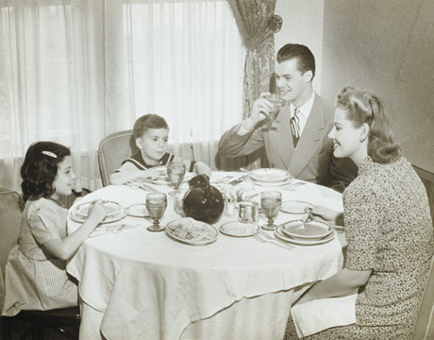
Dialectic between behaviours
afforded by technology
legitimised by family contracts
permissiontounwind.blogspot.com/2009_04_01_archive.html
Notes:
…and the behaviors that are legitimized by family contracts, with their explicit or implicit sets of expectations and acconutabilities.

Slide 31
Closeness and control
F2-Mother
F2-Son
“At times I’d rather she didn’t track me…but I wouldn’t use privacy preferences [as] I know that would hurt her feelings”
Notes:
For example, because the mother of the second family expected to be able to track their children at any time, her son did not feel at liberty to use the location sharing preferences as he feared to let her down, even though he would have preferred not to be tracked and even though the technology could have afforded him invisibility.

Slide 32
Breach and predation
“I feel because [they] have shown in the past that [they] are not trustworthy, that kind of [they] started it…it means I can check up on [them] and not feel too bad…[they] are unlikely to do what [they] say the do, so anything you see [on the tracker] is probably just going to confirm that”
Notes:
On the other hand, when one of the participants deemed another to have breached their family contract, their sense of accountability towards them disappeared altogether, in which case the technology afforded them the ability to indulge in predatory behavior that they would have otherwise considered unacceptable.

Slide 33
Ordinariness and accountability
F1-Mother
F1-Father
“If I cannot remember a place I went to and cannot explain, it’s really uncomfortable…I might have done nothing wrong but might have not done enough right. It took you long to get there. Well, I got lost. Why did you get lost? Well, it doesn’t matter!”
Notes:
But even benign tracking could be uncomfortable for participants, because of the way in which the technology exasperated their sense of accountability, as in the case of the father from the first family.

Slide 34
Unexpectedness and destabilisation
F1-Daughter2
F1-Boyfriend
“I looked him up…he was last tracked four hours ago…I thought oh did he turn his phone off…or did he turn the tracker off and why did he do that… why didn’t he tell me? Who is he with? And why is he there?”
Notes:
However, it wasn’t just those being tracked who were undermined by the effects of tracking, as demonstrated by the anxious reaction of the middle daughter of the first family when she could not locate her boyfriend.

Slide 35
Conclusions
Notes:
In conclusion…

Slide 36
Conclusions
close knit tracking is not safer
tracking affects both parties
the closer the less in control
Notes:
…tracking in close groups is not necessarily safer, tracking can equally negatively affect both tracked and tracker and the closer the relationship the less at liberty one is of using control mechanisms.

Slide 37
Conclusions
Close knit tracking is not safer
Tracking affects both parties
The closer the less in control
Notes:
Instead, there is a complicated dialectic between the ways in which technology can be used and the subtle negotiations by which close relationships are managed. It is with this in mind that designers need to build these technologies.

