Slide 1
Challenges and Tradeoffs in Activity and Sleep Monitoring
Blaine Price

Slide 2
Working Here
Personal Informatics
Persuasive Technologies

Slide 3
Some Goals
Engagement
Automation/ Convenience
Non-Invasiveness
Accuracy/ Precision
Data
Openness
Privacy Control

Slide 4
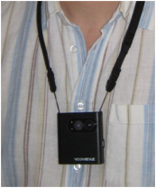
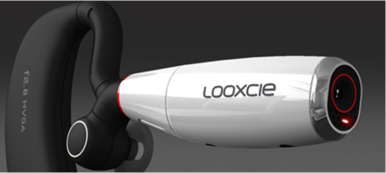
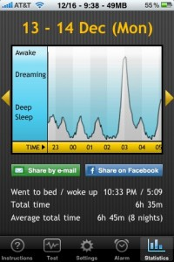
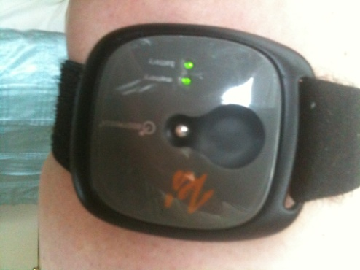
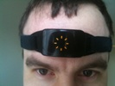
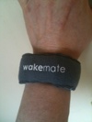
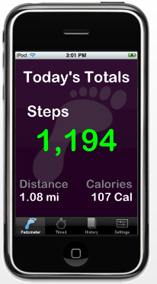
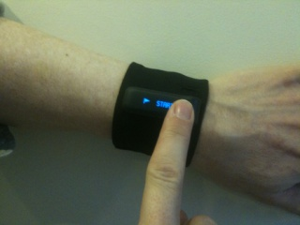
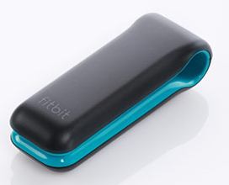
Domains
Image/Video
Biosensors
Activity
Sleep

Slide 5
Smartphone Apps
Automation/ Convenience
Accuracy/ Precision
Sleep
Non- Invasiveness
Data
Openness*
Automation/ Convenience
Accuracy/ Precision
Activity
Data
Openness
Non- Invasiveness

Slide 6
Proprietary Devices (Sleep)
Data
Openness
Automation/ Convenience
Accuracy/ Precision
Data
Openness
Non- Invasiveness
Non- Invasiveness
Accuracy/ Precision
Automation/ Convenience
Automation/ Convenience

Slide 7
Proprietary Devices (Activity)
Data
Openness
Automation/ Convenience
Accuracy/ Precision
Non- Invasiveness
Automation/ Convenience
Accuracy/ Precision
Non- Invasiveness

